Slide 1

A BRIEF SURVEY OF THE
NEW TESTAMENT

Slide 2
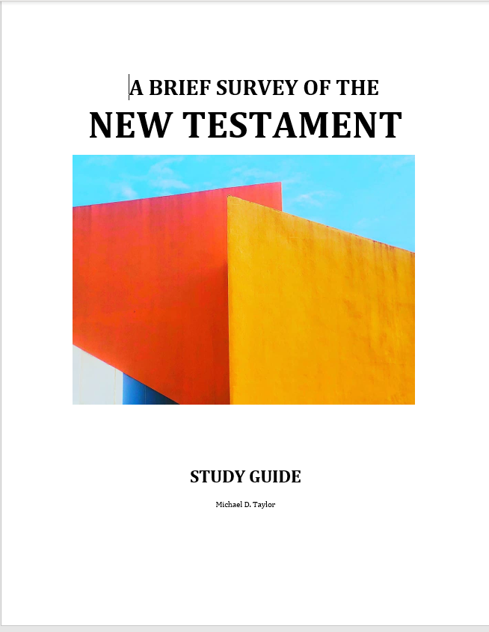


Please take out your Study Guides
Notes:
Please take out your notes.

Slide 3
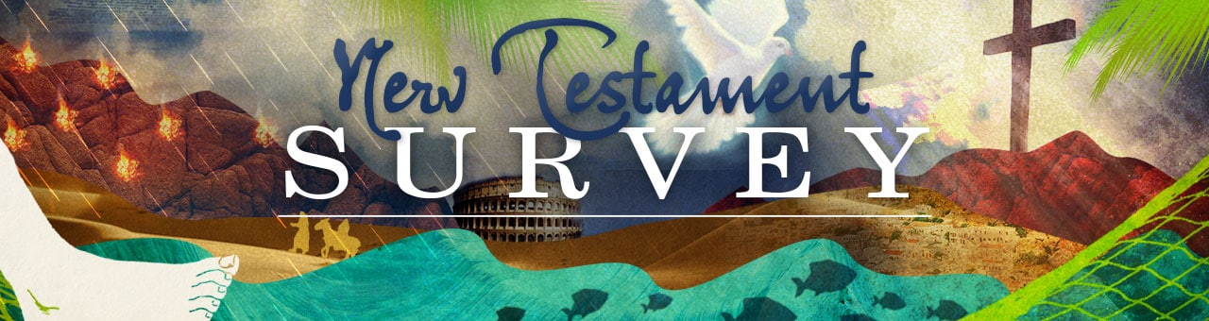
PRIME TIME
Welcome!

Slide 4
Tonight
About the ABT Program
About this class
Part 1: Introduction to the New Testament
Prayer and Praise
Close

Slide 5


Please mute your mic until you are ready to speak. Thanks
to speak, press and hold the space bar.
Notes:
Thanks for muting yourself…to speak, press and hold the space bar

Slide 6
ADVANCED BIBLE & THEOLOGY PROGRAM
Notes:
ADVANCED BIBLE & THEOLOGY PROGRAM

Slide 7
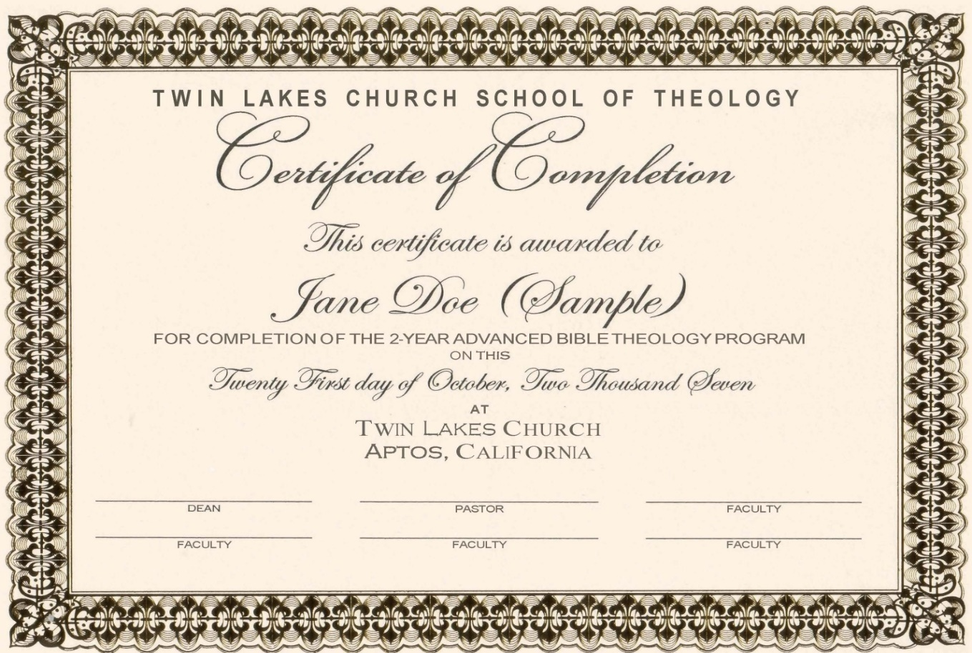
ABT CERTIFICATE
Notes:
ABT CERTIFICATE
Attend 75% of each course
Don’t need to do any written assignments
Term paper: optional (See website)

Slide 8

ABT COURSES
MONITOR ONLY
EARN CERTIFICATE
OR
Notes:
MONITOR or CERTIFICATE
Register (once, not each class)

Slide 9
ABT COURSES
No. | Course | Duration
Class 601 | Old Testament Survey | 8 Classes
Class 602 | New Testament Survey | 8 Classes
Class 603 | Hermeneutics | 4 Classes
Class 604 | Christianity I | 8 Classes
Class 605 | Christianity II | 8 Classes
Class 606 | Roots: Church History | 4 Classes
For more about the ABT Courses, refer to the Appendix in the New Testament Survey booklet, or go to www.TaylorNotes.Info.
Certificate: Attend 75% of each class
Notes:
Monitor or go for the certificate.
75% of each class.
Why a certificate?
Personal enrichment
Lead a small group Bible study
Better defend your Christian beliefs
It equips you to teach Christian beliefs to your children
Recognize false teachings
Sense of accomplishment

Slide 10
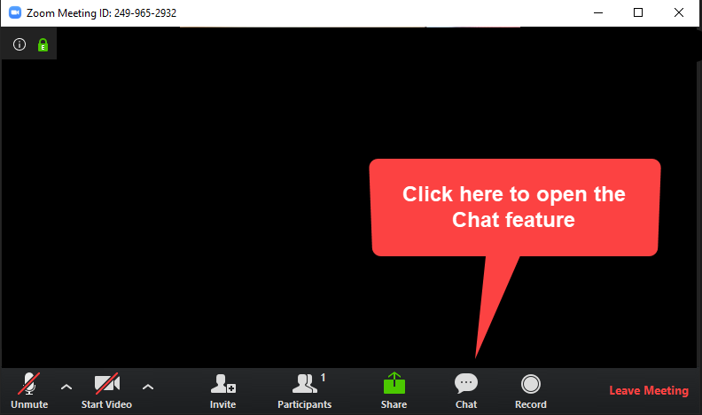
Please sign in each week
CHAT BOX
George Thompson
Betty White
Warren Willsby
Ed Asner
Sue Thompson
Don Schultz
Please type in your name each week
Notes:
Please type in your name each week (credit toward certificate)
Handouts (me)

Slide 11
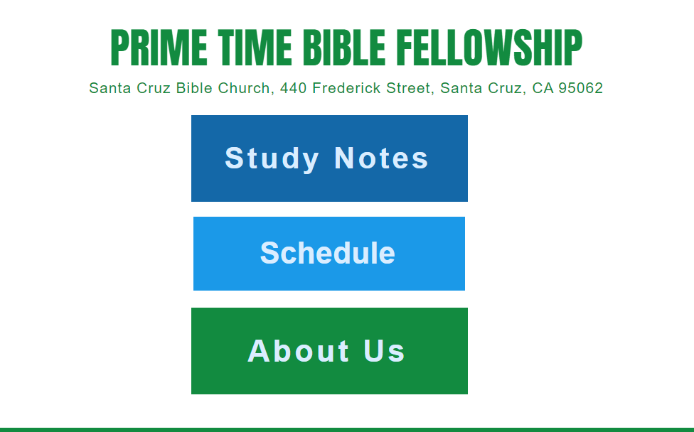
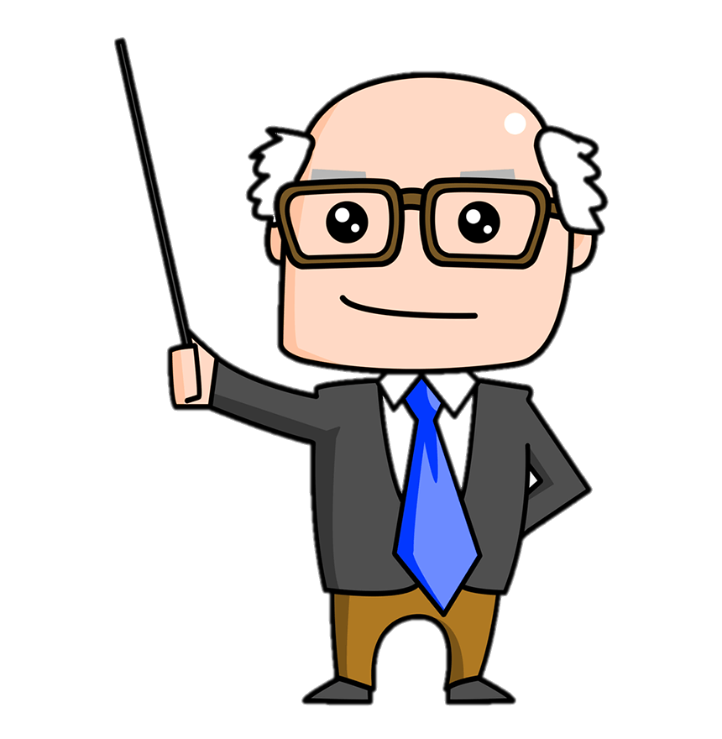
Taylornotes.info/prime
Notes:
My website
Notes
Schedule

Slide 12

INTRODUCE YOURSELF
“What do you like to do in your free time?”
5 Minutes
Notes:
INTRODUCE YOURSELF
“What do you like to do in your free time?”
5 Minutes

Slide 13
PART 1
INTRODUCTION TO THE NEW TESTAMENT

Slide 14
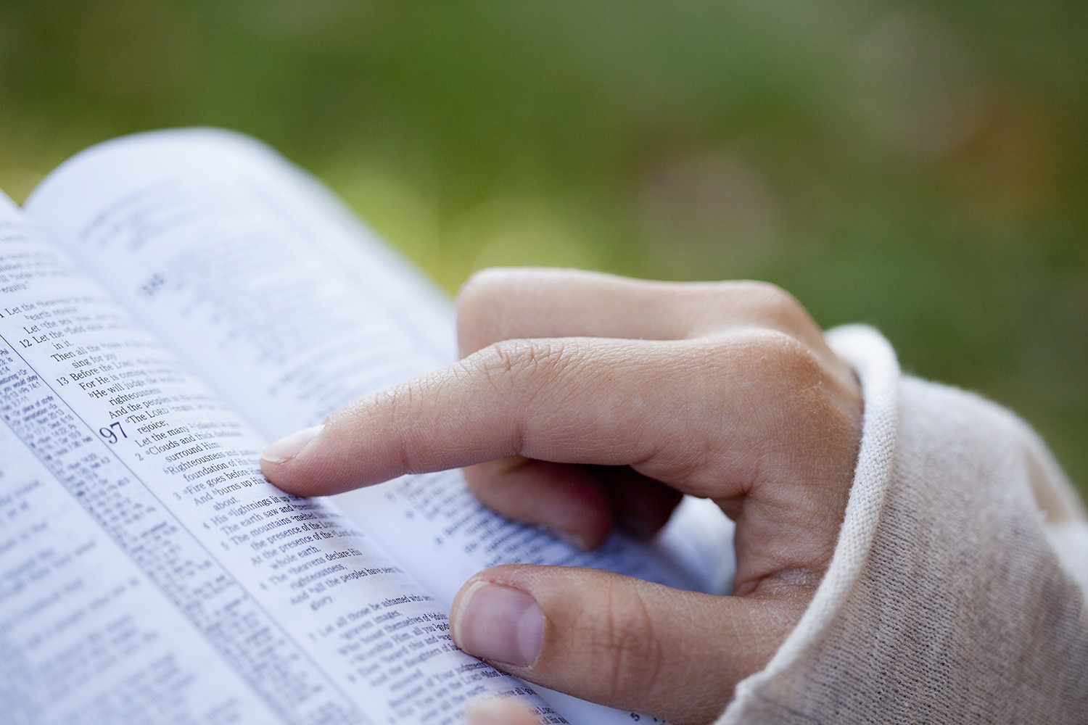
THIS STUDY WILL HELP YOU TO…
Quickly grasp the message of each NT book
See the “big picture” of the entire NT
Discover ways to apply the Bible to your life
Appreciate early Christianity
Understand where God is taking you
Share the good news of the gospel more clearly
Notes:
THIS STUDY WILL HELP YOU TO…
Quickly grasp the message of each NT book
See the “big picture” of the entire NT
Discover ways to apply the Bible to your life
Appreciate early Christianity
Understand where God is taking you
Share the good news of the gospel more clearly

Slide 15

This class will help you to…
…see the big picture (Macro)
Notes:
This course will help you to…
Grasp the message of each NT book more quickly
See the “big picture” of the entire NT
Apply the Bible to your life
Appreciate early Christianity
See where God is taking you
Share the good news of the gospel more clearly

Slide 16


Who wrote most of the New Testament?
Peter
Paul
Luke
John
LUKE
27%
(Luke-Acts)
Notes:
John 18%
Paul 26%
Luke 27% (Luke/Acts)
All others combined = 29%
Average Time to read a NT Book = Less 20 minutes (1 cappuccino)

Slide 17
New Testament
The New Testament has a total of 260 chapters
The New Testament has 7,957 verses
The longest book in the New Testament is the Book of Acts
The shortest book in the New Testament is 3 John
Notes:
NEW TESTAMENT
The New Testament has a total of 260 chapters
The New Testament has 7,957 verses
The longest book in the New Testament is the Book of Acts
The shortest book in the New Testament is 3 John

Slide 18
New Testament
The longest chapter in the New Testament is Luke 1
The shortest verse in the Bible is in the New Testament, which is John 11:35
The word ‘grace’ appears 128 times in the New Testament
There are only eight writers for the New Testament books
Jesus fulfilled over 300 prophecies of the Old Testament in the New Testament
Notes:
NEW TESTAMENT
The longest chapter in the New Testament is Luke 1
The shortest verse in the Bible is in the New Testament, which is John 11:35.
The word ‘grace’ appears 128 times in the New Testament
There are only eight writers for the New Testament books
Jesus fulfilled over 300 prophecies of the Old Testament in the New Testament

Slide 19
How to learn the New Testament
MACRO
Micro
Micro
Micro
Notes:
Macro before micro!
Big picture
Like 30,000 ft in airplane
Then…micro
Chapters, verses…better understanding
Better understanding of Bible

Slide 20
Please take out your Study Guides
Notes:
Please take out your study guides.

Slide 21
Four main parts of the Bible

Slide 22
Four Major Parts of the Bible
Preparation | Old Testament | Makes ready for the coming of the Messiah
Manifestation | Gospels | The Messiah enters the world, dies for the world, and establishes his church
Appropriation | Acts, Epistles | Reveals the ways in which the Messiah was received, appropriated, and applied in individual lives
Consummation | Revelation | God’s perfect plan completed and the eternal reign of the Messiah
1
2
3
4
“Messiah” means anointed one, King
Notes:
Four Major Parts of the Bible
[CLICK]
1. PREPARATION →Old Testament: Makes ready for the coming of the Messiah.
2. MANIFESTATION → Gospels: The Messiah enters the world, dies for the world, and establishes his church
3. APPROPRIATION → Acts, Epistles: Reveals the ways in which the Messiah was received, appropriated, and applied in individual lives
4. CONSUMATION: Revelation → God’s perfect plan completed and the eternal reign of the Messiah

Slide 23


The word “Testament” means covenant or contract
Notes:
Latin (testamentum) meaning Covenant or Contract
Covenant →a binding agreement or contract between man and man, or between man and God.
Two types
Conditional (depends on two parties to fulfill their parts)
Unconditional (depends on only one party to fulfill its part)
FIVE MAJOR COVENANTS OF THE BIBLE
Noahic Covenant (unconditional)
Abrahamic Covenant (unconditional)
Mosaic Covenant (conditional)
Davidic Covenant (unconditional)
New Covenant (unconditional, once a person enters into it).
New Covenant canceled out the “Old Covenant” (Mosaic)
Read Matt. 5:17 "Do not think that I have come to abolish the Law or the Prophets; I have not come to abolish them but to fulfill them." (Matt. 5:17 NIV)
Read Heb. 8:13 " By calling this covenant "new," he has made the first one obsolete; and what is obsolete and outdated will soon disappear. " (Heb. 8:13-9:1 NIV)
Only what is carried out from OT into NT is valid

Slide 24
The Old Testament was primarily between
God and Israel
Notes:
The Old Testament was primarily between God and Israel
The Old Testament or Old Covenant is primarily a record of God’s dealings with the Israelites on the basis of the Mosaic Covenant given at Mount Sinai.
The Mosaic Covenant became obsolete when the New Covenant began (Heb. 8:13).
Only those portions of the Old Covenant that have been carried into the New Covenant are valid today.

Slide 25

The New Testament is between
God and all people
Notes:
The New Testament is between God and all people
Jeremiah 31:31 Lord said he will make a new covenant with Israel
"The days are coming," declares the LORD, "when I will make a new covenant with the people of Israel and with the people of Judah. It will not be like the covenant I made with their ancestors when I took them by the hand to lead them out of Egypt, because they broke my covenant, though I was a husband to them, " declares the LORD. "This is the covenant I will make with the people of Israel after that time," declares the LORD. "I will put my law in their minds and write it on their hearts. I will be their God, and they will be my people.
BUT When Jesus was rejected as the Messiah by the leaders of Israel, the gospel was opened to all who people who would accept Christ as Messiah.

Slide 26
Which books belong in the Bible?
Notes:
Which books belong in the Bible?
Many writings claiming to be inspired by God.
Must create a standard.

Slide 27
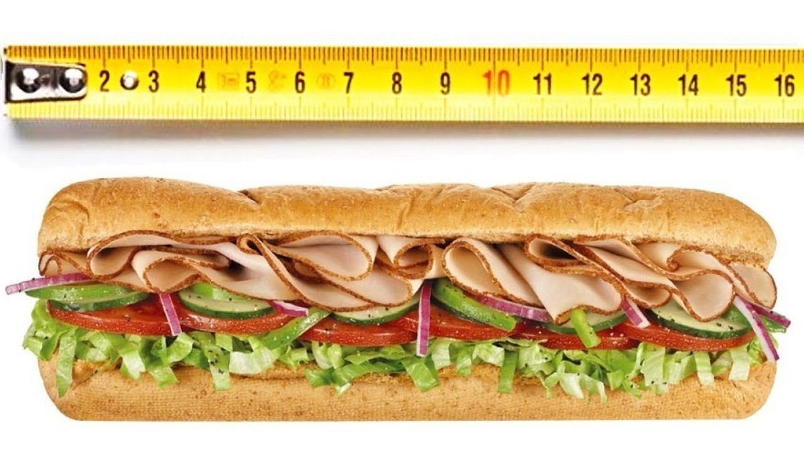
“16-INCH SANDWICH”
Notes:
“16-inch sandwich”
How do you know?
You need a standard (ruler)

Slide 28
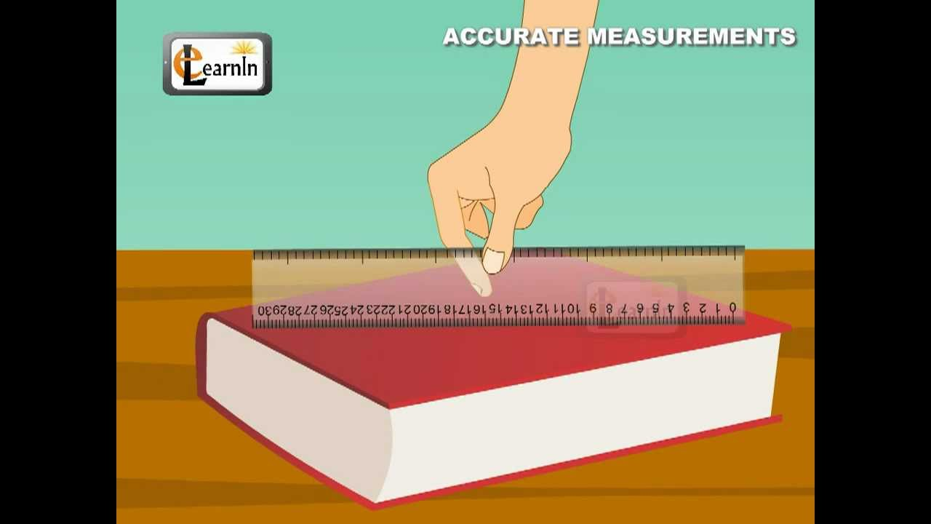
Notes:
So how did the early church know which books were inspired by God?
(A standard is needed…not a physical ruler)
This standard is known as the CANON
Canon→ Greek kanōn (reed, or a rod or bar)
NOTE:
Papyrus rolls→ papyrus codex (book like)→Vellum (calf skins) codex (book like)
Printing Press: German goldsmith Johannes Gutenberg is credited with inventing the printing press around 1436.
Books were first written on papyrus rolls.
Papyrus is a plant (Cyperus papyrus), rather like a reed, which used to grow in Egypt .
Sheets of papyrus were often stuck together to form long rolls (scrolls) for lengthy documents like Books
Later, Papyrus Codex (stacks of sheets making books) replaced rolls.
In about the 4th century, vellum replaced papyrus as a writing material.
From then on, handmade copies of the New Testament took the form of vellum codex.

Slide 29
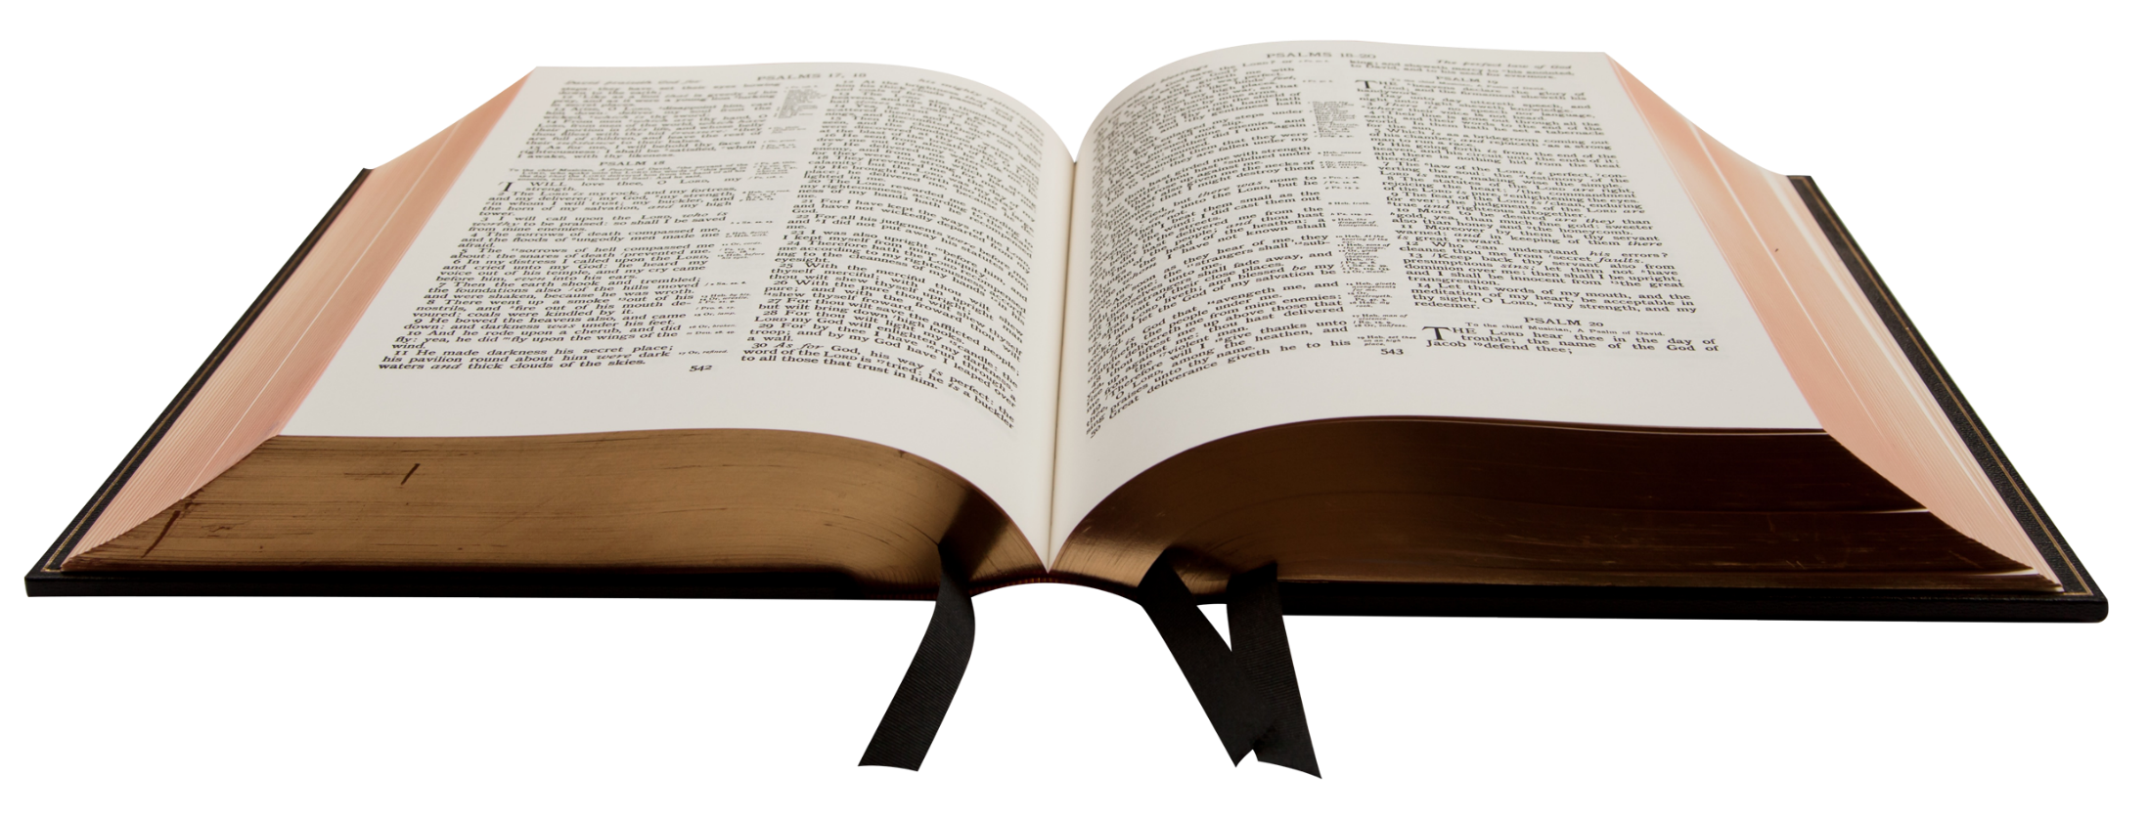
The only books that belong in the Bible are those that met the CANON of the early church.
Notes:
The only books that belong in the Bible (NT) are those that met the CANON of the early church.
The OT was already accepted by early church

Slide 30
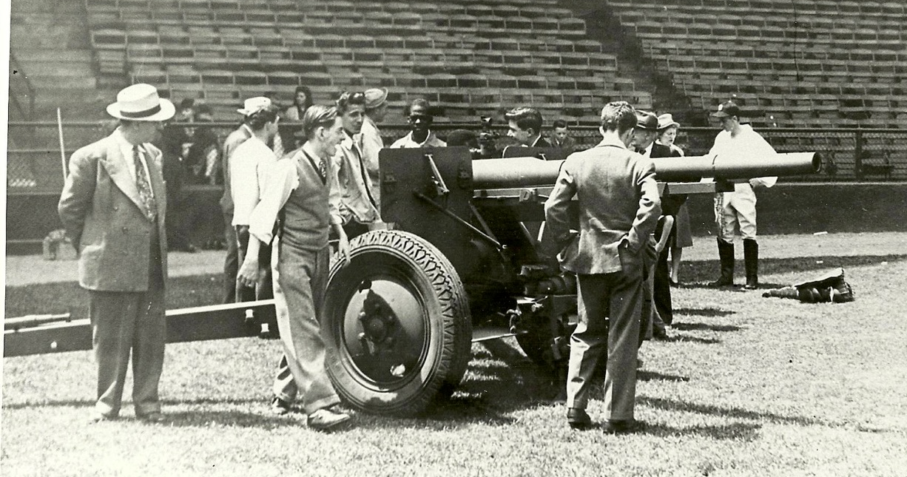
Notes:
NOT THIS KIND OF CANNON
75 mm Howitzer Field Cannon
Philadelphia 1945 (Dad 30 years old)
Pseudonym: Ian Brokaw…didn’t want to alarm my Mom
Shibe Park (aka Connie Mack Stadium)
30,000 spectators
Sold $5 Million in savings bonds for WW2 support
Possibly Guinness book of records…fastest baseball ever caught?

Slide 31
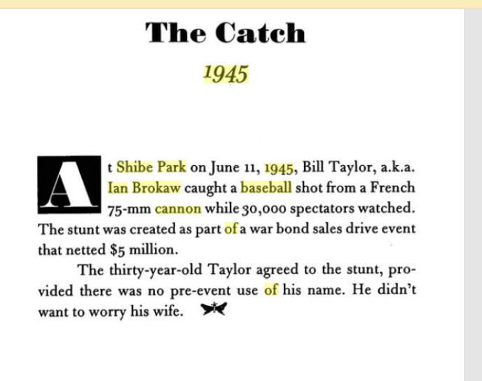
Strange Philadelphia: Stories from the City of Brotherly Love - Lou Harry - Google Books

Slide 32
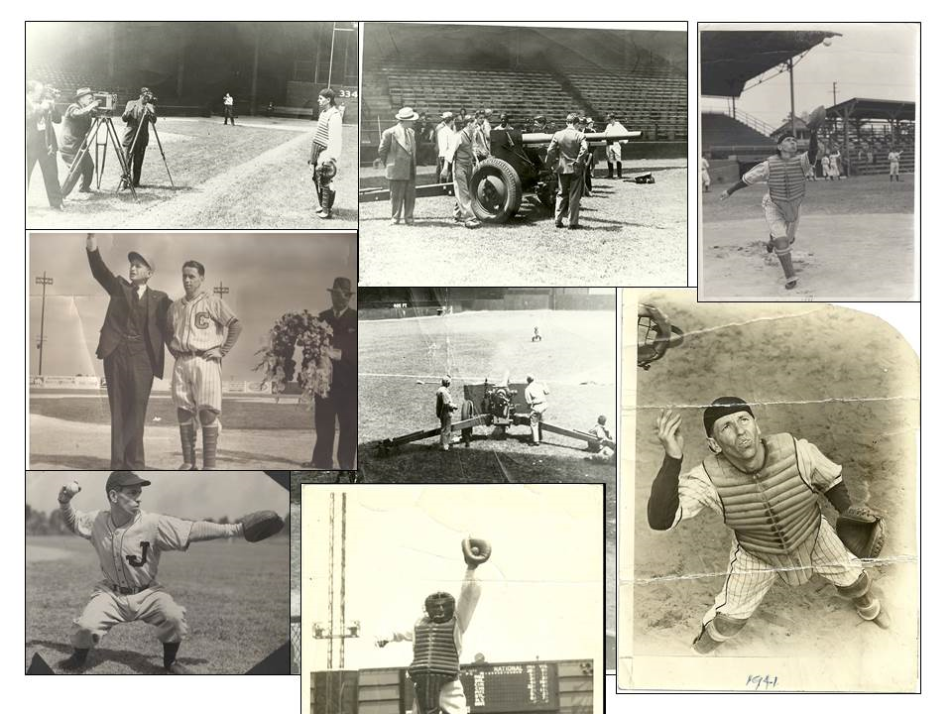

Slide 33
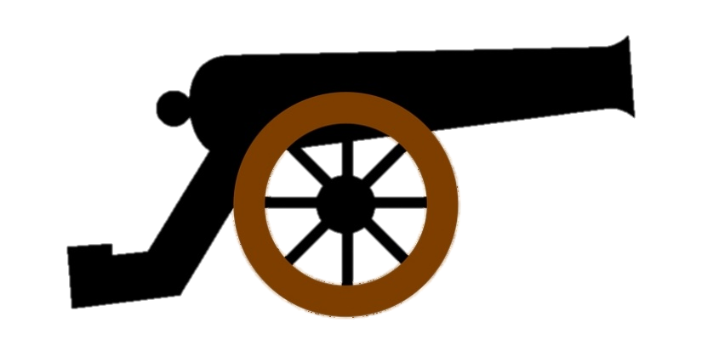
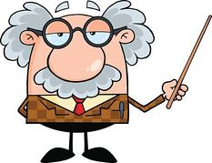
CANON
Divine inspiration?
Authorship?
Consistency?
Testimony?
Fulfillment?
Not this!
Notes:
“Canon” means “standard”
Canon = acceptance criteria and the list of books.
Next slide →

Slide 34
CANON
Divine inspiration?
Authorship?
Consistency?
Testimony?
Fulfillment?
Not this!
Notes:
THE CANON OF SCRIPTURE
The test of divine inspiration
Did the book claim to be divinely inspired?
The test of authorship.
Was the book written, edited, or endorsed by an accredited agent of God, such as a prophet, the Lord Jesus Christ, or one of his apostles?
If not, did the writer have the gift of prophecy (David, Daniel) or a relation to a prophet or an apostle (Mark, Luke) that would raise his book to the level of their writings?
The test of consistency
Was there soundness and consistency with other canonized writings?
Did the book agree doctrinally with the teachings of known canonical books?
While there is progression in the Bible's revelation of doctrine, there could be no contradiction.
The test of testimony
Was the book universally recognized by the Jews and/or by the early Christian church as being God's Word?
Does the Holy Spirit bear witness to the regenerated reader that the book is His Word?
The test of fulfillment
Is there any evidence in history, or in the known canonical books, of the fulfillment to this book's promises or predictions?

Slide 35

IMPORTANT POINT
The canon detected the inspired books of the NT-it did not make them inspired!
Notes:
The canon detected the inspired books of the NT-it did not make them inspired
A Geiger counter detects radioactive material, it does not make the material radioactive.
Likewise, the canon detected inspired writings, it did not make the writings inspired.

Slide 36
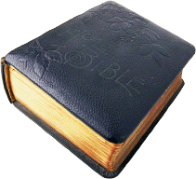
This…
Not this…
CHURCH
CHURCH
Notes:
Q: Why is this important?
If the Church has authority over the Bible then it is free to authorize new beliefs and doctrines.
Any so called religious book, if not one of the 27, is not inspired
Includes:
Qur’an
Book of Mormon
Key to Health and Scriptures
Apocryphal books
So called Gnostic Gospels
Etc.

Slide 37
Incorrect View | Correct View
Church Determines Canon Church is Mother of Canon Church is Magistrate of Canon Church Regulates Canon Church is Judge of Canon Church is Master of Canon | Church Discovers Canon Church is Child of Canon Church is Minister of Canon Church Recognizes Canon Church is Witness of Canon Church is Servant of Canon

Slide 38
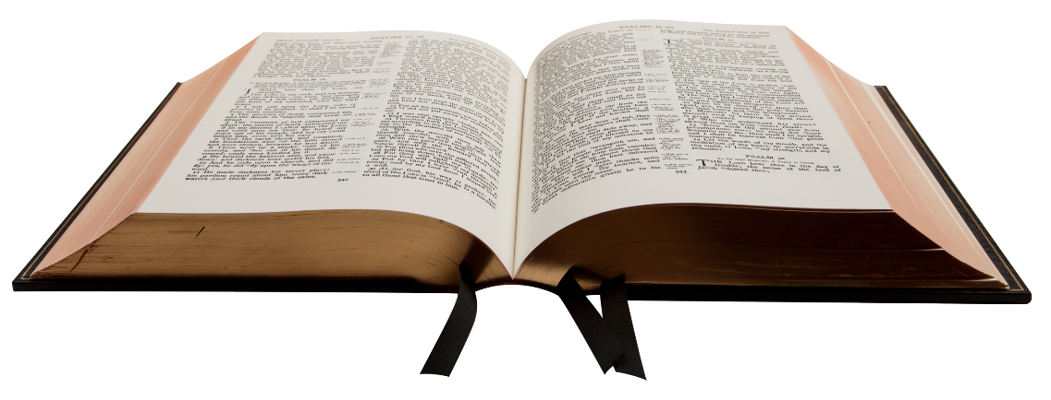

The Canon of the Bible is now
Notes:
The canon of the Bible is now CLOSED
There are no apostles or prophets today who are receiving new messages from God.
No other books or writings outside the canon are considered inspired by God.
Acknowledging a closed canon means accepting the idea that God has already revealed everything His children need to know.
It also means that everything He has revealed in the Scriptures is divinely inspired.
Nothing should be added, and nothing ought to be taken away or ignored (Prov. 30:5-6; Deut. 4:2; Rev. 22:18-19).
No new revelations of truth outside of what He has already revealed in the Bible to the church.
Scripture everything we need to know about Himself, and about who we are, how we ought to live, and what will happen in the future (see 2 Peter 1:3).

Slide 39

Only 27 NT books passed the canon test
Notes:
Only 27 books passed the canon test
Athanasius: AD 367 Pascal letter (Easter date) first to listhe 27 canonized books of the NT
(A Paschal Letter was one written in the early Christian church period by a patriarch, archbishop, or bishop to a clerical under his authority, announcing the date of the next Easter festival)
Same list ratified at Council in Carthage in A.D. 397.

Slide 40
 | Written by an agent of God/inspired | Consistent with other canon books | Accepted by early church | Fulfilled prophecies
BIBLE (66 Books) | YES | YES | YES | YES
Apocrypha | No | No | No | No
Pseudepigrapha | No | No | No | No
Gnostic gospels | No | No | No | No
Book of Mormon | No | No | No | No
Qur’an | No | No | No | No
All other books | No | No | No | No
Notes:
Apocrypha.
Meaning “hidden, spurious, not authentic”
15 books of Jewish literature written mostly during the intertestamental period.
Some are legendary and fantasy.
No major canon or church council included them as inspired books of the Bible.
Some of them have historic value, but all are spurious, of unknown authorship, and without claim of inspiration or authority.
Roman Catholic Bible:
Called “Deuterocanonical” books.
Jerome (Latin Vulgate) never considered them as inspired canonical books
Added at Council of Trent 1543
Pseudepigrapha.
52 texts written between 200 BC and AD 200
Falsely ascribed to various prophets and kings in the Hebrew Scriptures
Called “Apocrypha” by the Roman Catholic Church
They were not accepted as Scripture by the early church.
Jerome rejected them also
Gnostic Gospels.
The 16 Gnostic Gospels (so called “Secret Gospels”) written around the 2nd to 4th centuries, did not meet the canon criteria.
The Gospel of Thomas (second century CE)
The Gospel of Truth (second century CE)
The Gospel of Judas (second century CE)
The Gospel of Peter (second century CE)
The Gospel of Mary (second century CE)
The Gospel of Philip (second–third centuries CE)

Slide 41
NEW
TESTAMENT
Gospels (4)
Acts (1)
Paul’s Epistles (13)
General Epistles (8)
Apocalyptic (1)
Journey Epistles (6)
Prison Epistles (4)
Pastoral Epistles (3)
Notes:
27 NT books that met the canon.
→ next

Slide 42
No. | Genre | NT Books
1 | Gospels | Mathew--John
2 | Historical Narrative of the Early Church | Acts
3 | Pauline Epistles | Romans--Philemon
4 | General Epistles | Hebrews--Jude
5 | Apocalyptic | Revelation
Notes:
Books are arranged by TYPE OF GENRE (5)
Matthew-John: Gospels (the life and message of Jesus Christ)
Acts: Historical narrative (development of first churches)
Paul Epistles: instructions/guidance to specific churches or individuals
General Epistles: messages to churches scattered throughout Mediterranean
Apocalyptic: Revelation (future)
WHY KNOW THE GENRE OF A BOOK?
More accurately interpret it and discover the author’s intended message (AIM).
For instance,
Gospels: interpret as being biographic
Acts: historical
Epistles may be interpreted more literally
Apocalyptic literature may be interpreted more figuratively

Slide 43
The original language of the New Testament was koine Greek
Example
Ἐν ἀρχῇ ἦν ὁ λόγος, καὶ ὁ λόγος ἦν πρὸς τὸν θεόν, καὶ θεὸς ἦν ὁ λόγος.
Notes:
The original language of the New Testament was koine Greek
“Koine” means “common”
The common everyday form of language used by everyday people.
Efficient:
Present tense: ongoing (Matt.7:7) A-S-K
30% of English words are of Greek origin:
Democracy: from demos (δήμος, "people") and kratos (κράτος, "power").
Marathon: from the Greek city of Marathon.
Butter: from boútȳron ( βούτυρον, butter).
Telephone: from telos and foní (τῆλε and φωνή “far” and “voice)
Septuagint: Greek version of OT
72 translators—six from each tribe of Israel
About 250 BC

Slide 44
The New Testament books were written between
AD 49 to early AD 90s
4 BC
AD 20
AD 40
AD 60
AD 80
AD 100
Jesus Christ
NT Books
Notes:
The NT books…written between AD 49 to early AD 90s
Earliest book is most likely Galatians (ca. A.D. 49),
Lates books were probably the
Gospel of John,
1/2/3 John,
Revelation (ca. A.D. early 90s).

Slide 45


Next Week…
Matthew, Mark, Luke, John
Why are they called “Gospels”?
Notes:
Next week…Matthew, Mark, Luke and John
Why are they called Gospels?

Slide 46


