Slide 1
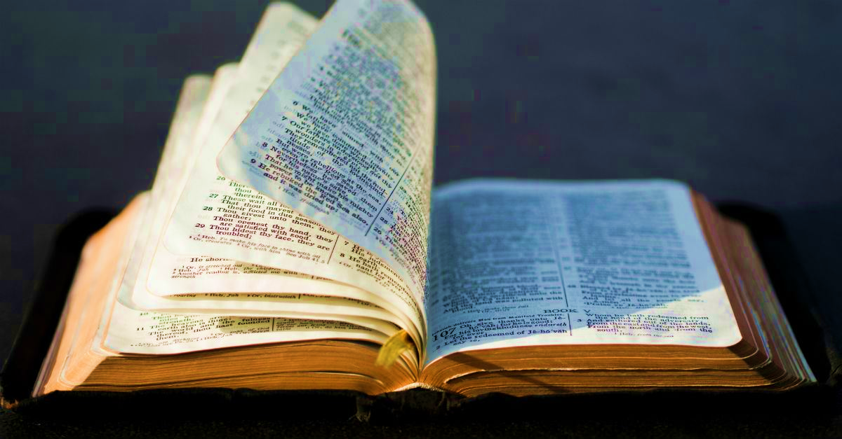
NEW TESTAMENT SURVEY
PART 3
Acts, Romans, 1-2 Corinthians

Slide 2


Please mute your mic until you are ready to speak. Thanks
to speak, press and hold the space bar.
Notes:
Thanks for muting yourself…to speak, press and hold the space bar

Slide 3

Please sign in each week
George Thompson
Betty White
Warren Willsby
Ed Asner
Sue Thompson
Don Schultz
Please type in your name each week
CHAT BOX
Notes:
Please type in your name each week (credit toward certificate)
Handouts (me)

Slide 4

INTRODUCE YOURSELF
“What’s your favorite restaurant?”
5 Minutes
Notes:
INTRODUCE YOURSELF
“What’s your favorite restaurant?”
5 Minutes

Slide 5

Please take out your notes
Notes:
Please take out your notes.

Slide 6
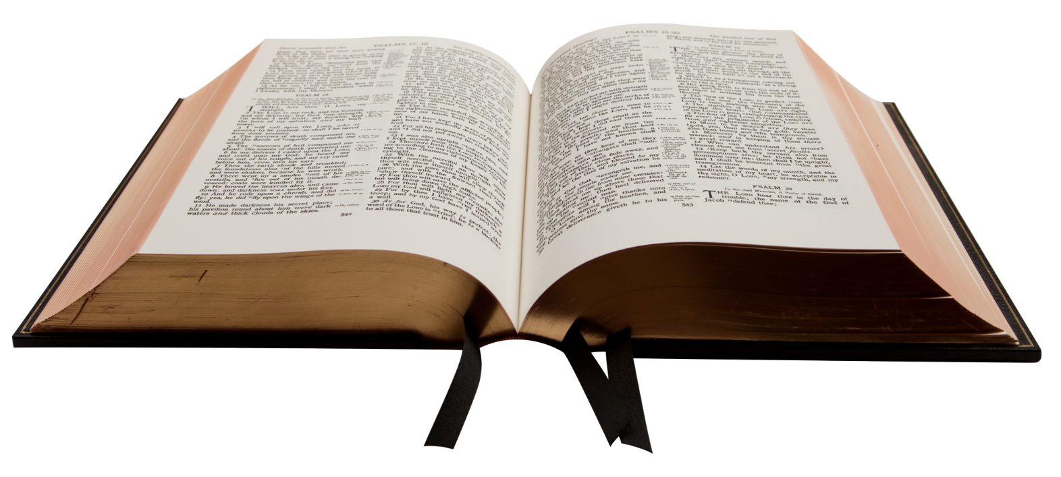
Part 3: Acts of the Early Church
Notes:
PART 3: ACTS OF THE EARLY CHURCH
If you had a chance to read it this week what stood out most to you?

Slide 7
INTRODUCTION
TO THE acts of the early church
Notes:
INTRODUCTION TO THE ACTS OF THE EARLY CHURCH

Slide 8
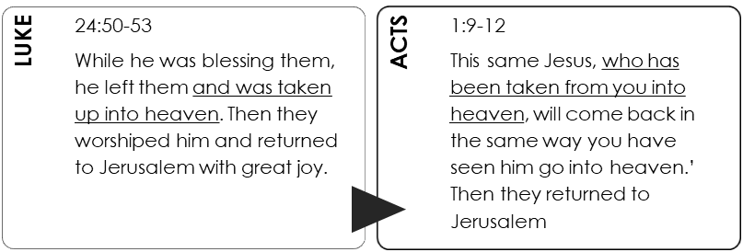
The Luke-Acts Connection
Notes:
THE LUKE-ACTS CONNECTION
The book of Acts was probably written sometime following the writing of the book of Luke.
Acts is in a sense “Luke Part 2.”
Notice the continuity between the close of Luke and the beginning of Acts.
Much of Acts focuses on the beginning of the church at Pentecost and its two leading individuals are Peter and Paul.

Slide 9
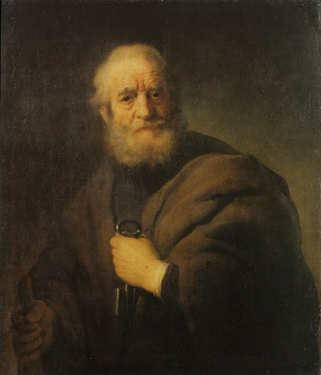
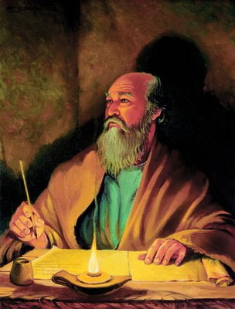
ACTS: TWO MAIN PEOPLE
PETER
PAUL
Notes:
TWO MAIN PEOPLE
Peter
Paul
Both played a very significant role in the NT

Slide 10
Who was the Apostle Peter?
Notes:
TITLE: WHO WAS THE APOSTLE PETER?

Slide 11
APOSTLE PETER
Fisherman
Born in Bethsaida
Married
Very outspoken
Part of Jesus’ inner circle
Denied Jesus (3X)
Strong accent
Leader of the early church
Notes:
APOSTLE PETER
Fisherman
Born in Bethsaida (North of Sea of Galilee)
Married
Very outspoken
Part of Jesus’ inner circle
Denied Jesus (3X)
Strong accent
Leader of the early church

Slide 12
APOSTLE PAUL
Trained pharisee
Well educated
Initially a Christian hater
Confronted by risen Jesus
Became a successful missionary
Suffered greatly as a Christian
Notes:
APOSTLE PAUL
Trained pharisee (likely on Sanhedrin)
Well educated (~ Ph.D.; Gamaliel, leading authority on Sanhedrin)
Initially a Christian hater
Stoning of Stephen
Persecutor of Christians (Damascus)
Confronted by risen Jesus
Started many churches in Turkey, Greece, Macedonia, and Rome
But suffered greatly as a Christian
Imprisoned unjustly
Beaten with rods 3x
Pelted with stones, left for dead
Shipwrecked 3x
Went without sleep, food & clothes
And more (2 Cor. 11)

Slide 13
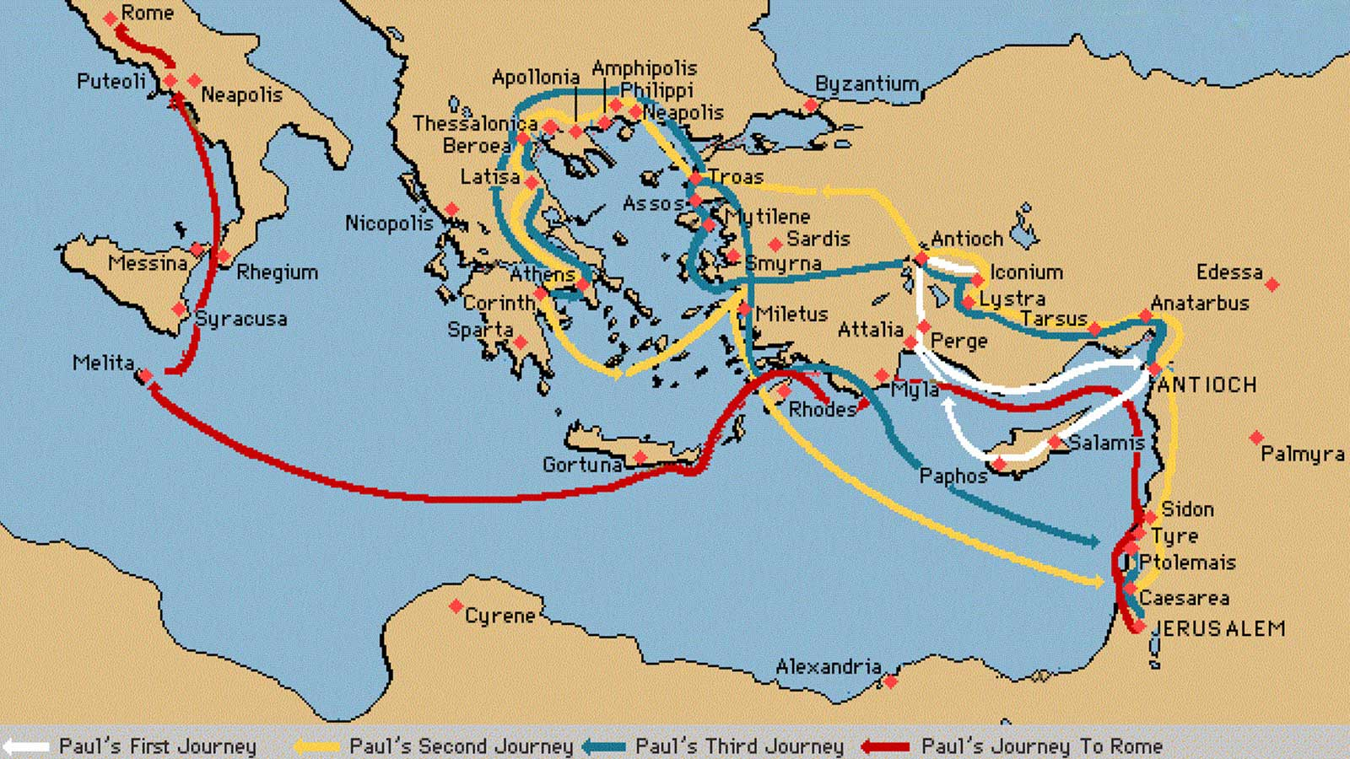
Notes:
Paul’s 1st Missionary Journey
From home town Antioch: Established churches at Pisidian Antioch, Iconium, Lystra, and Derbe (Modern day Turkey)
Paul’s 2nd Missionary Journey
After the Apostolic Council of Jerusalem
Revisited the churches on his 1st journey
Preached the Gospel in Philippi, Thessalonica, Berea, Athens, and Corinth.
Afterward he returned to Antioch by way of Ephesus and Jerusalem.
Paul’s 3rd Journey
He visited nearly the same regions as on the second trip,
Stayed in Ephesus 3 years…
Intended to leave Jerusalem for Rome and Spain, but due to strong opposition by the Jews, was hindered. Arrested.
After two years of imprisonment at Caesarea he finally reached Rome, where he was kept for another two years as a prisoner of Rome.
Probably released for a while, later imprisoned in Rome again…executed by Nero

Slide 14
ACTS
Notes:
BOOK OF ACTS

Slide 15
MAIN POINT
Acts records a selective history of the early church following the resurrection of Jesus Christ.
Page 43

Slide 16
Ends of the Earth
Samaria
Judea
Jerusalem
“…and you will be my witnesses in Jerusalem, and in all Judea and Samaria, and to the ends of the earth.”
Acts 1:8
Notes:
ACTS 1:8 “…and you will be my witnesses in Jerusalem, and in all Judea and Samaria, and to the ends of the earth.”
Key verse in Acts
This progression of the gospel is exactly what ACTS describes

Slide 17
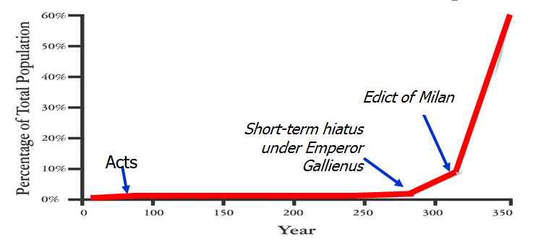
By AD 350 Christians made up over 60% of the Roman Empire population
Notes:
BY AD 350 Christians made up over 60% of the Roman Empire
Emperor Gallienus (AD 213-268 260)
AD 260 Extended tolerance to Christians
Emperor Diocletian (~284-311)
Most severe persecutor
Murdered 1000s of Christians…the worse persecutor ever
Tried to burn all Bibles
But many people had became disgusted with martyrdom
Emperor Constantine (~312-337).
Edict of Milan (AD 313) granted religious freedom to all
Theodosius I (347-395)
AD 375 proclaimed Christianity as the state religion

Slide 18
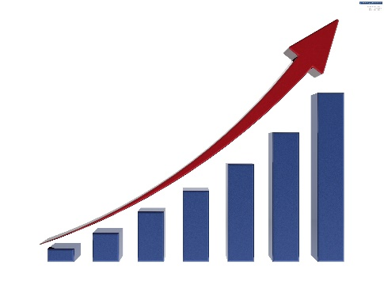
“…and to the ends of the earth”
Christianity today comprises one-third of the world population
Notes:
Acts 1:8 “…and to the ends of the earth”
Christianity Today
Iran: More Muslims have come to Christ since 1980 than in the previous 1,000 years.
Korea: IN 1900 no Protestant churches, today it is 30% Christian with 7,000 churches in Seoul and 1,000 missionaries each year.
Mexico: 800,000 Christians in 1960, today 7,000,000.
Nepal: 25 believers in 1961, today 400,000.
Philippines: 3,000 churches in 1975, today 50,000.
Sudan: 5% Christian in 1960, today 70%.
Vietnam: 130,000 Christians in 1975, today 1,000,000.
Christianity today comprises one-third of the world population—estimated 2.2 billion Christians. The growth of Christianity is faster than growth of world population.
Sources: Charles Stanley, Investing in Eternity and World Christian Encyclopedia

Slide 19
Part 4: PAUL’S EPISTLES
Notes:
PART 4: PAUL’S EPISTLES

Slide 20
Aspect | Typical Greek Letters | Biblical Epistles
Opening | ✓ | ✓
Thanksgiving |  | ✓
Body | ✓ | ✓
Exhortation |  | ✓
Closing | ✓ | ✓
Notes:
Epistles are like informal Greek letters but usually have a more formal structure as shown here.

Slide 21
Paul’s Epistles
Prison
Epistles
Pastoral
Epistles
Journey
Epistles
Galatians
1, 2 Thessalonians
1, 2 Corinthians
Philemon
Romans
Colossians
Ephesians
Philippians
1, 2 Timothy
Titus
Notes:
Paul’s Epistles
Journey Epistles
Prison Epistles
Pastoral Epistles

Slide 22
ROMANS
Notes:
ROMANS

Slide 23

Rome was like New York City
Notes:
Rome was like NYC
NYC
Is densely populated
Over one million people
Iconic city of America (besides Fresno)
People flowing in/out constantly
Rome
About 6 ½ square miles (2 ½ x 2 ½ miles)…not big.
But strategic center of the civilized world
And capital of Roman Empire

Slide 24

MAIN POINT
To present basic doctrine of Christianity to a church that had not received the teaching of an apostle before.
Page 51
Notes:
MAIN POINT
To present basic doctrine of Christianity to a church that had not received the teaching of an apostle before.

Slide 25
Romans Outline
Sin (1:18-3:20)
Sovereignty (9:1--11:36)
Service (12:1-15:13)
Sanctification (6:1-- 8:31)
Salvation (3:21--5:21)
Notes:
SIN (1:18-3:20)
Disobedience to God
Man is doomed
SALVATION (3:21-5:21)
Rom. 3:21-24. “But now a righteousness from God, apart from law, has been made known, to which the Law and the Prophets testify. ²² This righteousness from God comes through faith in Jesus Christ to all who believe.
SANCTIFICATION (6:1-8:31))
More free from sin itself, and more like Christ
The work of God in the believer’s life → Rom. 8:29.
SOVEREIGNTY(9:1-11:36)
God’s supreme right and authority over the nation of Israel
God’s sovereignty over the believer
SERVICE (12:1-15:13)
Building up one another (spiritual gifts)
Loving one another
Caring for one another

Slide 26

Brief description of the book
Do Christians need to become Jews first?
The Law did not produce righteousness
Jews and Gentiles are one people of God
Notes:
BRIEF DESCRIPTION OF ROMANS
Do Christians need to become Jews first?
Circumcised?
Jewish Sabbath?
Jewish food laws?
The Law did not produce righteousness
Jews and Gentiles are now one people of God

Slide 27

Are we saved by faith?
Notes:
Are we saved by faith? Yes, No?
Next slide →

Slide 28
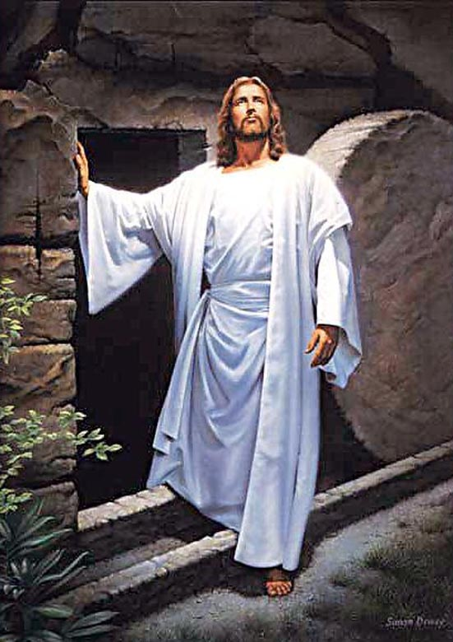
It is the object of our faith that counts
Notes:
It is the object of our faith that counts!
I can have complete faith in a chair made of paper – but it will collapse nonetheless
I can have faith in false religions but they will all collapse nonetheless
The object of our faith is Jesus Christ!
" This righteousness is given through faith in Jesus Christ to all who believe" (Rom. 3:22 NIV)

Slide 29
1 Corinthians
Notes:
1 CORINTHIANS

Slide 30
MAIN POINT
To unite a divided church so that it will work together to advance the gospel.
Page 55
Notes:
MAIN POINT
To unite a divided church so that it will work together to advance the gospel.

Slide 31

The Church in Corinth was…
Paul’s “problem child”
Notes:
Unlike the church at Philippi or Ephesus, Corinth had many problems.
Paul’s problem child
Couldn’t break away from harmful cultural influences
Some rejected Paul’s teachings and authority
Paul had reprimand them like a father reprimands a disobedient child
If it was a child, Paul would have sent him to his room
This church struggled to grow

Slide 32

Brief description of the book
Divisions in church
Sexual immorality
Rampant law suits against each other
Improper worship
False teachers
Notes:
BRIEF DESCRIPTION OF 1 CORINTHIANS
Q: Is it wrong to be tolerant?
A: Ethnic and racial differences must be tolerated…BUT anything that undermines God’s moral laws is not to be tolerated.
Church at Corinth was proud of their tolerances
Divisions in church (Paul, Apollos, Christ)
Sexual immorality (man having an affair with his father's wife)
Rampant law suits against each other
Improper worship (Lord’s Supper)
False teachings (teaching different Jesus)

Slide 33
2 Corinthians
Notes:
2 CORINTHIANS

Slide 34
MAIN POINT
Paul defends his apostleship and his message because some in the Corinthian church had apparently taken his meekness among them to be a sign of moral weakness or lack of authority.
Page 57
Notes:
MAIN POINT
Paul defends his apostleship and his message because some in the Corinthian church had apparently taken his meekness among them to be a sign of moral weakness or lack of authority.
False teachers said Paul’s sufferings were because of his bad teachings and God was punishing him.
Principle of retribution: The view that all suffering is due to disobedience.
"His disciples asked him, "Rabbi, who sinned, this man or his parents, that he was born blind?"" (Jn. 9:2 NIV)

Slide 35
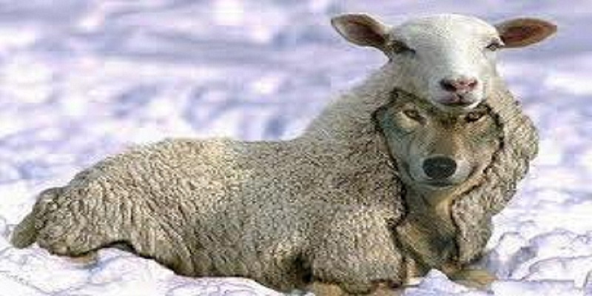
Brief description
False apostles infiltrated the church
They criticized Paul’s apostleship
Rebellious minority
Notes:
Brief Description of 2 Corinthians
False apostles infiltrated the church (Judaizers)
They criticized Paul’s apostleship
Rebellious minority

Slide 36

For next week…
Read Galatians, Ephesians, Philippians and Colossians.
Notes:
FOR NEXT WEEK…
Read Galatians, Ephesians, Philippians and Colossians

