Slide 1
NEW TESTAMENT SURVEY
PART 4
Galatians, Ephesians, Philippians, Colossians

Slide 2


Please mute your mic until you are ready to speak. Thanks
…to speak, press and hold the space bar.
Notes:
Thanks for muting yourself…to speak, press and hold the space bar

Slide 3
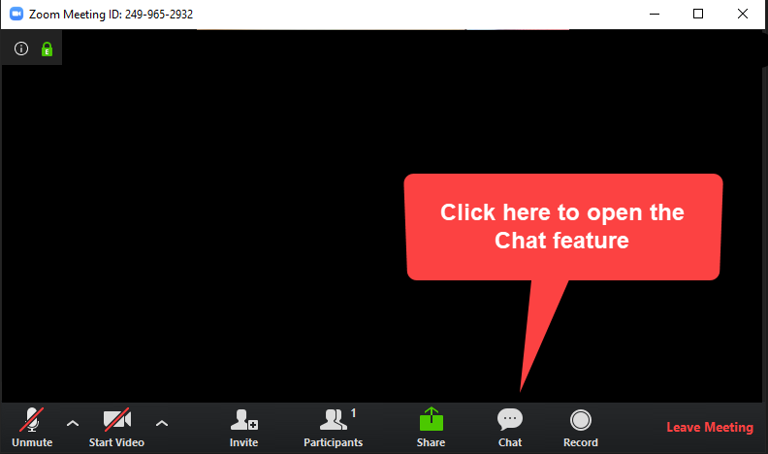
Please sign in each week
George Thompson
Betty White
Warren Willsby
Ed Asner
Sue Thompson
Don Schultz
Please type in your name each week
CHAT BOX
Notes:
Please type in your name each week (credit toward certificate)
Handouts (me)

Slide 4

NEXT SUNDAY…
SPRING FORWARD ONE HOUR

Slide 5

INTRODUCE YOURSELF
“What’s your favorite movie?”
3 Minutes
Notes:
INTRODUCE YOURSELF
“What’s your favorite movie?”
3 Minutes

Slide 6

Please take out your notes
TaylorNotes.Info/abt
Notes:
Please take out your notes.

Slide 7
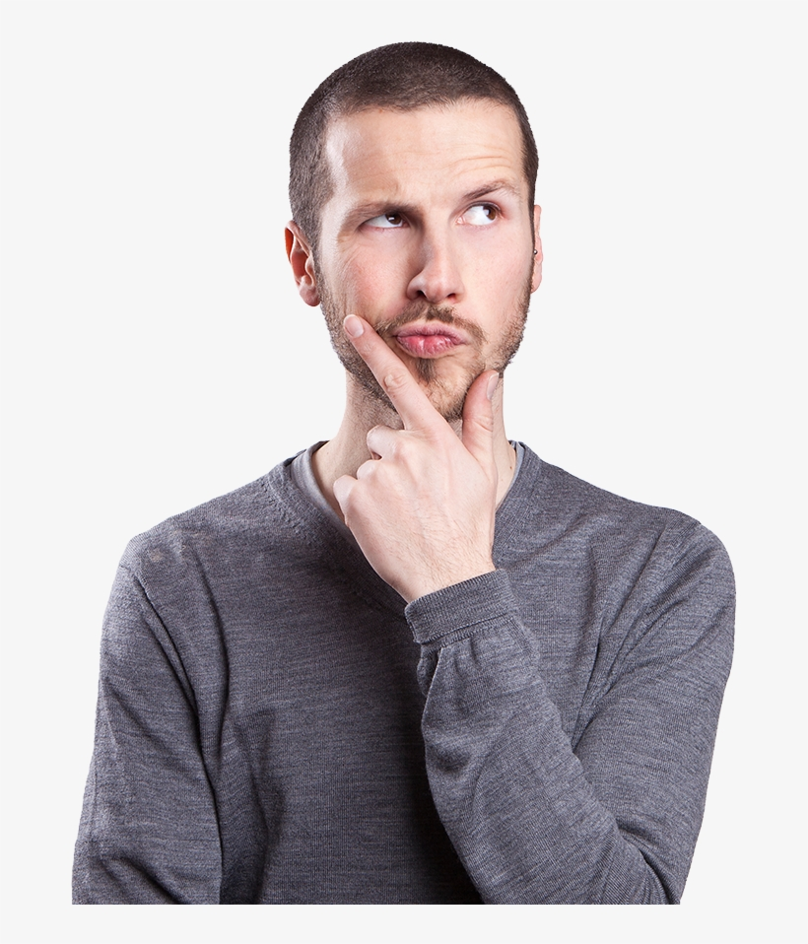
TONIGHT
Does God love me only because of what I do?
How can I experience real joy when life gets rough?
What exactly is the most important thing in my life? What is my highest priority?
Don’t I need to earn at least part of my salvation?
Notes:
TONIGHT
Does God love me only because of what I do?
How can I experience real joy when life gets rough?
What exactly is the most important thing in my life? What is my highest priority?
Don’t I need to earn at least part of my salvation?

Slide 8
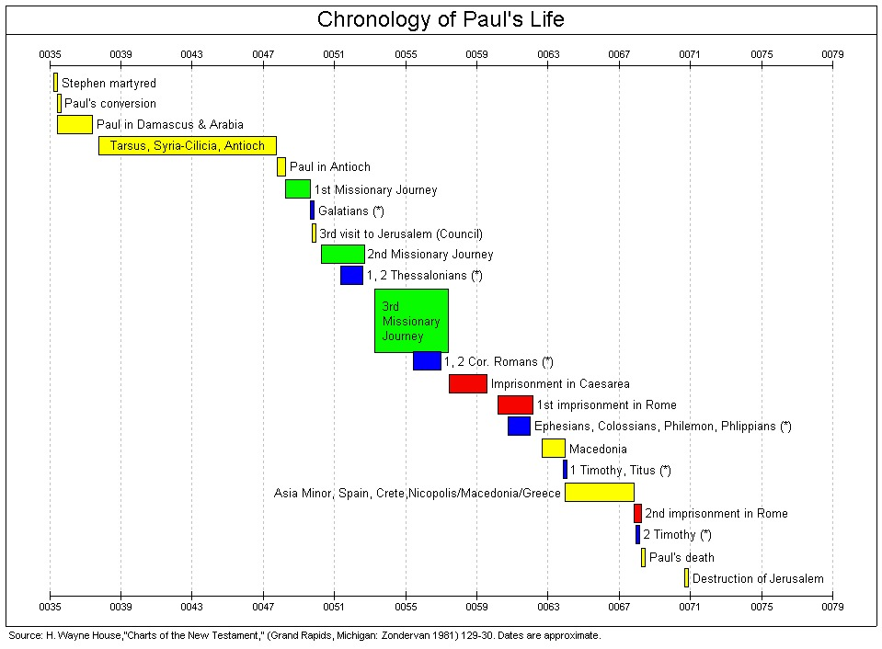
Notes:
1st visit to Jerusalem--get acquainted with Peter (~AD 36)
2nd visit: brought some famine relief, food, etc., from Antioch to Jerusalem (~AD 47)
3rd visit: attend Jerusalem council over issue of Gentile Christians (~AD 50)
Note: Debate over Paul’s trips to Jerusalem, when, etc.

Slide 9
GALATIANS

Slide 10

MAIN POINT
Christ’s death has brought in the age of the new covenant in which believers do not have to become Jews or follow the outward ceremonies of the Mosaic Law.
Notes:
MAIN POINT
Christ’s death has brought in the age of the new covenant in which believers do not have to become Jews or follow the outward ceremonies of the Mosaic Law.

Slide 11
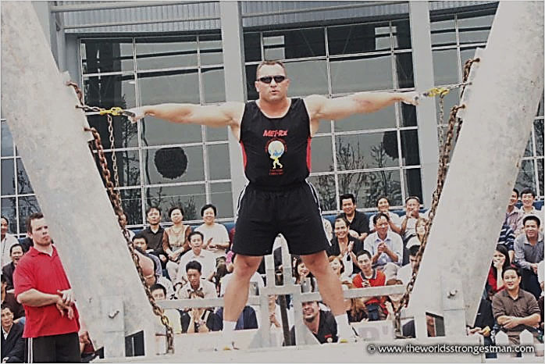
GALATIANS
WHAT TO LOOK FOR IN THIS BOOK
Grace (free)
Law (bondage)
You are saved by grace through faith in Christ, period!
Notes:
GALATIANS
Hercules Hold-World’s Strongest Man Competition
“Pillars of Hercules” (350 lb. on each side).
Law is definitive. Grace is unclear.
They were caught between the teachings of Paul and Judaizers
THE SITUATION
Judaizers taught…
Salvation couldn’t possibly be free…its’ much too valuable.
In order for a Christian to truly be right with God, he must conform to the Mosaic Law.
Salvation = Law + grace through Christ
Paul before had taught…
You are saved by grace through faith in Christ, period!
You are not saved by keeping the Mosaic Law.
Paul now
Galatians 1:6-7 “I am astonished that you are so quickly deserting the one who called you by the grace of Christ and are turning to a different gospel!
"As we have already said, so now I say again: If anybody is preaching to you a gospel other than what you accepted, let them be under God's curse!" (Gal. 1:9 NIV)
Galatians 3:1-5 “You foolish Galatians! Who has bewitched you?
2:15-21. He presents his arguments that Christ’s death has brought an end to the Mosaic Law

Slide 12
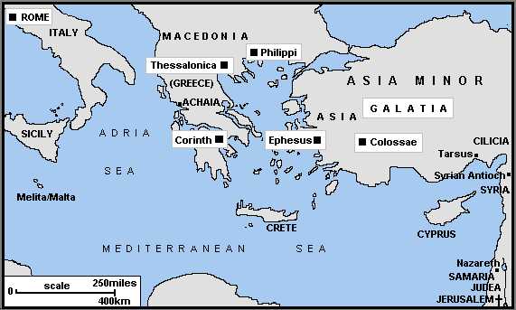
Notes:
Galatia was a region (modern Turkey), not a city like Ephesus, Philippi or Colossae.

Slide 13
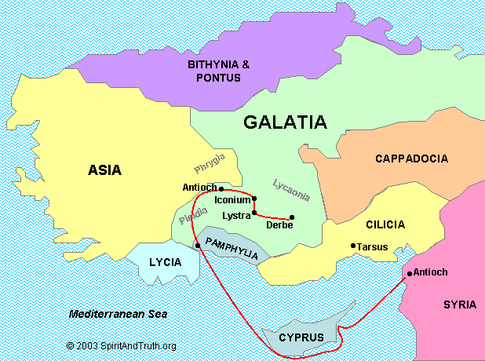
Notes:
The term Galatia is somewhat ambiguous….region, not a city.
It may refer to the older ethnic region in the northern part, or the later and larger Roman province in the southern part.
The northern part was settled in the 3rd century BC by tribes that had been driven out of Gaul, today’s France.
Most likely the southern region with the churches he visited during his first missionary journey
Pisidia, Antioch, Iconium, Lystra, and Derbe.

Slide 14
" …know that a person is not justified by the works of the law, but by faith in Jesus Christ. So we, too, have put our faith in Christ Jesus that we may be justified by faith in Christ and not by the works of the law, because by the works of the law no one will be justified."
Gal. 2:16 NIV

Slide 15
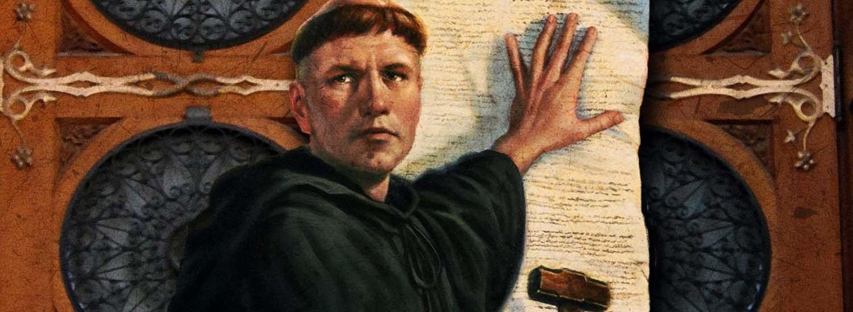
Martin Luther lived a “try harder” life until he read Galatians
Notes:
Martin Luther lived a “try harder” religious life
Monks get up every few hours at night to pray, attend services…extreme self-denial!
Recently, a criminal serving his sentence with Capuchin (kap-u-shin) monks (Sicily) pleaded to be sent back to prison... because monastery life is too hard.
Martin Luther lived a “try harder” religious life until he read Galatians 3:24 “So the law was put in charge to lead us to Christ that we might be justified by faith”
Read Galatians 2:15-16 "We who are Jews by birth and not 'Gentile sinners‘ know that a man is not justified by observing the law, but by faith in Jesus Christ. So we, too, have put our faith in Christ Jesus that we may be justified by faith in Christ and not by observing the law, because by observing the law no one will be justified.

Slide 16


MOSAIC LAW
GRACE
The Law is fulfilled
“You foolish Galatians”
Notes:
You foolish Galatians…the law is fulfilled by Christ.

Slide 17
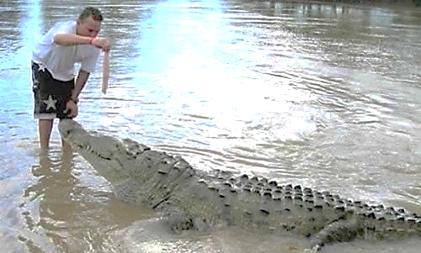
Notes:
Q: Foolishness or being brave?
Paul…you foolish Galatians!

Slide 18
How were people saved in the OT?
Salvation was not achieved by keeping the Law (Gal. 3:11)
Salvation has always been through faith in God (Hab. 2:4)
OT salvation was based on believing that God would provide a perfect sacrifice, a Savior (Gen. 3:15; 12:3; Isa. 53:5-6)
Notes:
[CLICK] Salvation was not achieved by keeping the Law (Gal. 3:11)
Q: Purpose of the Mosaic Law?
The Law merely showed man his sinfulness, and his need for a Savior
[CLICK] Salvation has always been through faith in God (Hab. 2:4)
Abraham believed God and it was counted to him as righteousness (Rom. 4:3)
This took place BEFORE the law was given.
[CLICK] OT salvation was based on believing that God would provide a Savior (Gen. 3:15; 12:3; Isa. 53:5-6)
Read Gal. 3:8-9. “The Scripture foresaw that God would justify the Gentiles by faith, and announced the gospel in advance to Abraham: ‘All nations will be blessed through you.’ So those who have faith are blessed along with Abraham, the man of faith” (Galatians 3:8-9, quoting Genesis 12:3)
Read more: http://www.gotquestions.org/Old-Testament-salvation.html#ixzz3bRbCHUYY

Slide 19
EPHESIANS
Notes:
EPHESIANS

Slide 20
MAIN POINT
Unity and love, in the bond of peace, mark the work of the Savior as well as the Christian’s grateful response to his free grace in their lives.
Notes:
MAIN POINT
Unity and love, in the bond of peace, mark the work of the Savior as well as the Christian’s grateful response to his free grace in their lives.
Q: If Christians are living under God’s grace can we live any way we choose? Why or why not? (What does Romans 6:1-2 say about this?).

Slide 21

EPHESIANS
WHAT TO LOOK FOR IN THIS BOOK
Maintain UNITY in the church body
Notes:
EPHESIANS: WHAT TO LOOK FOR
Ephesians begins with praise to God for the generous blessings he has given in Christ (1:3-14).
It then moves into thanksgiving and prayer (1:15-23), followed by the reconciliation of both Jews and Gentiles, including Paul's role in it (2:1-22; 3:1-13).
The letter moves to another prayer and doxology (3:14-21).
The remaining portion of the letter urges these Christians to maintain the unity with which God has provided through Christ's death and resurrection, along with the empowerment of the Holy Spirit (4:1-5:20), especially in Christian households (5:21--6:9).
The letter concludes by encouraging them to remain bold in Christ and the Holy Spirit, especially against spiritual enemies (6:10-20).

Slide 22
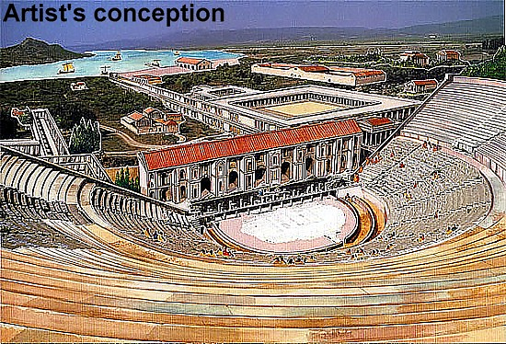
Notes:
EPHESUS
Size: largest city in Asia (300,000 people→ like Santa Cruz).
Important trade center west of Tarsus
Banking center ….great vault in the Temple of Artemis…considered to be the safest place in Asia Minor
Large library.
Parabolic theater seating up to 25,000 people
One of the most advanced aqueduct systems in the ancient world

Slide 23
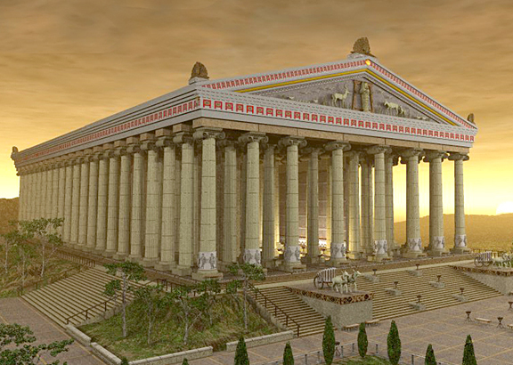
Ancient Ephesus
The temple of Artemis in Ephesus
Notes:
RELIGION OF EPHESUS
It was the center of worship for goddess Artemis.
Artemis also called Diana (KJV, NKJ)
Temple : one of the Seven Wonders of the Ancient World.
The goddess Artemis was the patron of all prostitutes and represented fertility and sexuality.
Ephesus, like Corinth was known for its immorality.
Worshippers of Artemis brought much business to Ephesus (Acts 19:23-27).
Demonism and sorcery were rampant (Acts 19:13-19).

Slide 24
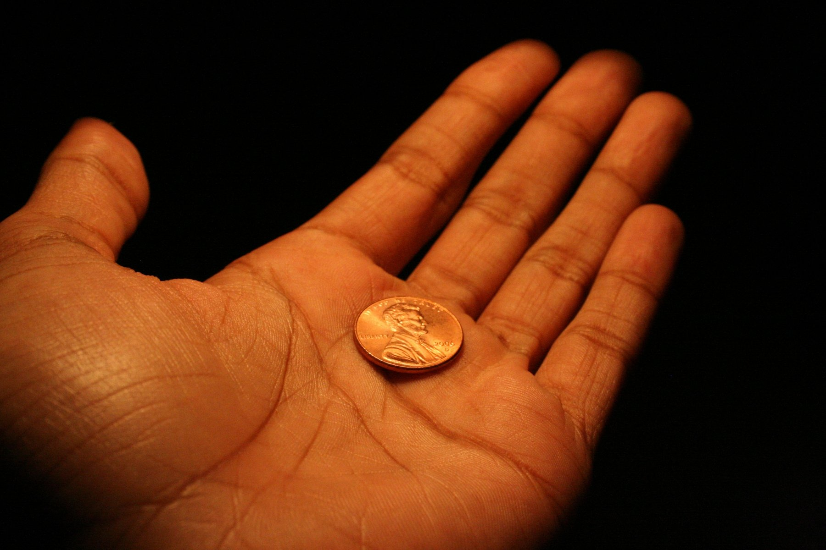
"And you also were included in Christ when you heard the message of truth, the gospel of your salvation. Ephesians 1:13a
Notes:
Phrase, “in Christ” throughout Ephesians.
Penny…us (sinners)
Hand…Jesus
God sees us “in Christ”

Slide 25
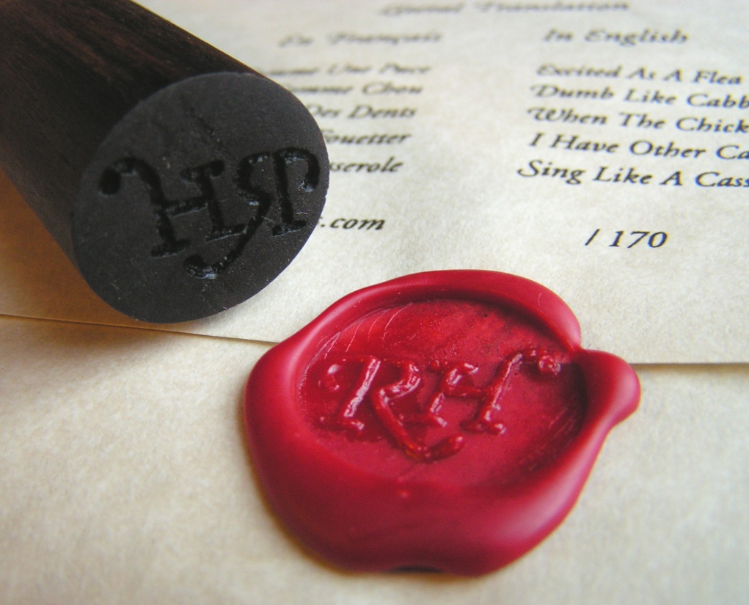
"When you believed, you were marked in him with a seal, the promised Holy Spirit"
Eph. 1:13b NIV
Notes:
SEALING OF THE HOLY SPIRIT…
The sealing like letter seal.
Being sealed by the Holy Spirit…
Represents ownership (owned by God)
Represents authentication (a genuine believer).
Represents approval (in Christ we are approved and declared “not guilty”).
Represents protection
From anything God does not permit.
God will continue to “guard [our] hearts and [our] minds in Christ Jesus”
The Holy Spirit is also a guarantee of the believer’s future inheritance in glory (cf. 2 Cor. 1:21-22).

Slide 26
PHILIPPIANS

Slide 27
MAIN POINT
True joy is found only in a loving relationship with Jesus Christ.
Notes:
Main Point: True joy is found only in a loving relationship with Jesus Christ.

Slide 28

PHILIPPIANS
WHAT TO LOOK FOR IN THIS BOOK
How to experience real joy when life gets rough!

Slide 29
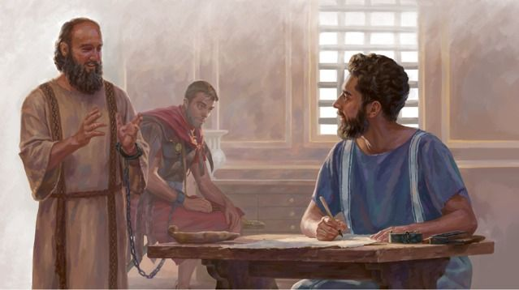
JOY comes from seeing life as God sees it
Notes:
Paul was in prison, chained to a guard, when he wrote Philippians
Yet Philippians is about having genuine joy
He saw how God was working through his situation
The gospel was being spread all through the Roman Empire (Praetorian Guards)
How do we experience that kind of joy?
A: First, we need to understand that joy is not the same as happiness.
Happiness is based on what is HAPPENING
→ next slide

Slide 30
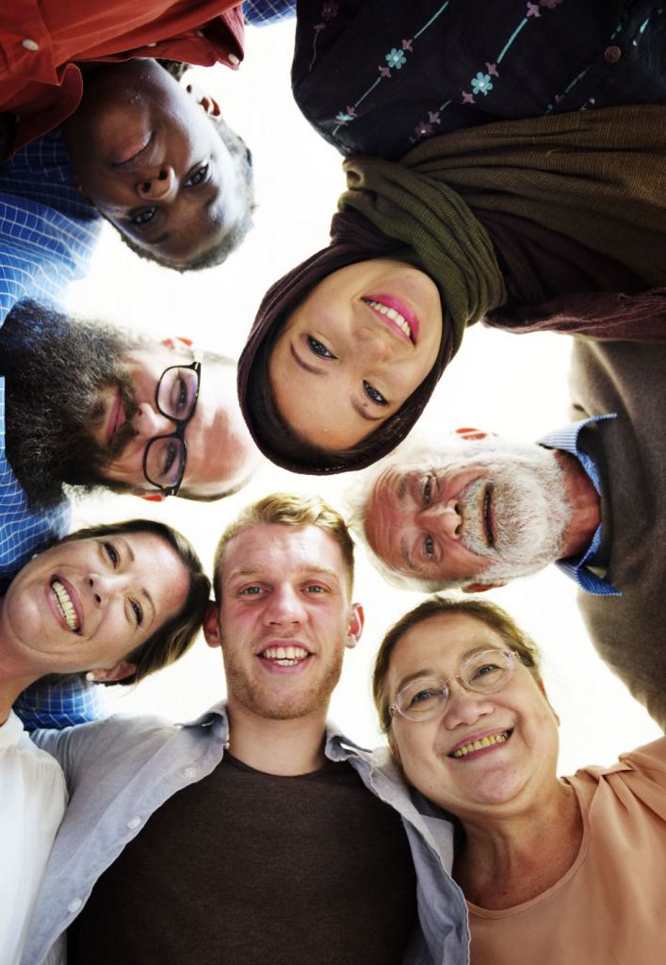
  Joy comes from knowing we are secure in Jesus Christ
  Joy comes from knowing that difficult times can strengthen our faith in Christ
  Joy comes from knowing that difficult times are TEMPORARY
Notes:
Real joy is from God.
Joy comes from knowing we are secure in God
Joy comes from knowing that difficult times can strengthen our faith in Christ
Joy comes from knowing that difficult times are TEMPORARY

Slide 31
COLOSSIANS

Slide 32
MAIN POINT
Christ is Lord over all creation, including the invisible realm. He secured redemption for his people, enabling them to participate with him in his death resurrection, and fullness

Slide 33
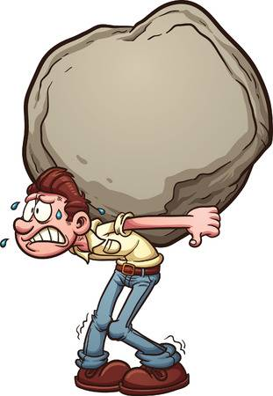
COLOSSIANS
WHAT TO LOOK FOR IN THIS BOOK
Man-made religion
False teachers were promoting a heresy that stressed man-made rules (legalism).

Slide 34

GNOSTICISM
PHYSICAL WORLD
(evil)
Aeons (progressively lower divine beings)
SUPREME GOD (spirit)
Wicked god (demiurge)
GNOSTICISM: “Salvation” is the process of gaining secret knowledge (gnosis) which eventually, through incarnations, brings one to the supreme being.
Notes:
FALSE TEACHINGS → “"See to it that no one takes you captive through hollow and deceptive philosophy, which depends on human tradition and the elemental spiritual forces of this world rather than on Christ." (Col. 2:8 NIV)
Most likely Gnosticism.
GNOSTICISM
Gnosticism proved to be the greatest philosophical threat to early Christianity based on the philosophy of “dualism.”
Problem: If god is spirit (good) and physical things are evil (Plato-dualism) how could a good god create an evil physical world?
Solution: Aeons (emanations from the Supreme God), were progressively lower divine beings until an evil being “demiurge” was created.
The evil demiurge then created the evil physical world. Gnostics taught that the demiurge was the Hebrew God Yahweh.
Salvation is based “secret knowledge” (ostensibly taught by Jesus) which was gained through secret rites and ceremonies that often appealed to the intelligentsia.
Gnostics taught that Jesus was a teacher of “secret knowledge.” He was only a spirit and did not have a physical body (Docetism).
Gnostics professed to be Christians.

Slide 35
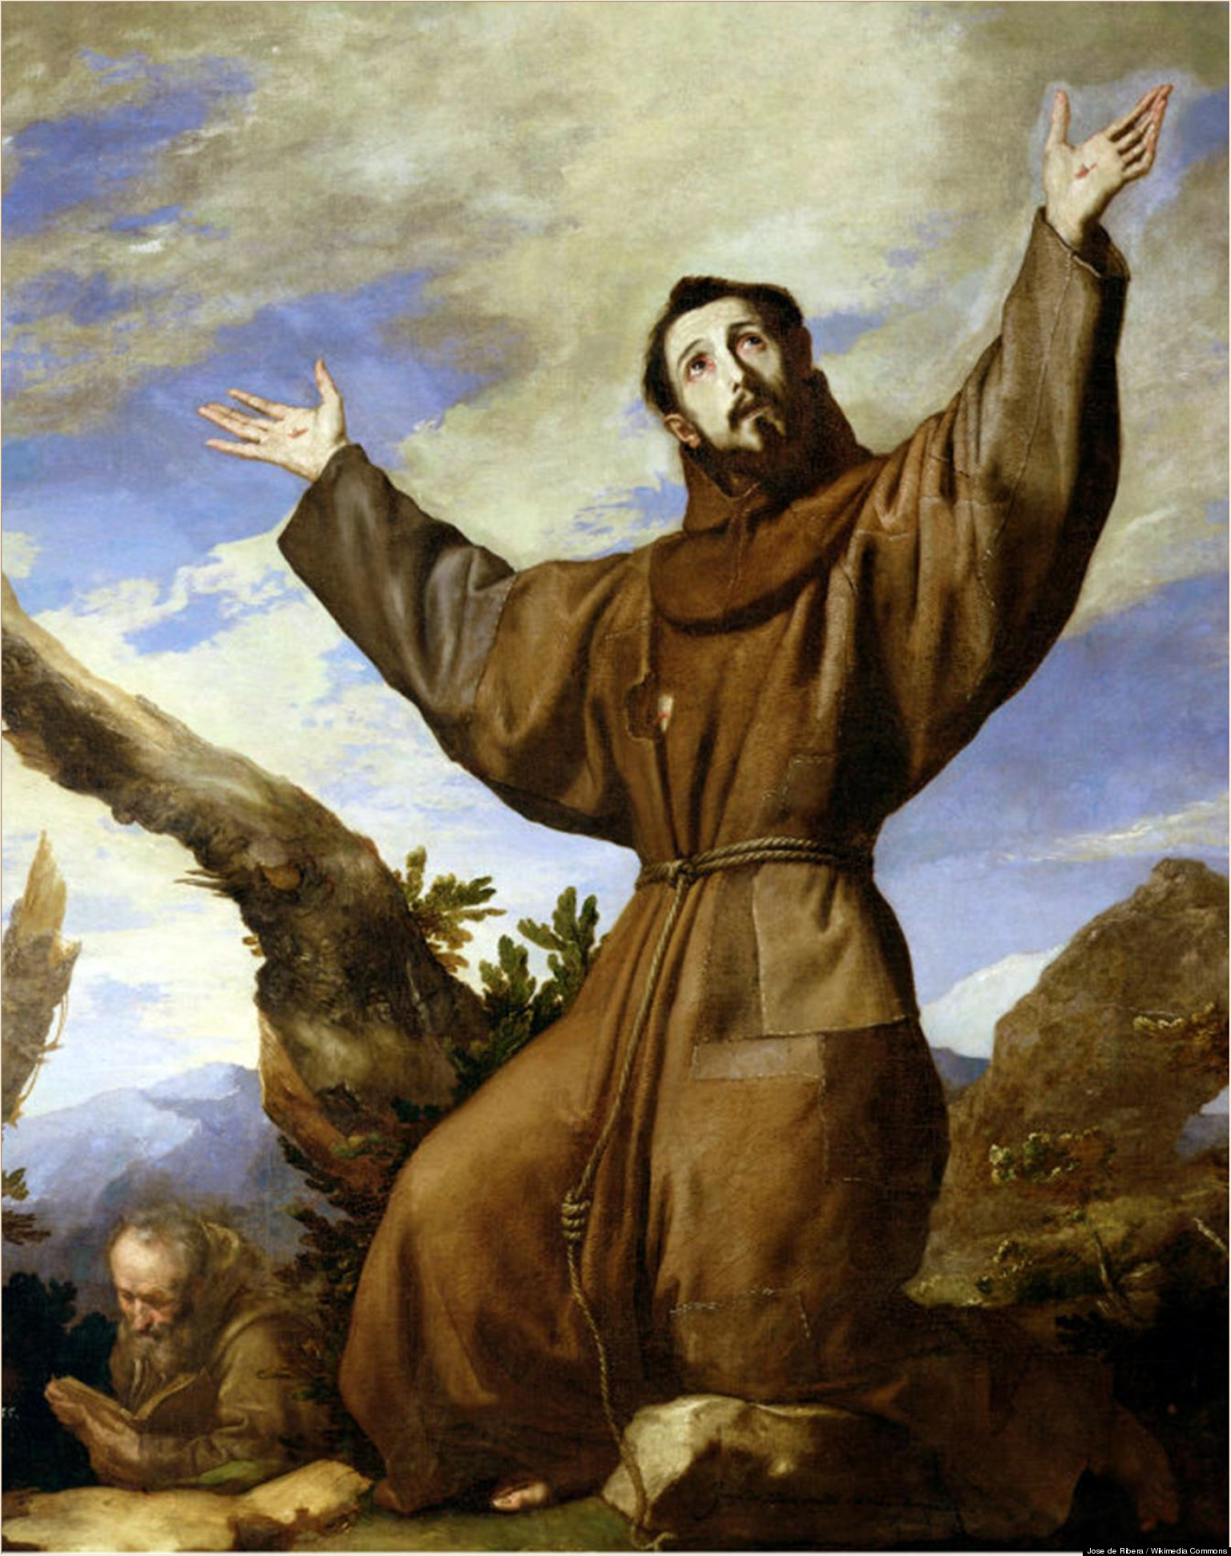
FALSE TEACHERS IN COLOSSAE
GREEK DUALISM
Spirit is good
Physical is bad
Spiritual growth comes from severe discipline of the body (asceticism)
Notes:
Gnosticism
Beginning to creep into early churches
Spiritual growth comes from severe self-discipline of the body (asceticism)
Spirit = good Physical = evil
Therefore you must punish your body

Slide 36
Summary
God loves you because, as a believer, you are in Christ
Real joy comes from trusting God no matter what
The most important thing in life is a loving relationship with Jesus Christ
You don’t need to earn salvation…it is a gift from God

Slide 37

For Next Week
Read
1, 2 Thessalonians and
1,2 Timothy
Notes:
For next week…
Read 1, 2 Thessalonians
Read 1,2 Timothy

Slide 38

Ron Eddow

