Slide 1
NEW TESTAMENT SURVEY
PART 7
1,2 Peter 1,2,3 John Jude

Slide 2
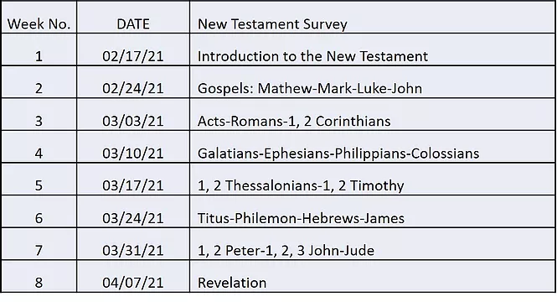

Slide 3

HERMENEUTICS CLASS
MAY 5
Notes:
Hermeneutics Class…May 5
Do you have the right Bible?
Bible translations
Is your Bible the only Bible?
Why some Bibles have more books than others
How you can get the most out of your Bible.
How to use the O-I-A Method for interpreting the Bible
How you can keep your Bible study fresh.
Various ways to read and enjoy God’s Word

Slide 4


Please mute your mic until you are ready to speak. Thanks
…to speak, press and hold the space bar.
Notes:
Thanks for muting yourself…to speak, press and hold the space bar

Slide 5
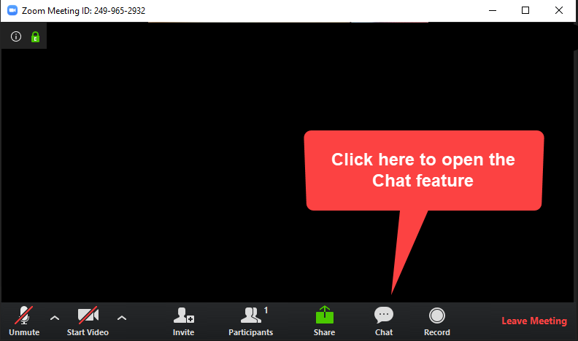
Please sign in each week
George Thompson
Betty White
Warren Willsby
Ed Asner
Sue Thompson
Don Schultz
Please type in your name each week
CHAT BOX
Notes:
Please type in your name each week (credit toward certificate)
Handouts (me)

Slide 6

3-Minute huddle
What’s your favorite book in the Bible?
Notes:
3-Minute huddle
What’s your favorite book in the Bible?

Slide 7

Please take out your notes
TaylorNotes.Info/abt
Notes:
Please take out your notes.

Slide 8
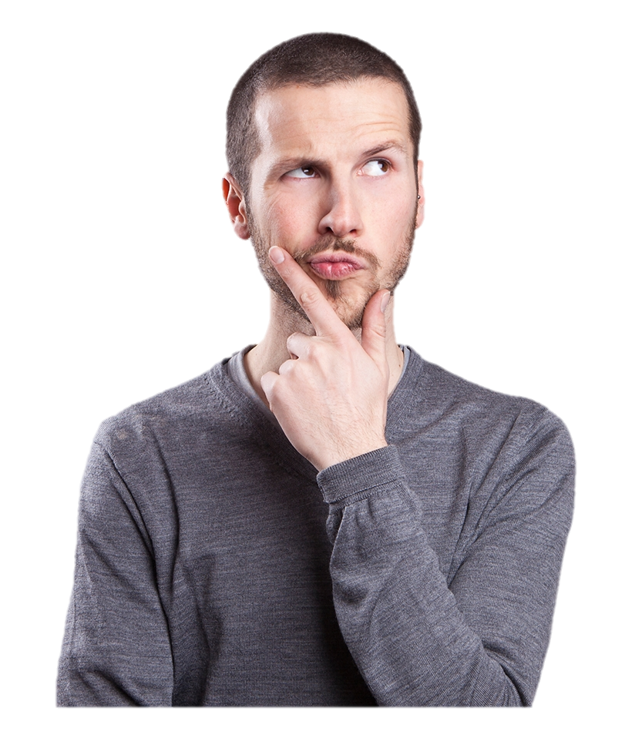
TONIGHT
What advice did the Apostle Peter give to Christians going through tough times?
Who was telling everyone that Jesus was only a “ghost”?
How can I recognize “fake” Christians?
Notes:
TONIGHT
What advice did the Apostle Peter give to Christians going through tough times?
Who was telling everyone that Jesus was only a “ghost”?
How can I recognize “fake” Christians?

Slide 9


Notes:
QUIZ

Slide 10
Who was to appoint elders on Crete?
Timothy
Philemon
Titus
James
Caesar

Slide 11
Who was Onesimus?
A runaway slave
An elder on Crete
An apostle
A wealthy slave owner
Third baseman for Red Sox

Slide 12
The book to the Hebrews was written because the recipients were…
Without a Hebrew Bible
Without kosher food
Feeling neglected
Not getting their email
Going back to the Mosaic Law

Slide 13
The book of James teaches us…
How to witness to Gentiles
How to find a good astrologer
How to walk the talk
How to speak Greek
How to be indifferent toward apathy

Slide 14
NEW
TESTAMENT
Gospels (4)
Acts (1)
Paul’s Epistles (13)
General Letters (8)
Apocalyptic (1)
Hebrews, James, 1, 2 Peter, 1,2, 3 John, Jude
Notes:
GENERAL EPISTLES (8)
Hebrews,
James,
1, 2 Peter,
1, 2, 3 John,
Jude

Slide 15
1 Peter

Slide 16
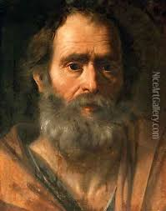
PETER
Notes:
PETER (Cephas, Κηφᾶς)
Q: What kind of a person was Peter?
A: First to speak (sometimes without thinking)
A: Inner circle: Peter, James, and John. (e.g. transfiguration).
Denied knowing Jesus to avoid being arrested himself.
His Galilean accent gave him away
When he heard a cock crow, he remembered what Jesus had said, and wept bitterly
Later, after Jesus' resurrection, Peter is presented as meeting the risen Jesus and reaffirms his love for his master three times.
Luke portrays Peter as an extremely important figure within the early Christian community.
He delivered a powerful speech immediately after the event of Pentecost
His letters are “direct” and have great literary form.

Slide 17
MAIN POINT
Christians are to endure suffering for the sake of Jesus Christ, looking back on his sufferings and forward to his second coming.
Notes:
MAIN POINT
Christians are to endure suffering for the sake of Jesus Christ, looking back on his sufferings and forward to his second coming.
Q: Does this apply to Christians in America? Don’t we have it fairly easy today?

Slide 18
Background
Author | Apostle Peter
Recipients | To God's elect, strangers in the world, scattered throughout Pontus, Galatia, Cappadocia, Asia and Bithynia (1:1, 4:3-4)
Where | Peter was probably in Rome (called “Babylon” in 5:31)
When | AD 62-63
Notes:
BACKGROUND (1 Peter)
Apostle Peter
To God's elect, strangers in the world, scattered (διασπορᾶς) throughout Pontus, Galatia, Cappadocia, Asia and Bithynia (1:1, 4:3-4)
“scattered” (diaspora, not “the” diaspora)…Assyrians
Written to Jews and Gentiles who were located all over the world
Recipients included Gentiles (4:3-4)
Peter was probably in Rome (called “Babylon in 5:31)
AD 62-63 (prior to Neronian persecution)

Slide 19
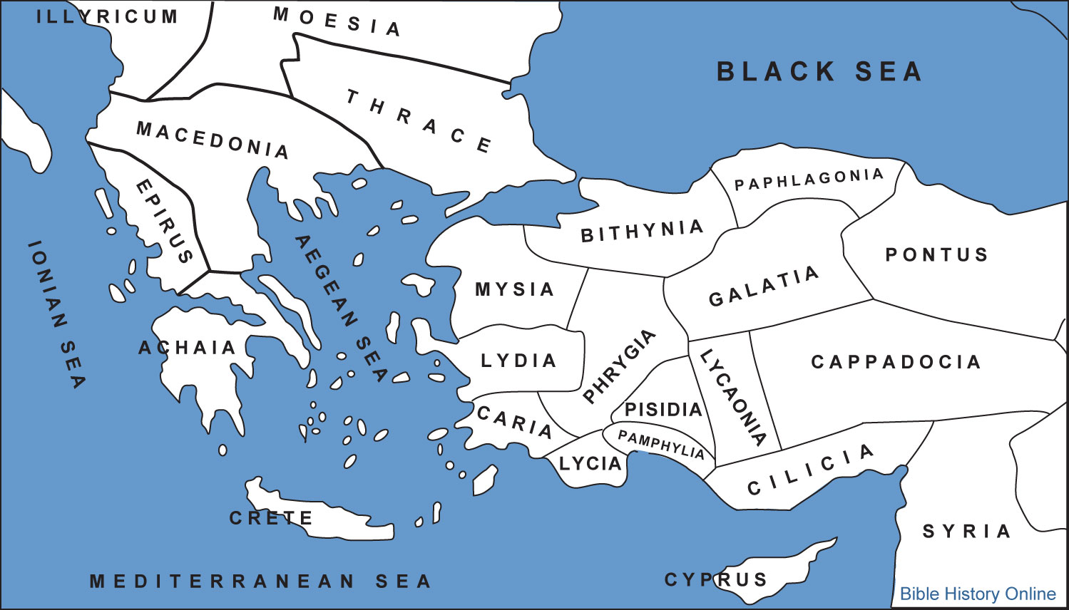
Notes:
To God's elect, strangers in the world, scattered (διασπορᾶς) throughout Pontus, Galatia, Cappadocia, Asia and Bithynia (1:1) → Modern day Turkey

Slide 20
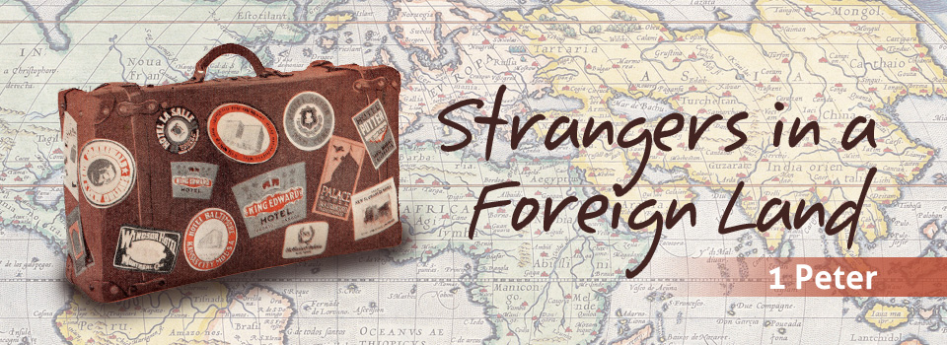
What to look for in this book
Notes:
WHAT TO LOOK FOR IN THIS BOOK
We are strangers in a foreign land…this is not our home!
This is a letter written specifically to newer Christians (mostly Gentiles) who were experiencing persecution because of their beliefs.
Peter explains how suffering for being a Christian should not surprise us…remembering that our hope for the future is based on the certainty of Jesus Christ's return.
Difficult times (trials) refine and strengthen the believer’s faith, which in turn brings glory and honor to Jesus (1:6-7).
Because all are accountable to God, we can leave judgment of others to him. We must not hate or resent those who persecute us. We should realize that we will be held responsible for how we live each day.

Slide 21
“Praise be to the God and Father of our Lord Jesus Christ! In his great mercy he has given us new birth into a living hope through the resurrection of Jesus Christ from the dead, and into an inheritance that can never perish, spoil or fade-- kept in heaven for you…”
1 Peter 1:3-4
Notes:
KEY VERSE 1 Peter 1:3-4
“Praise be to the God and Father of our Lord Jesus Christ! In his great mercy he has given us new birth into a living hope through the resurrection of Jesus Christ from the dead, and into an inheritance that can never perish, spoil or fade-- kept in heaven for you…”
INHERITANCE (Randy Alcorn)
“It’s something very tangible belonging to you as a believer”
Curious? (You’ll have to wait)

Slide 22

Cast all your ANXIETY
on him because he cares for you.
1 Peter 5:7
Notes:
Anxieties
Financial anxiety
Anxiety over health
Anxiety over job
Anxiety over relationships
Anxiety about the future
REMEMBER…GOD GENUINELY CARES ABOUT YOU!
Peter had great anxiety when he denied know Jesus…how did Jesus respond?

Slide 23

JESUS the cornerstone
1 Peter 2:6
Notes:
1 Peter 2:6 “See, I lay a stone in Zion, a chosen and precious cornerstone, and the one who trusts in him will never be put to shame.“
Q: Why did Peter liken Jesus to a cornerstone?
The first stone set in the construction of a masonry foundation
All other stones will be set in reference to this stone,
Determines the position of the entire structure.
Jesus is metaphorically like a Cornerstone in that His church would be built upon, a unified body of believers, both Jew and Gentile.
Peter was quoting Isaiah 28:16-17 where the Messiah is likened to a cornerstone...the Jews would have seen the connection between the metaphor and the Messiah

Slide 24

Always be prepared to give an answer
1 Peter 3:15
Notes:
READ 1 Peter 3:15
Always be prepared to give an answer to everyone who asks you to give the reason for the hope that you have. But do this with gentleness and respect,
We need to give an answer to those who believe differently than us…
Scientism: “The only real truth is that which can be proved scientifically!”
Moral relativism: “What may be truth for you may not be truth for me.”
Skepticism: “How do you know the Bible is really God’s Word?”
These ABT Classes are designed to help you with this.

Slide 25
2 Peter
Notes:
2 PETER

Slide 26
Main Point
It is God’s grace, through Jesus Christ, that truly transforms and empowers Christians to live righteously, even in the face of opposition and false teachings.
Notes:
Main Point
It is God’s grace, through Jesus Christ, that truly transforms and empowers Christians to live righteously, even in the face of opposition and false teachings.

Slide 27

What to look for in this book
Grow and mature spiritually
Notes:
Brief description of the book
This is somewhat of a “farewell letter” urging Christians to grow and mature spiritually depending on God’s divine power as their source for living the Christian life (1:3-11).
False teachers, who denied the second coming of Jesus Christ were creating confusion among a specific, but unidentified group of believers.
These greedy teachers were secretly introducing destructive heresies, made up stories, and even denying the sovereign Lord (2:1-3).
Apparently, these false teachers were more interested in making money by distorting the truth.
Peter warns these Christians about these false teachers and encourages them to grow in their faith and knowledge of Jesus Christ (1:5-8).

Slide 28
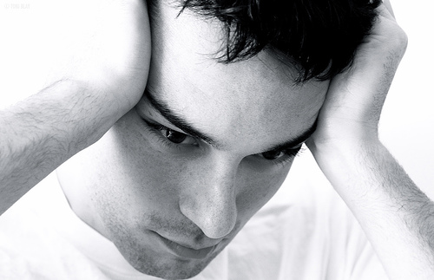
Ever feel like you can’t live the Christian life?
Notes:
Q: Ever feel like you can’t live the Christian life?
Q: Does God expect us to live the Christian life in our own strength?
→ Next slide

Slide 29
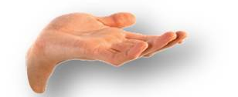
“His divine power has given us everything we need for life and godliness through our knowledge of him who called us by his own glory and goodness.” 2 Peter 1:3
Notes:
2 Peter 1:3
“His divine power (Jesus) has given us everything we need for life and godliness through our knowledge of him who called us by his own glory and goodness.”
This power comes from:
Knowing what the Bible says about life, temptations, trust, etc.
The Holy Spirit
→ Next slide

Slide 30
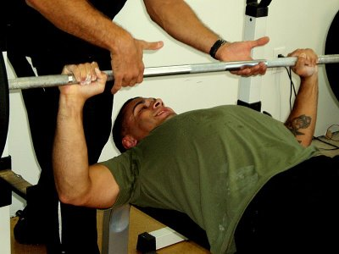
Notes:
Here is a metaphor for the Christian life…bench pressing
Someone “spots” the lifter when it the weight gets too heavy
As we live the Christian life, God gives us the power to live it, when we need it.
We are not passive.

Slide 31
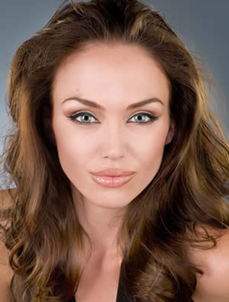
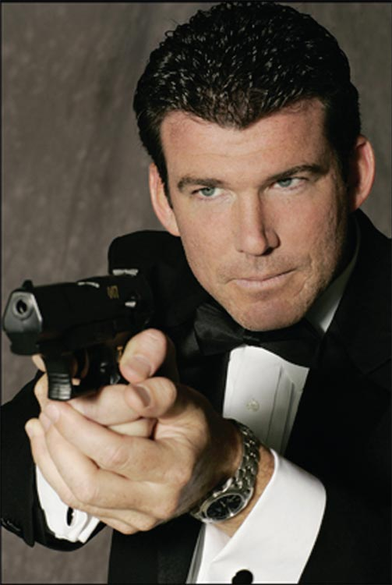
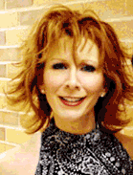
Can you name them?
Notes:
Can you name these people?
They are all imposters
Angelina Jolie look-alike/Impersonator→Tiffany Claus
Pierce Brosnan → Glenn Reichle
Reba MacEntire → “Marie”
2 Peter 2:1
But there were also false prophets among the people, just as there will be false teachers among you.
They will secretly introduce destructive heresies, even denying the sovereign Lord who bought them-- bringing swift destruction on themselves.

Slide 32
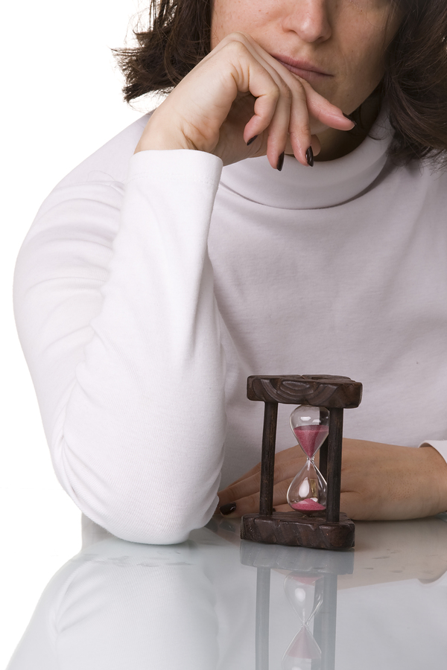
Why is Jesus taking so long to come back?
(Hint: 2 Pet. 3:8-10)
Notes:
Q: Why is Jesus taking so long to come back?
READ 2 Peter 3:8-10
But do not forget this one thing, dear friends: With the Lord a day is like a thousand years, and a thousand years are like a day.
9 The Lord is not slow in keeping his promise, as some understand slowness. He is patient with you, not wanting anyone to perish, but everyone to come to repentance.
10 But the day of the Lord will come like a thief. The heavens will disappear with a roar; the elements will be destroyed by fire, and the earth and everything in it will be laid bare.

Slide 33

1, 2, 3 John
Notes:
1, 2, 3 John → Only 5 Chapters → “1 cappuccino”
2 John = 13 verses
3 John = 14 verses (less than 2 minutes)
I’m going to cover all three books together—they are very short

Slide 34
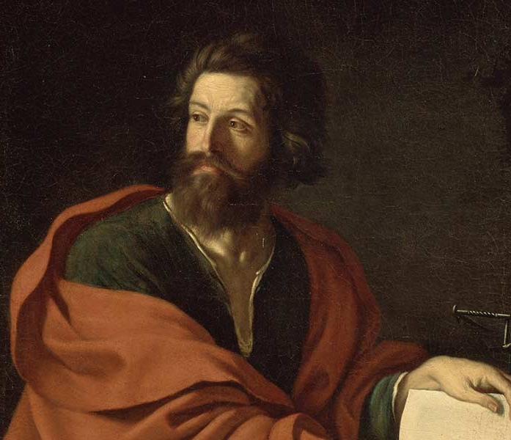
JOHN
Notes:
John the Apostle (not half-brother of Jesus)
Ordinary fisherman
Inner circle of Jesus…Peter, James and John
Referred to himself as “the disciple whom Jesus loved”
Probably the youngest of the apostles
A leader in the Jerusalem church
Wrote the latest books of the NT (~AD 90-95)

Slide 35
Main Point (1 John)
John calls the readers back to the three basics of the Christian life: 1) knowing biblical truths,
2) living obedient lives,
3) and being completely devoted to God.
Notes:
Main Point (1 John)
John calls the readers back to the three basics of the Christian life:
knowing biblical truths,
living obedient lives,
and being completely devoted to God.

Slide 36
Main Point (2 John)
Live in God’s amazing love, and not to God only but to other people as well.
Notes:
MAIN POINT (2 John)
Live in God’s amazing love, and not to God only but to other people as well.

Slide 37
Main Point (3 John)
Live your life in the truth of God’s Word, and let your love for fellow believers be expressed openly, especially through hospitality to itinerant Christian workers.
Notes:
MAIN POINT ( 3 John)
Live your life in the truth of God’s Word, and let your love for fellow believers be expressed openly, especially through hospitality to itinerant Christian workers.

Slide 38
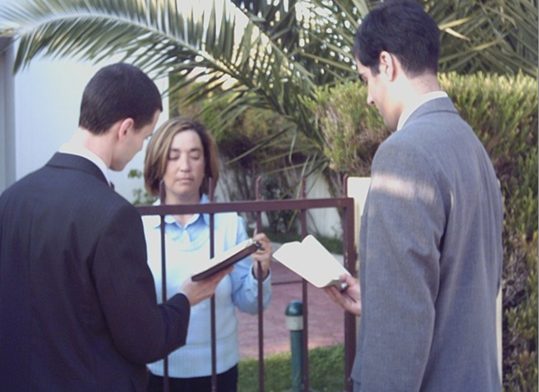

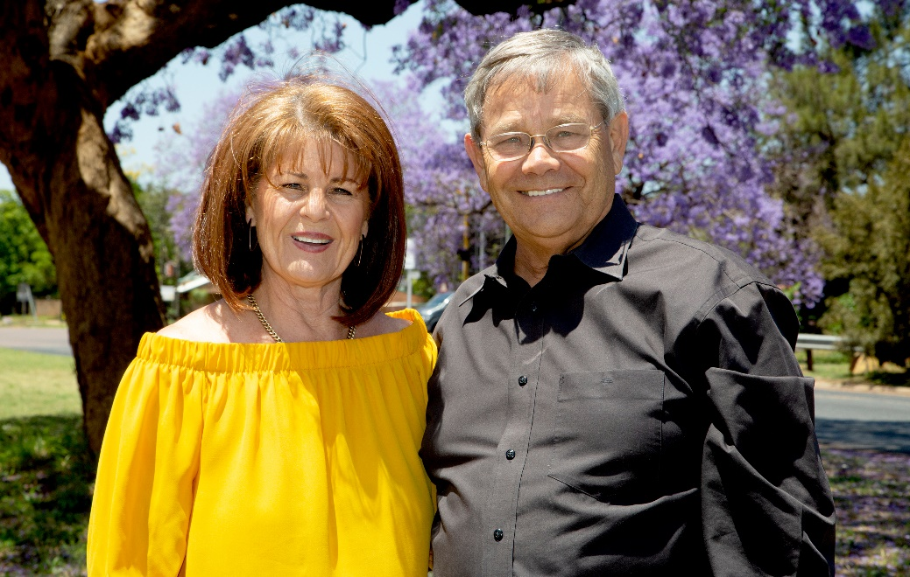
1, 2, 3 John
1
2
3
Give them the “Jesus test”
(1 John 4:1-3)
Genuinely care for and love fellow Christians
(2 John 5-6)
Show hospitality to missionaries
(3 John 8)
Notes:
1 John:
Give them the “Jesus test.” (1 John 4:1-3; 2 John 1:10) → do you believe Jesus is from God?
Early church → Docetists (1 John 1:1 -> “touched”)
Jesus was from God (fully God) + Jesus was fully human
2 John
Genuinely care for and love fellow Christians (2 John 5-6)
3 John
"It was for the sake of the Name that they went out, receiving no help from the pagans. We ought therefore to show hospitality to such people so that we may work together for the truth" (3 Jn. 1:7-8 NIV)
Johan & Christa Combrinck – AfNet South Africa

Slide 39
Jude
Notes:
1 Chapter

Slide 40
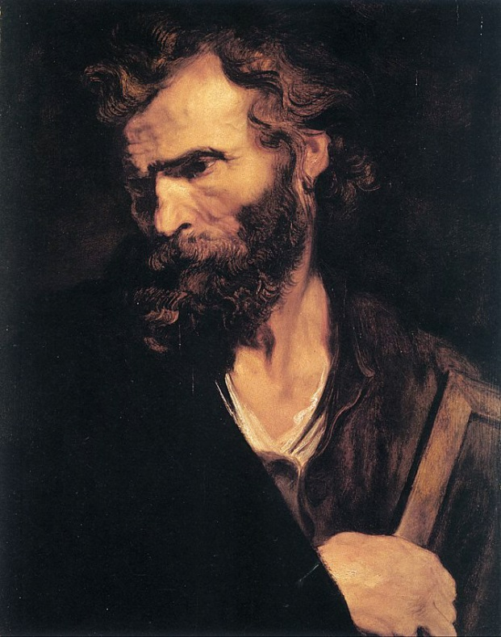
Jude
An apostle of Jesus
Half-brother of Jesus, and brother of James
Probably became a believer after Jesus’ resurrection
Notes:
JUDE
An apostle of Jesus
Half-brother of Jesus
Probably became a believer after Jesus’ resurrection

Slide 41
Main Point
Be careful about following false teachers who have surreptitiously infiltrated the church and perverted the truth of God’s Word. The church is to defend the truth aggressively against such false teachers.
Notes:
MAIN IDEA (Jude)
Be careful about following false teachers who have surreptitiously infiltrated the church and perverted the truth of God’s Word. The church is to defend the truth aggressively against such false teachers.

Slide 42

“I’m under God’s grace so I can live any way I want”
Notes:
Q: Is this statement true?
“I’m under God’s grace so I can live any way I want”
Q: What do these verses say about this?
Jude 4 For certain men whose condemnation was written about long ago have secretly slipped in among you. They are godless men, who change the grace of our God into a license for immorality and deny Jesus Christ our only Sovereign and Lord.
Romans 6:1 What shall we say, then? Shall we go on sinning so that grace may increase? 2 By no means! We are those who have died to sin; how can we live in it any longer?" (Rom. 6:1-2 NIV)
God wants us to experience the best life possible!
Obedience to him always produces the best there is!

Slide 43

What to look for in this book
Help those who have been influenced by these heresies

Slide 44

For Next Week
Read
Revelation
Notes:
Read Revelation

Slide 45

Ron Eddow

