Slide 1
NEW TESTAMENT SURVEY
PART 6
Titus, Philemon, Hebrews, James

Slide 2
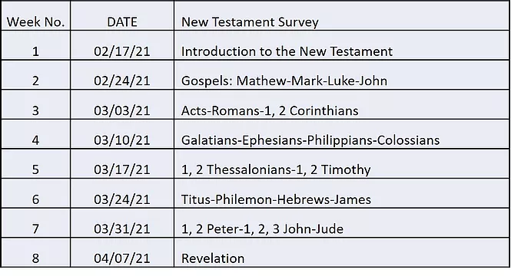

Slide 3


Please mute your mic until you are ready to speak. Thanks
…to speak, press and hold the space bar.
Notes:
Thanks for muting yourself…to speak, press and hold the space bar

Slide 4
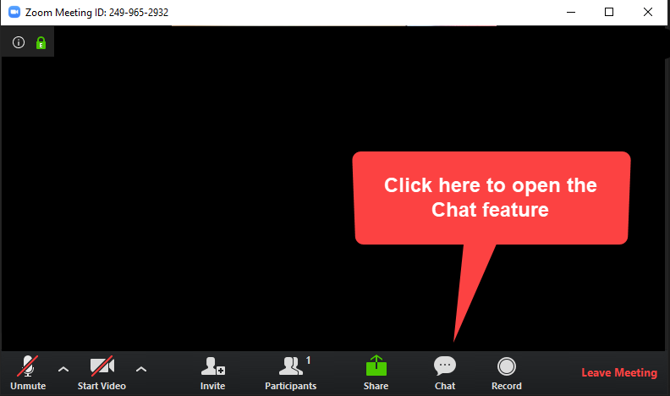
Please sign in each week
George Thompson
Betty White
Warren Willsby
Ed Asner
Sue Thompson
Don Schultz
Please type in your name each week
CHAT BOX
Notes:
Please type in your name each week (credit toward certificate)
Handouts (me)

Slide 5
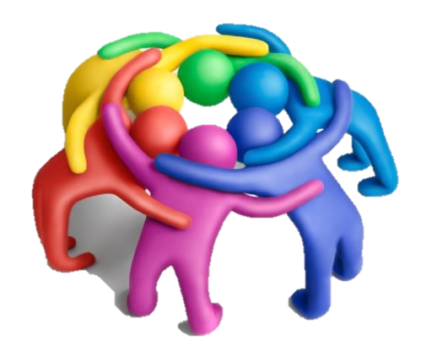
3-Minute huddle
What would you do if you had a whole day to yourself?
Notes:
3-Minute huddle
What would you do if you had a whole day to yourself?

Slide 6

Please take out your notes
TaylorNotes.Info/abt
Notes:
Please take out your notes.

Slide 7
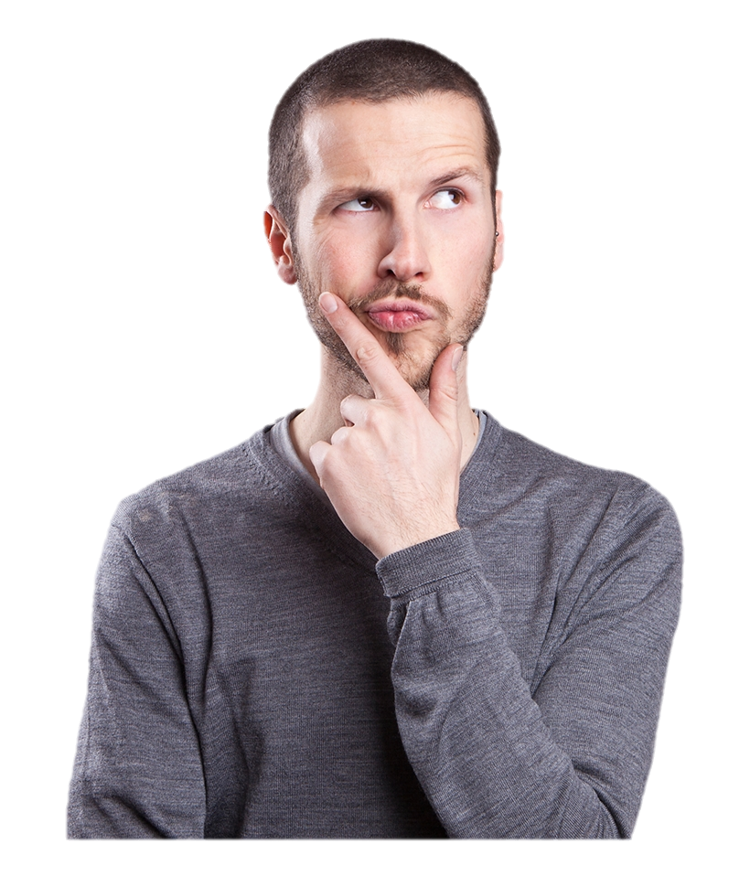
TONIGHT
I have two Christian friends who are angry at each other. Should I step in?
Is it normal to struggle with my faith at times?
Did Paul and James disagree over the issue of “works”?
Notes:
TONIGHT
I have two Christian friends who are angry at each other. Should I step in?
Is it normal to struggle with my faith at times?
Did Paul and James disagree over the issue of “works”?

Slide 8
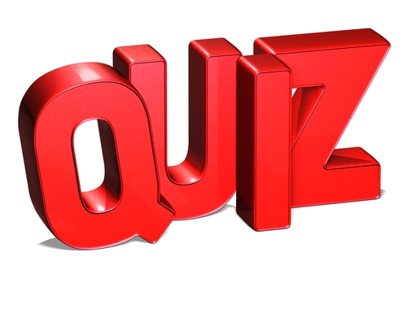

Notes:
QUIZ

Slide 9
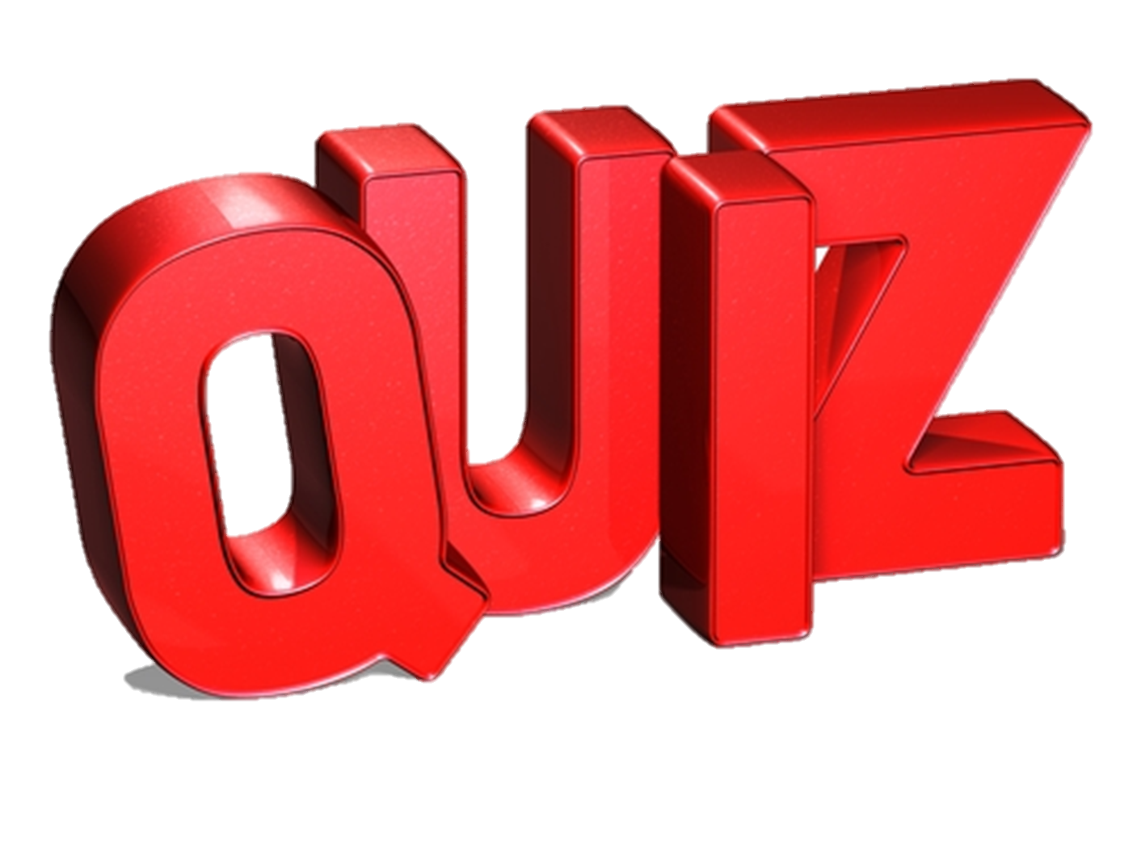
What was the main point of confusion in the Thessalonian Church?
Salvation + Grace
Law + grace
Should the choir wear robes
What happened to people who died?

Slide 10
Timothy was…?
Paul’s 2nd cousin
A young pastor in Ephesus
Head of the church in Jerusalem
A Roman pole vaulter

Slide 11
Paul wrote, “If you don’t work, you don’t…”?
Sit in front pew during church
Get “happy meals”
Get promoted
Eat

Slide 12
The only mediator between God and men is…?
The church
Roman senators
Jesus Christ
Old Testament prophets

Slide 13
This year Easter falls on…
Saturday
Monday
Palm Sunday
Easter Sunday

Slide 14
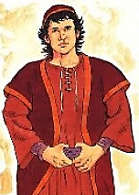
TITUS
Notes:
Titus was sent for three main purposes:
To build up churches on an island where the inhabitants had a bad reputation.
To teach sound doctrine.
To refute false teachers.
False teachers were apparently distorting—
God’s sovereignty (1:1, 2)
His saving grace (2:11; 3:5)
Christ’s deity and 2nd Coming (2:13)
Work of the Holy Spirit in believers’ lives

Slide 15

MAIN POINT
There is an inseparable link between one’s faith and one’s practice. Between one’s beliefs and one’s behavior.
Notes:
MAIN POINT
There is an inseparable link between one’s faith and one’s practice. Between one’s beliefs and one’s behavior.

Slide 16
What to Look for in this book
Titus was to…
Establish strong church leaders on Crete
Straighten out Paul’s unfinished work
Teach sound doctrine (beliefs)
Silence “rebellious people”
Notes:
BRIEF DESCRIPTION OF THE BOOK
Establish strong church leaders on Crete
Leader qualifications → Read Titus 1:5-9
“Blameless, one wife (a one-woman man, faithful to his wife), obedient children, not overbearing, not quick-tempered, not given to drunkenness, not violent, not pursuing dishonest gain, hospitable, loves what is good, self-controlled, upright, holy and disciplined.”
Straighten out what Paul left unfinished (to organize & nurture churches)
Teach sound doctrine
Beliefs rooted in the gospel
Silence “rebellious people”
Christian Jews who were insubordinate to leaders
Silence them through good conduct

Slide 17

Who was Titus?
Dependable
Reliable
Diligent
Loved people
Notes:
Titus
Dependable (2 Cor. 8:17)
Reliable (2 Cor. 7:6)
Diligent (2 Cor. 8:17)
Troubleshooter, problem solver, manager
Had great capacity for human affection (2 Cor. 7:13-15).
First bishop (pastor) of the church of Crete.
Appointed church elders (“overseers”)

Slide 18
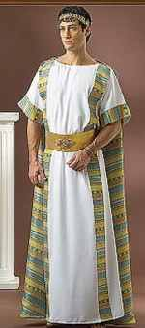
TITUS | TIMOTHY
Gentile | Half-Jew, half Gentile
Served at Corinth & Crete | Served at Corinth & Ephesus
Strong personality | Nervous, timid
Notes:
TITUS: Gentile → Timothy Half-Jew, half Gentile
TITUS: Served at Corinth & Crete →TIMOTHY: Served at Corinth & Ephesus
TITUS: Strong personality → TIMOTHY: Nervous, timid

Slide 19
Both were young and gifted
Both were co-workers of Paul
Both were charged with building up churches
Titus
Timothy
Notes:
TIMOTHY and TITUS
Both were young and gifted
Both were co-workers of Paul
Both were charged with building up churches
God uses all kinds of people, with all types of personalities, in the church

Slide 20
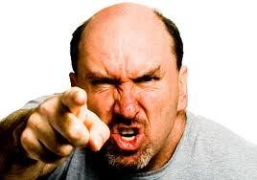
“Those Cretans are liars, evil brutes, lazy gluttons”
Notes:
People on Crete had a very bad reputation.
Read Titus 1:12 “Those Cretans are liars, evil brutes, lazy gluttons”
Cretans hated work but loved to eat and thus were generally self-indulgent, greedy, lustful and overfed.
Very immoral
“To Cretanize meant “to lie”
Paul quotes Epimenides (“one of their own prophets”) who was from Crete.
For this reason Christian elders on Crete must be above reproach (1:7)
Q: How do people in today’s culture often describe Christians?

Slide 21
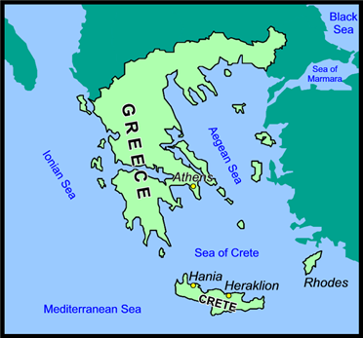
Notes:
CRETE
The largest and most populous of the Greek islands, and the fifth-largest island in the Mediterranean Sea
160 mi from east to west, and 37 miles at its widest point
About 5X size of Santa Cruz

Slide 22
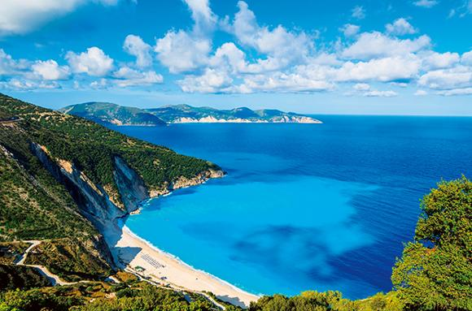
Notes:
CRETE
Extremely mountainous (Highest 8,000 ft.)
Temperate Mediterranean climate
Crete had a highly developed, literate civilization--it has been ruled by Greeks and Romans

Slide 23
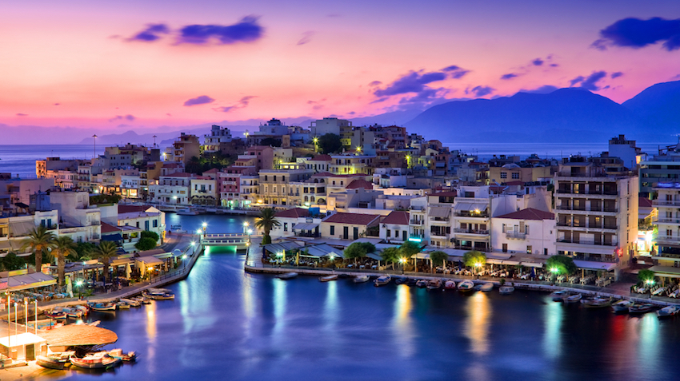
Notes:
CRETE TODAY
Vacation spot
Canyon hiking
Luxurious hotels
Great food

Slide 24
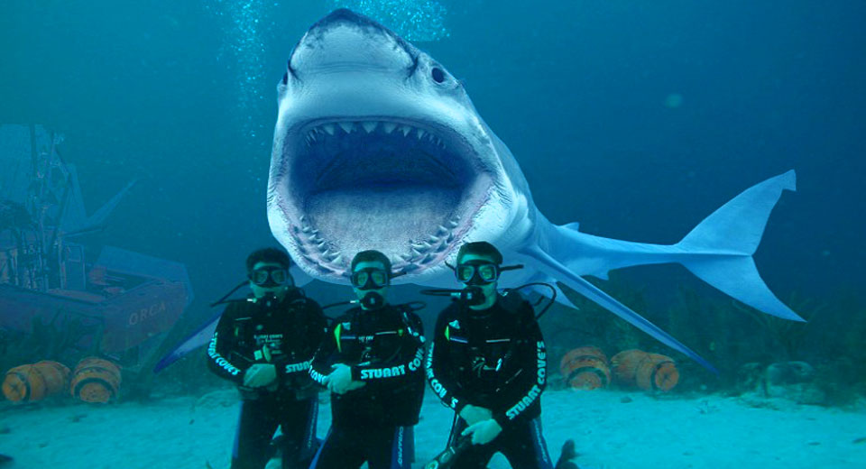
Notes:
For some reason scuba diving has not caught on…

Slide 25
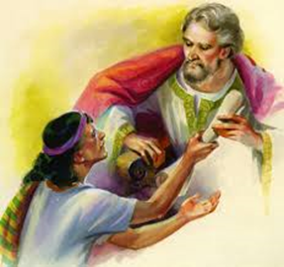
Philemon
Notes:
Three main people
Philemon
Wealthy Gentile believer living in Colossae whose slave (Onesimus) had ran away
Saved under Paul’s ministry, probably in Ephesus
Prominent leader in the church at Colossae
Onesimus
stole some money from Philemon his master.
Not a believer at the time
Ran away to Rome, to get lost in the crowds.
Could be legally killed as a runaway slave.
Sent him back with Tychicus, along with a letter
Paul
In prison
Led Onesimus to the Lord
Loved Onesimus
Urging Philemon to forgive Onesimus who is now a fellow believer and brother in the Lord.

Slide 26
MAIN POINT
The gospel can transform lives and impact human relationships
Notes:
MAIN POINT
The gospel can transform lives and impact human relationships

Slide 27
What to look for in this book…
The change in Onesimus’ life when he became a believer
Forgiveness toward a fellow believer who made a mistake
The need to restore broken Christian relationships
Notes:
WHAT TO LOOK FOR IN THIS BOOK…
The change in Onesimus’ life when he became a believer
Forgiveness toward a fellow believer who made a mistake
The need to restore broken Christian relationships

Slide 28
CHRISTIAN LOVE
Grateful for the best in others (v. 4)
Seeks welfare of others (v. 10)
Believes the best in others (v. 21)
Bears the burdens of others (v. 18)
Deals honestly with others (v. 12)
Source: John MacArthur, The MacArthur Bible Commentary (Thomas Nelson, 2005)
Notes:
Philemon
Diagram from John MacArthur’s Bible Commentary, p. 1829.

Slide 29

HEBREWS
Notes:
Author unknown: possibly Paul (not likely), Barnabas, Apollos
Recipients Hebrew Christians → being persecuted by Jews and Romans
Christ had not yet returned…they were giving up on Christianity
Author shows how Jesus is superior to…
the Law,
Moses,
Abraham,
angels

Slide 30
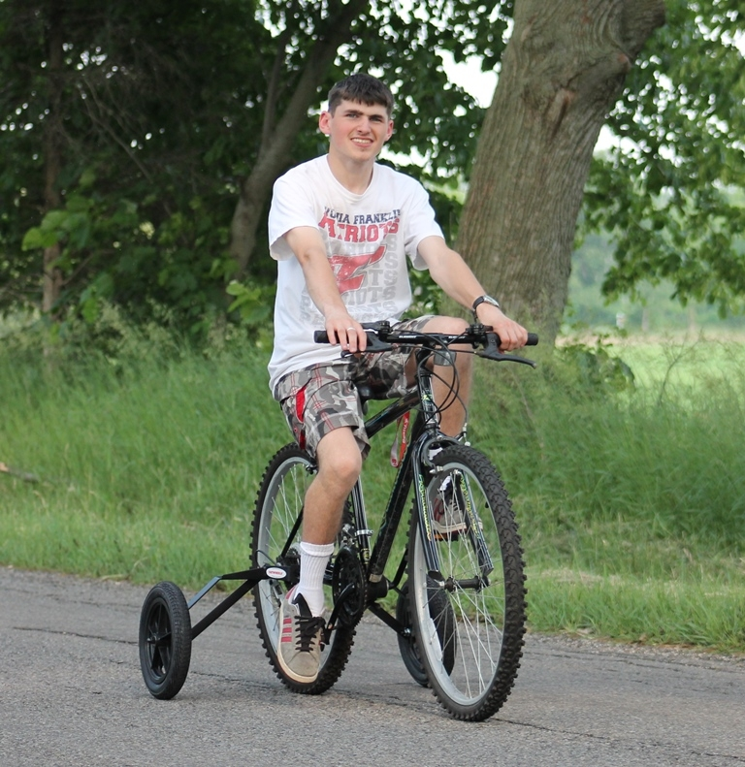
“I don’t want to give up my training wheels.”
Notes:
These Hebrew Christians wanted to stay with their familiar ways. The Law was like training wheels on a bike
Grace was a new concept.
Thinking about going back into Judaism (training wheels)
The Law was familiar to them...it made them feel safe
Christ had not yet returned—they were getting impatient.
Unconverted Jews were also putting pressure on them to go back to the Law!
DISCUSSION
Q: Why do people tend to revert back to old habits even when they know they’re harmful?
A: Familiarity—a sense of security– as a result they suffer the harmful consequences.

Slide 31
MAIN IDEA
Jesus Christ is greater than any angel, priest, or old covenant institution.
Notes:
MAIN POINT (Hebrews)
Jesus Christ is greater than any angel, priest, or old covenant institution.

Slide 32
What to look for in this book…
Recipients were struggling with their new faith
Following Jesus seemed to nullify their Jewish heritage
The main thought throughout Hebrews is that Jesus Christ is far superior to any aspect of the old Jewish religion

Slide 33
To convince Jewish Christians not to revert back to the Mosaic Law.
To show that Christianity had replaced Judaism.
To present the sufficiency and superiority of Christ.
The three-fold purpose of the letter is:
Notes:
The three-fold purpose of the letter is:
To convince Jewish Christians not to revert back to the Mosaic Law.
To show that Christianity had replaced Judaism.
To present the sufficiency and superiority of Christ.

Slide 34
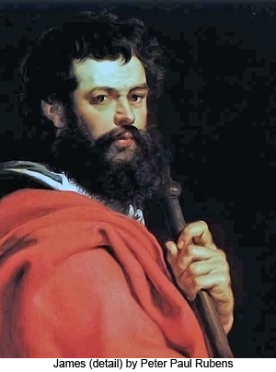
JAMES
Notes:
JAMES – Half brother of Jesus (Mark 6:3)
Hebrew – “Jacob”
“Proverbs of the NT
Very easy to understand

Slide 35
Who is right?
???
PAUL
JAMES
“For it is by grace you have been saved, through faith-- and this not from yourselves, it is the gift of God--not by works, so that no one can boast.” Eph. 2:8,9
You see that a person is justified by what he does and not by faith alone.” James 2:24
Notes:
WHO WAS RIGHT?
PAUL: “For it is by grace you have been saved, through faith-- and this not from yourselves, it is the gift of God--not by works, so that no one can boast.” Eph. 2:8,9
JAMES: You see that a person is justified by what he does and not by faith alone.” James 2:24

Slide 36
Both are right!
 | Paul | James
Problem | Legalism | Laxity
Definition of “works” | Trying to gain God’s grace | A response to God’s grace
Purpose | How to become a Christian | How to behave like a Christian
Source: Rene Schlaepfer, Faith That Makes a Difference: What is Real Faith? (October 20 & 21, 2007)

Slide 37
MAIN POINT
How to live out one’s faith in Jesus Christ, being a doer and not just a hearer of the Word. Believers are not saved by good works, they are saved for good works.
Notes:
MAIN POINT
How to live out one’s faith in Jesus Christ, being a doer and not just a hearer of the Word. Believers are not saved by good works, they are saved for good works.

Slide 38

Faith and Works
Good works are not a substitute for faith (Paul)
Good works are the result of faith (James)
Salvation
Notes:
Good works are not a substitute for faith (Paul)
Good works are the result of faith (James)
Works are a response to God’s love because of his generous grace to us.

Slide 39

For Next Week
Read
1, 2 Peter; 1, 2, 3 John and Jude
Notes:
Read
1, 2 Peter; 1, 2, 3 John and Jude

Slide 40

Ron Eddow

