Slide 1
NEW TESTAMENT SURVEY
PART 8
Revelation

Slide 2
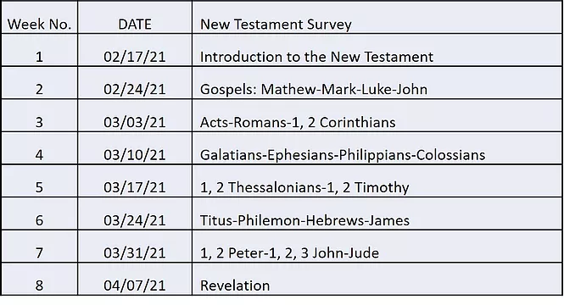

Slide 3

HERMENEUTICS CLASS
Begins: May 5
  Do you have the right Bible?
  Is your Bible the only Bible?
  How to get the most out of your Bible.
  How to keep your Bible study fresh.
Notes:
Hermeneutics Class…May 5
Do you have the right Bible?
Bible translations
Is your Bible the only Bible?
Why some Bibles have more books than others
How you can get the most out of your Bible.
How to use the O-I-A Method for interpreting the Bible
How you can keep your Bible study fresh.
Various ways to read and enjoy God’s Word

Slide 4


Please mute your mic until you are ready to speak. Thanks
…to speak, press and hold the space bar.
Notes:
Thanks for muting yourself…to speak, press and hold the space bar

Slide 5
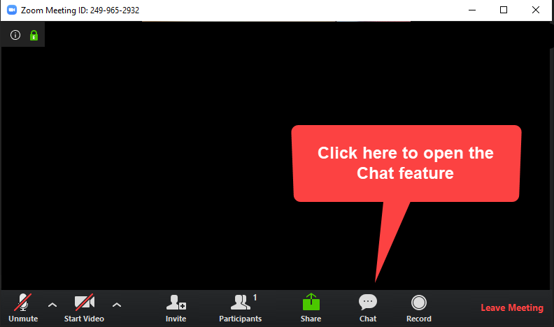
Please sign in each week
George Thompson
Betty White
Warren Willsby
Ed Asner
Sue Thompson
Don Schultz
Please type in your name each week
CHAT BOX
Notes:
Please type in your name each week (credit toward certificate)
Handouts (me)

Slide 6

3-Minute huddle
Have you ever read the book of Revelation?
If so, what was your impression of it?
Notes:
3-Minute huddle
What’s your favorite book in the Bible?

Slide 7

Please take out your notes
TaylorNotes.Info/abt
Notes:
Please take out your notes.

Slide 8

Why is the book of Revelation so confusing?
Notes:
Q: Why is the book of Revelation so confusing?
Next slide →

Slide 9

The beast out of the sea?
Woman clothed with the sun?
The beast out of the earth?
Big red dragon?
144,000?
Seven seals, seven bowls, seven trumpets?
Notes:
REVELATION’S SYMBOLS AND ANIMALS CAN MAKE IT A CONFUSING BOOK
The beast out of the sea?
Woman clothed with the sun?
The beast out of the earth?
Big red dragon?
144,000?
Seven seals, seven bowls, seven trumpets?
It is tempting to read INTO Revelation (eisegete)

Slide 10

Notes:
QUIZ

Slide 11
When experiencing anxieties you should…
Run a marathon
Pig out on chocolate ice cream
Give them to God right away
Go into denial
Deal with them by yourself
Notes:
1 Peter 5:7

Slide 12
To test those claiming godly knowledge you should ask them…
What their political ideologies are
Who Jesus is
To take a written exam
To explain creation
Into your house

Slide 13
Who wrote the book of Jude?
Peter
John
James
Onesimus
Jude

Slide 14
The next ABT class is…?
Hermeneutics: How to Read Greek
Hermeneutics: How to Repair Your Old Car
Hermeneutics: How to Interpret the Bible
Hermeneutics: How to Speak Aramaic
Hermeneutics: How to Appreciate Disco Music

Slide 15
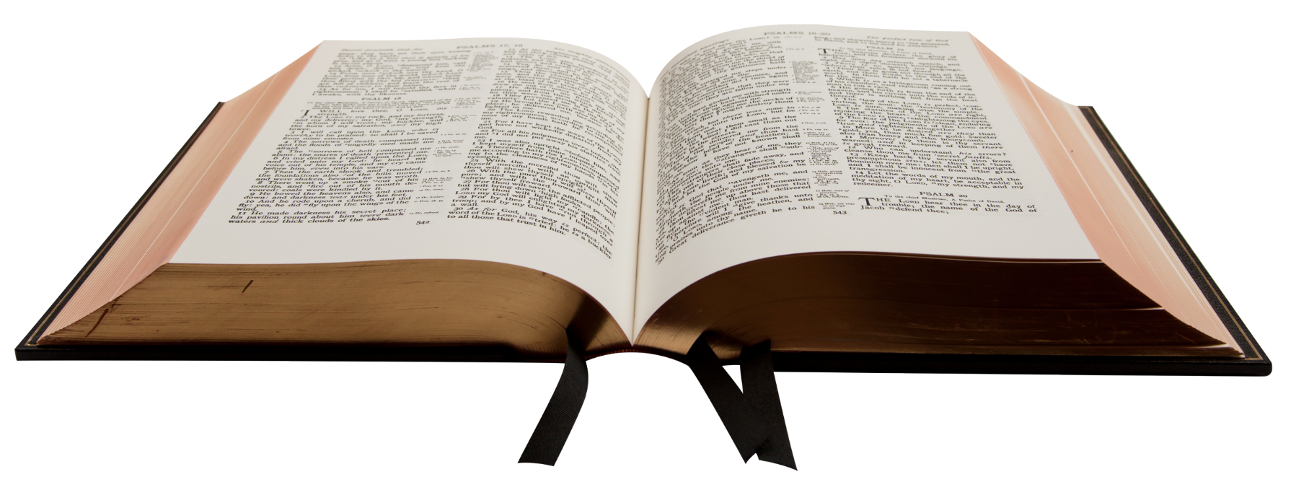
NEW
TESTAMENT GENRES
Gospels (4)
Acts (1)
Paul’s Epistles (13)
General Letters (8)
Apocalyptic (1)
Revelation
Notes:
GENERAL EPISTLES (8)
Revelation (Greek apokalupsis) means “an uncovering,” an “unveiling”, or a “disclosure.”
In the NT, this word describes the unveiling of spiritual truth (Rom. 16:25; Gal. 1:12; Eph. 1:17, 3:3).
The word revelation refers to something or someone, once hidden, becoming visible.
What this book reveals or unveils is Jesus Christ in glory and his return as King of kings.

Slide 16

MAIN POINT
Jesus is coming again to rid the earth of evil and establish his kingdom
Notes:
Main point: Jesus is coming again to rid the earth of evil and establish his kingdom

Slide 17

TONIGHT
How Revelation is structured (organized)
Brief description of Revelation
Six ways Revelation can be viewed
Eight principles for interpreting Revelation
Notes:
TONIGHT
How Revelation is structured (organized)
Brief description of Revelation
Six ways Revelation can be viewed
Eight principles for interpreting Revelation

Slide 18

SETTING
Notes:
SETTING
This is not actually John ☺
About 90 AD, ~60 years after Jesus’ resurrection.
Apostle, John (in his late 80s, early 90s) probably last living Apostle
Banished to Patmos a remote island in the Mediterranean Sea by Roman authorities for preaching the good news of Jesus Christ (1:9).
While on Patmos, John received a series of visions from God that laid out the future history of the world.
When John was arrested, he was in Ephesus, ministering to the church there and in the surrounding cities.
John the Apostle was the son of Zebedee and the younger brother of James, son of Zebedee (James the Greater).
According to Church tradition, their mother was Salome.
Also according to some traditions, Salome was the sister of Mary, Jesus' mother, making Salome Jesus' aunt, and her sons John the Apostle and James were Jesus' cousins.

Slide 19
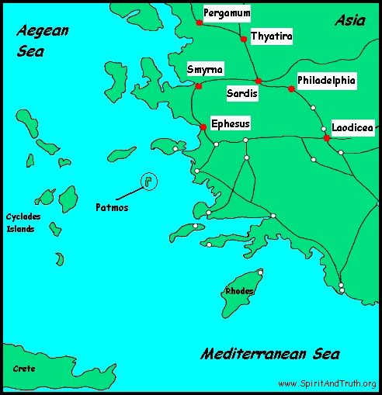
Notes:
Written to the Seven Churches were located in modern-day Turkey (Asia Minor)
What do you notice about the sequence?
Ephesus (2:1-7)
Smyrna (2:8-11)
Pergamum (2:12-17)
Thyatira (2:18-29)
Sardis (3:1-6)
Philadelphia (3:7-13)
Laodicea (3:14-22)

Slide 20
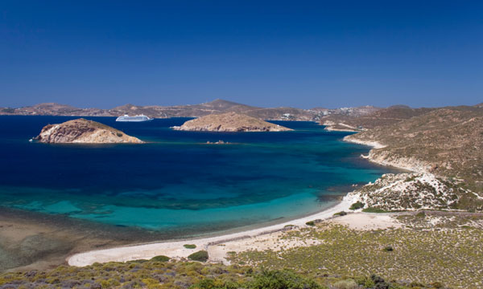
Notes:
PATMOS
Patmos is a small rocky island in the Aegean Sea about 50 miles offshore from the city of Ephesus
10 x 6 miles
Criminals were banished there
Forced to work at hard labor in the mines and quarries
John probably suffered from harsh treatment
Tradition → He was there for 1 ½ years
Rocky and almost treeless with many volcanic hills rising as high as 900 feet
John probably lived in a cave
It was here that God gave John the revelation of Jesus Christ to reveal the things that must soon take place.” Rev 1:1 (ESV)
Today, the island is known as Patino.
Population today about 3,000

Slide 21
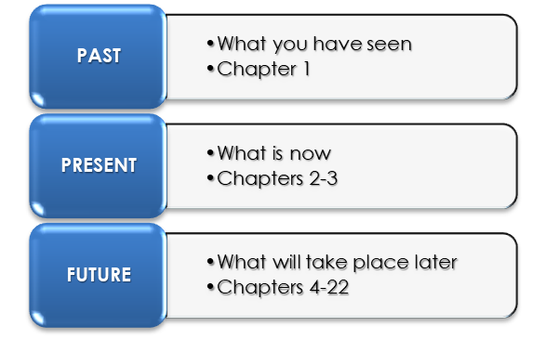
Structure of Revelation
John sees the glorified Jesus Christ
Notes:
John’s now, not our “now”
John sees the glorified Jesus Christ
"I, John, your brother and companion in the suffering and kingdom and patient endurance that are ours in Jesus, was on the island of Patmos because of the word of God and the testimony of Jesus. 10 On the Lord's Day I was in the Spirit, and I heard behind me a loud voice like a trumpet, 11 which said: "Write on a scroll what you see and send it to the seven churches: to Ephesus, Smyrna, Pergamum, Thyatira, Sardis, Philadelphia and Laodicea."
12 I turned around to see the voice that was speaking to me. And when I turned I saw seven golden lampstands, 13 and among the lampstands was someone like a son of man, dressed in a robe reaching down to his feet and with a golden sash around his chest. 14 The hair on his head was white like wool, as white as snow, and his eyes were like blazing fire. 15 His feet were like bronze glowing in a furnace, and his voice was like the sound of rushing waters. 16 In his right hand he held seven stars, and coming out of his mouth was a sharp, double-edged sword. His face was like the sun shining in all its brilliance. 17 When I saw him, I fell at his feet as though dead. Then he placed his right hand on me and said: "Do not be afraid. I am the First and the Last. 18 I am the Living One; I was dead, and now look, I am alive for ever and ever! And I hold the keys of death and Hades.
19 "Write, therefore, what you have seen, what is now and what will take place later." (Rev. 1:9-19 NIV)

Slide 22
Structure of Revelation
God’s messages to the seven churches in John’s day
Notes:
John’s now, not our “now”

Slide 23
Structure of Revelation
The return of Jesus Christ
Notes:
The great Tribulation Period (6-19) followed by the return of Jesus Christ

Slide 24
A description of Jesus Christ at his second coming
BRIEF DESCRIPTION OF THE BOOK
The reader will be blessed
Jesus’ victory over Satan, and his future physical reign on earth
Notes:
BRIEF DESCRIPTION OF THE BOOK
Revelation discloses the full glory, character, and deity of Jesus Christ (1:1), and his second coming (1:7).
1st Coming: Lamb
2nd Coming Lion
This book promises a blessing to whoever reads it and takes it to heart (1:3).
“Blessed” (Gr. makarios) means fortunate, to happy because of one’s circumstances.
The word also has the implication of being free from daily cares and worries.
The blessing includes knowing that your future as a believer is secured!
This book describes Christ’s complete and eternal victory over Satan and his future physical reign on the earth.
It tells more about Satan’s final doom than any other book in the Bible.
Someday a world without evil! Think about that.

Slide 25
CHURCH IN HEAVEN
(Rev. 4-5; 19:1-10)
REVELATION
Jesus’ 2nd Coming
(Rev. 19:11-21)
RAPTURE
(1 Thess. 4)
CHURCH ON EARTH
TRIBULATION ON EARTH
MILLENNIAL KINGDOM
FINAL REBELLION & JUDGMENT
ETERNAL STATE
(Rev. 1-3)
(Rev. 6-18)
(Rev. 20:1-6)
(Rev. 20:7-15)
(Rev. 21-22)
The figure is adapted from Paul Benware, Understanding End Times Prophecy (Chicago, Moody, 2006), 201 as referenced in John MacArthur’s, Because the Time is Near (Chicago, Moody, 2007), 16.
Notes:
CHART
The sequence of events as presented in Revelation.
Pre-Trib. View shown (Paul Benware)

Slide 26
“Bookends” of the Bible
GENESIS | REVELATION
Rise of Satan (Gen. 3:1-6) | Demise of Satan (Rev. 20:10)
Satan’s judgment pronounced (Gen. 3:15) | Satan’s judgment performed (Rev. 20:2)
Presence of God removed (Gen. 3:24) | Presence of God restored (Rev. 21:3)
The curse received (Gen. 3:17-19) | The curse removed (Rev. 22:3)
Death enters natural creation (Gen. 3:19) | Death excluded from new creation (Rev. 20:14; 21:4)
God’s face hidden (Gen. 4:14) | God’s face revealed (Rev.22:4)
Notes:
Bookends of the Bible.
Ref: H. Wayne House, “Charts of Bible Prophecy,”( Grand Rapids: Zondervan, 2003), p. 147

Slide 27

SIX BASIC INTERPRETIVE APPROACHES
REVELATION
Notes:
Approaches…like looking through a filter.

Slide 28

INTERPRETIVE CHALLENGES
Critical Approach
1
Revelation is not God-inspired. It is only a made-up human story.
Notes:
Critical Approach:
Denies either the inspiration or canonicity of the Book of Revelation and sees the writing as a purely human composition based on the historical situation at the end of the first century A.D.
This view must be rejected completely by all who hold unreservedly to the inspiration and canonicity of Revelation.

Slide 29
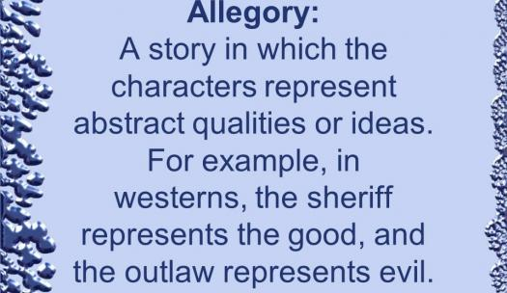
INTERPRETIVE CHALLENGES
Allegorical Approach
2
The characters and events in Revelation only represent ideas
Notes:
2) Allegorical Approach
Allegory: A story in which the characters represent abstract qualities or ideas.
The allegorical approach to the book denies the literal reality behind the descriptions of the narrated events, and takes the accounts to be solely allegories, parables, and metaphors which contain messages of spiritual encouragement.
For example: in westerns, the sheriff represents the good, and the outlaw represents evil.
In Revelation Satan is not a real character but only represents evil and Jesus is not a real person but only represents good.
This view is contradicted by the very first verse of the Revelation which states its purpose.

Slide 30
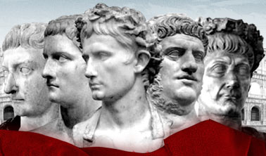
INTERPRETIVE CHALLENGES
Preterist Approach
3
Revelation is describing 1st Century events in the Roman Empire
Notes:
3) PRETERIST APPROACH
Preterist: one who holds that the prophecies in the Bible about the End Times have already been fulfilled.
The term preterism comes from the Latin praeter, meaning “past.”
Preterist Approach: Revelation is secretly describing 1st Century events in the Roman Empire.
Problem: This views conflicts with its own often-repeated claim to be prophecy 1:3; 22:7, 10, 18, 19)

Slide 31
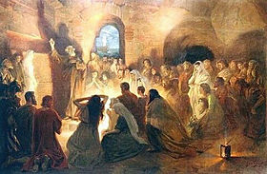
INTERPRETIVE CHALLENGES
Historical Approach
4
Revelation is describing church history from apostolic times to the present
Notes:
4) Historical Approach: Revelation is describing church history from apostolic times to the present.
The seven churches in Revelation 2–3 are symbolic of seven ages of church history
Church at Ephesus → the early church AD 31-100
Church at Smyrna → suffering church AD 100-313
Church at Pergamum → loyal church AD 313-528
Church at Thyatira → tolerating church AD 528-1350
Church at Sardis → spiritually dead church AD 1350-1740
Church at Philadelphia → loving church AD 1740-1844
Church at Laodicea → modern day lukewarm church AD 1844-present
The seals in chapters 4—7 represent the decline and fall of the Roman Empire.
The “little scroll” given to John in chapter 10 is a picture of the Protestant Reformation.
The beasts of chapters 12 and 13 represent Catholicism and the papacy.
Other passages in Revelation are linked to the invasion of the Huns, the spread of Islam, and the rise of the modern missionary movement.
Problem
This view robs Revelation of any meaning for those to whom it was written.
It also has major weaknesses lining up its events to actual historical events.

Slide 32
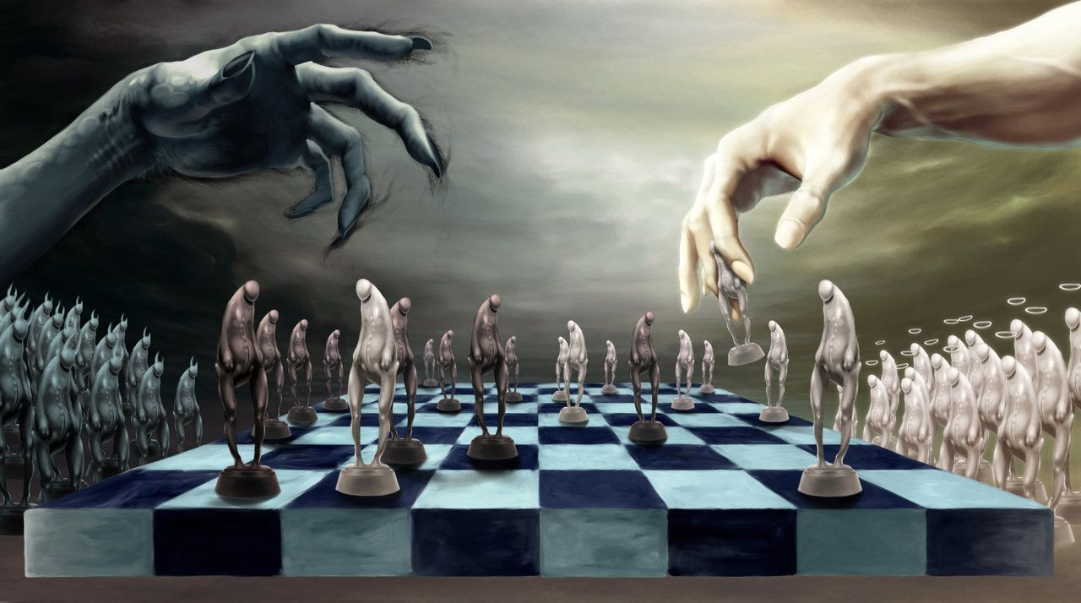
INTERPRETIVE CHALLENGES
Idealist Approach
5
Revelation is describing the cosmic struggles between the forces of good and evil
Notes:
5) Idealist Approach:
This view interprets Revelation as a timeless depiction of the cosmic struggle between the forces of good and evil.
It ignores Revelation’s prophetic character and, if carried to its logical conclusion, severs the book from any connection with actual historical events.
Revelation then becomes merely a collection of stories designed to teach spiritual truth.
Problems:
This view contains neither historical allusions nor predictive prophecy.
This view ignores Revelation’s prophetic character
This view simply becomes a collection of stories designed to teach spiritual truth

Slide 33

INTERPRETIVE CHALLENGES
Futurist Approach
6
Revelation Chapters 6-22 are yet in the future
Notes:
6) Futurist Approach:
This approach insists that the events of chapters 6-22 are yet future, and that those chapters literally and symbolically depict actual people and events yet to appear on the world scene.
It describes the events surrounding:
the Second Coming of Jesus Christ (Chapters 6-19)
the Millennium and final judgment (Chapter 20)
and the eternal state (Chapters 21, 22).
This view has the most reasons for acceptance and is the approach taken in this study.

Slide 34


Basic Principles for Interpreting Revelation
Notes:
8 BASIC PRINCIPLES for INTERPRETING REVELATION

Slide 35
John used
METAPHORS
to describe things beyond human comprehension
1
Notes:
Principle No. 1:
Whenever John saw things in the heavenly realm that were beyond human comprehension, he used metaphors to describe what he saw.
Metaphors are usually identified as similes, words such as “like,” or “as” (Rev. 1:13-16; 8:8; 9:7; 10:1; 13:2, 11).

Slide 36
2
  Be careful about forcing a meaning into a metaphor that isn’t there.
Notes:
Principle No. 2:
Be careful about forcing a meaning into a metaphor that isn’t there.
Remember, for now we see these things dimly (1 Cor. 13:12).

Slide 37
3
Always approach a prophecy as literal (in its usual, ordinary meaning)
Notes:
Principle No. 3:
Always approach a prophecy as literal (in its usual, ordinary meaning) unless one of the following occurs:
The grammatical context shows that it is figurative language by the use of similes, metaphors, parables, allegories, symbols, or types.
A literal interpretation violates common sense (i.e., it is contrary to what John is saying, or is contrary to what the rest of Scripture teaches).

Slide 38
4
When interpreting figurative or symbolic language in Revelation look for meanings in context
Notes:
Principle No. 4:
When interpreting figurative or symbolic language in Revelation look for meanings:
Within the surrounding context of the book in which the passage appears
In any other writings of John
In any other prophetic writings to which the John had access

Slide 39
5
When John refers to future events, he does not always use the future tense
Notes:
Principle No. 5
When John refers to future events, he does not always use the future tense.
"But the beast was captured, and with it the false prophet who had performed the signs on its behalf. With these signs he had deluded those who had received the mark of the beast and worshiped its image. The two of them were (not will be) thrown alive into the fiery lake of burning sulfur." (Rev. 19:20 NIV)

Slide 40
6
Consider the historical context of Revelation
Notes:
Principle No. 6:
Consider the historical context of Revelation, remembering that God was delivering his prophecy to a particular people at a particular time.
Example: "Then I saw in the right hand of him who sat on the throne a scroll with writing on both sides and sealed with seven seals." (Rev. 5:1 NIV).
Scrolls in the ANE were often used to describe a person’s ownings, especially when forfeited.

Slide 41
7
Events in Revelation are not always disclosed in chronological order
Notes:
Principle No. 7:
Events in Revelation are not always disclosed in chronological order, and not all Bible scholars agree to the exact order of events.
"And I will appoint my two witnesses, and they will prophesy for 1,260 days, clothed in sackcloth."" (Rev. 11:3 NIV)
When does this occur?

Slide 42
8
The book of Revelation is about Jesus, so keep your eye on the ball
Notes:
Principle No. 8:
The book of Revelation is about Jesus, so keep your eye on the ball (Jesus, and what he does), not just on the symbols and metaphors.
The three important questions to ask when reading the book of Revelation are:
What is Jesus doing?
He is ridding the earth of evil
Why is he doing it
Because he is about to return as the Sovereign King
What does this tell me about Jesus?
He is establishing his eternal physical kingdom

Slide 43

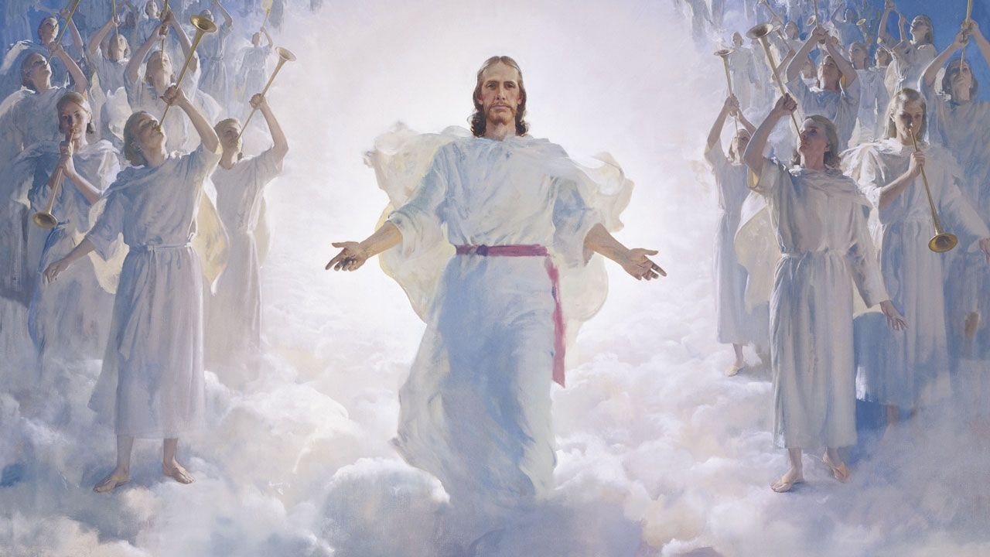
"Behold, I am coming soon!“
Rev. 21:7
Notes:
"Behold, I am coming soon! Blessed is he who keeps the words of the prophecy in this book.“ Rev. 21:7

Slide 44

You have completed the New Testament Survey

Slide 45


HERMENEUTICS CLASS
May 5, 6:30 pm
Online
Four Weeks
Notes:
Mark your calendar
Invitations will be sent to you automatically

Slide 46

Ron Eddow

