Slide 1

OLD TESTAMENT SURVEY
Notes:
ABT Program (title) →

Slide 2
TONIGHT
Welcome
Part 7: The Exile & Restoration Periods
Prayer & Praise
Close

Slide 3

Thanks for muting yourself…to speak, press and hold the space bar.
Notes:
Thanks for muting yourself…to speak, press and hold the space bar

Slide 4

Feel free to post
comments
prayer requests
Questions
ABT Certificate attendance
Notes:
CHAT: Feel free to post comments, etc., here.
Prayer requests?
Questions?

Slide 5

Old Testament Survey Notes
https://www.taylornotes.info/abt

Slide 6
Congratulations!
Maicey Madden
Debra West
You have completed your ABT Certificate requirements!
Notes:
CONGRATULATIONS
Maicey Madden & Debra West… You have completed your ABT Certificate requirements!

Slide 7
ABT Program
Earn your ABT Certificate
…or just monitor the class for personal enrichment

Slide 8

How to earn an ABT Certificate
Attend 75% of classes in each course
Notes:
EARN YOUR ABT CERTIFICATE
[CLICK]
Attend 75% of classes in each course.
Must complete all six courses

Slide 9
If you want attendance credit for this class, type your name in the chat box each week.
Notes:
If you want attendance credit toward your ABT Certificate, type your name in the chat box.

Slide 10
ABT Courses
No. | Course | Duration
TLC 601 | Old Testament Survey | 9 Weeks
TLC 602 | New Testament Survey | 8 Weeks
TLC 603 | Hermeneutics | 4 Weeks
TLC 604 | Christianity I | 8 Weeks
TLC 605 | Christianity II | 8 Weeks
TLC 606 | Roots: Church History | 4 Weeks
Notes:
No prerequisites…take in any order.

Slide 11
Check your course completions at: www.TaylorNotes.Info
Old Testament Survey
New Testament Survey
Hermeneutics
Christianity I
Christianity II
Roots: Church History
Advanced Bible & Theology
Notes:
Course completion at www.taylornotes.info (“Local Classes” page)

Slide 12
INTRODUCTION
OLD TESTAMENT SURVEY

Slide 13

So, why is the Old Testament in the Bible?
Notes:
Why is the OT in the Bible?
Have you ever asked yourself why the Old Testament is in the Bible since we have the New Testament?
Does the Old Testament apply today or is it simply a history of Israel?
Another question is should Christians today obey all 613 Mosaic Laws?
Did Adam have a belly button?
These questions and many others will be addressed in this study guide.
Q: Ever get lost in the OT so go back to NT?

Slide 14

If the Old Testament has been superseded by the New Testament, why should we read it?
Notes:
If the Old Testament has been superseded by the New Testament, why should we read it?

Slide 15


It’s confusing!
Reubenites
Beth Horon
Gadites
Zerahites
Zimri
Perizzites
Hittites, Amorites,
Canaanites, Hivites, Cellulites
Termites
Notes:
Genesis 15:18-21
To your descendants I give this land, from the river of Egypt to the great river, the Euphrates-- 19 the land of the Kenites, Kenizzites, Kadmonites, 20 Hittites, Perizzites, Rephaites, 21 Amorites, Canaanites, Girgashites and Jebusites."
Exodus 5:15-19
“The sons of Simeon were Jemuel, Jamin, Ohad, Jakin, Zohar and Shaul the son of a Canaanite woman. These were the clans of Simeon. These were the names of the sons of Levi according to their records: Gershon, Kohath and Merari. Levi lived 137 years. The sons of Gershon, by clans, were Libni and Shimei. The sons of Kohath were Amram, Izhar, Hebron and Uzziel. Kohath lived 133 years. The sons of Merari were Mahli and Mushi. These were the clans of Levi according to their records.”

Slide 16
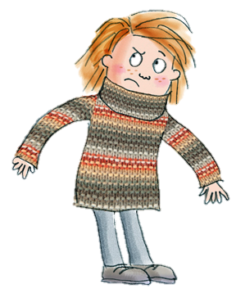
“Do not wear clothes of wool and linen woven together” (Deut. 22:11)
Notes:
“Do not wear clothes of wool and linen woven together” (Deut. 22:11)
Its in the Bible…should we obey this OT Law?

Slide 17
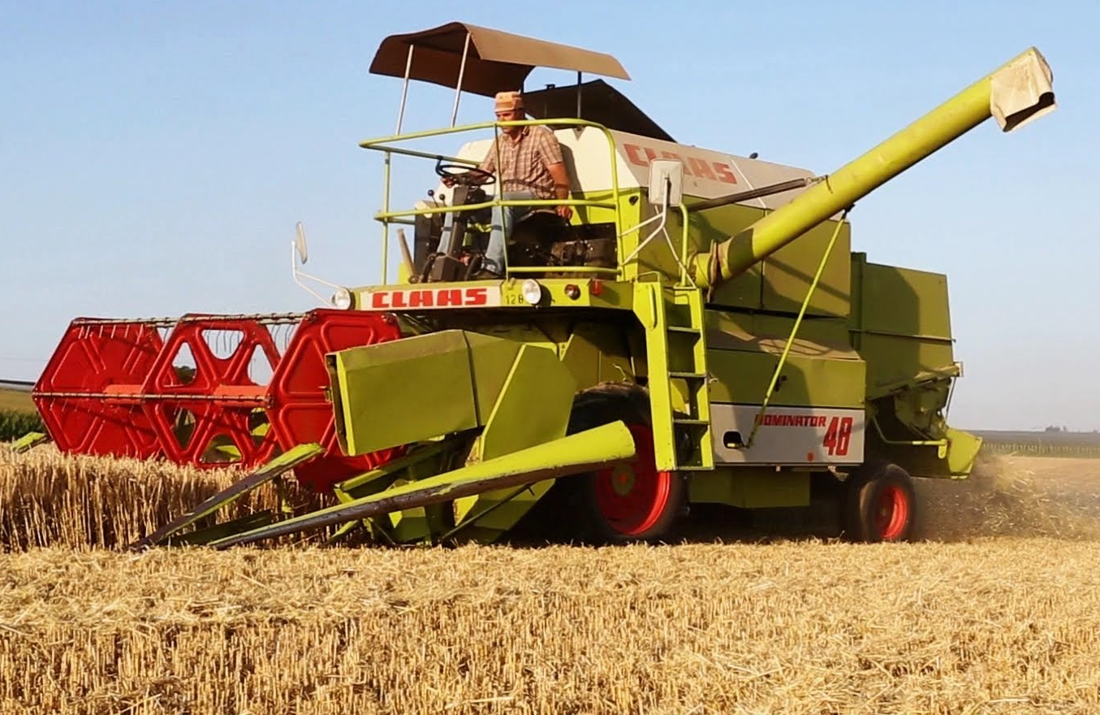
“When you are harvesting in your field and you overlook a sheaf, do not go back to get it” (Deut. 24:19)
Notes:
“When you are harvesting in your field and you overlook a sheaf, do not go back to get it” (Deut. 24:19)
Obey it?

Slide 18

“Do not have two differing measures in your house-- one large, one small” (Deut. 25:14)
Notes:
“Do not have two differing measures in your house-- one large, one small” (Deut. 25:14)

Slide 19
Seven Great Reasons to Study the Old Testament
Notes:
TITLE: Seven Great Reasons to Study the Old Testament

Slide 20
Seven Great Reasons to Study the Old Testament
1
The Bible is incomplete without the Old Testament.
Notes:
Seven Great Reasons to Study the Old Testament
1. The Bible is incomplete without the Old Testament
Creation?
Where did sin come from?
Why did Jesus have to die?

Slide 21
Seven Great Reasons to Study the Old Testament
2
The Old Testament presents great truths about humanity.
Notes:
Seven Great Reasons to Study the Old Testament
2. The Old Testament presents great truths about humanity.
Why we need a Savior
How humans can live the best life possible (Proverbs)
With so much misinformation today, people do not know what is true and what is not true (“fake news””)
The Bible is TRUTH, including the OT!

Slide 22
Seven Great Reasons to Study the Old Testament
The Old Testament provides the historical setting out of which Christianity and the New Testament emerged.
3
Notes:
Seven Great Reasons to Study the Old Testament
3. The Old Testament provides the historical setting out of which Christianity and the New Testament emerged.
The detailed prophecies of the Messiah and the Gospels

Slide 23
Seven Great Reasons to Study the Old Testament
4
The Old Testament instructs believers concerning the person and work of Jesus, the promised Messiah.
Notes:
Seven Great Reasons to Study the Old Testament
4. The Old Testament instructs believers concerning the person and work of Jesus, the promised Messiah.
How he would give himself as a ransom and die so believers may live eternally.
How to respond to him as the Messiah.
Over 300 prophecies describing the Messiah so there would be no confusion about who he is…only Jesus fulfilled these prophecies.

Slide 24
Seven Great Reasons to Study the Old Testament
The Old Testament presents spiritual truths and lessons that are applicable for Christians.
5
Notes:
Seven Great Reasons to Study the Old Testament
5. The Old Testament presents spiritual truths (guidance) and lessons that are applicable for Christians.
Christian ethics (right/wrong).
How to confront dangerous temptations (example: Joseph)
How to respond to a crisis (Daniel).
How to respond to man’s laws which contradict God’s laws (Shadrach, Meshack, Abednego).
How to recognize Satan’s tactics (Garden of Eden)

Slide 25
Seven Great Reasons to Study the Old Testament
6
The Old Testament lays the foundation for biblical prophecy.
Notes:
Seven Great Reasons to Study the Old Testament
6. The Old Testament lays the foundation for biblical prophecy.
The great human kingdoms which will be replaced someday by God’s Kingdom.
Prophecies about future events (1st and 2nd Comings of Jesus Christ, Tribulation)
By seeing how OT prophecies have come true…we gain confidence in OT.

Slide 26
Seven Great Reasons to Study the Old Testament
7
The Old Testament is
“God-breathed and profitable”
(2 Tim. 3:16)
Notes:
Seven Great Reasons to Study the Old Testament
7. The Old Testament is “God-breathed and profitable” (2 Tim. 3:16)
"All Scripture is God-breathed and is useful for teaching, rebuking, correcting and training in righteousness," (2 Tim. 3:16 NIV)
Q: God-breathed? = inspired by God.

Slide 27
How the OT Helps us Today
New Testament
OLD
TESTAMENT
Mosaic
Law
Transferable Principles
Our Practice
Notes:
TRANSFERABLE PRINCIPLES WHICH CAN BE USED TO GIVE US PRACTICES (BEHAVIOR) TODAY.
EXAMPLES:
OT: Do not reap the edges of your field but leave them for the poor (Lev. 19:9).
Transferable Principle: Take a portion of your income and give it to the Lord’s work which is to include caring for the poor (Matt. 19:21. Luke 14:13; 19:8; John 13:29; 2 Cor. 9:7-9; Gal. 2:8).
OT: Don’t cut the hair at the sides of your head or clip off the edges of your beard (Lev. 19:27).
Cultural Setting: Pagans would cut off part of their beards and offer them to their gods.
Transferable Principle: Keep your personal appearance from being associated with pagan practices or groups (e.g. wearing insignias such as swastikas—white supremacists).

Slide 28
How the OT Helps us Today
New Testament
OLD
TESTAMENT
Mosaic
Law
Transferable Principles
Our Practice
Need for Redeemer
Messiah Foretold
The Messiah Revealed
Notes:
Need for a Redeemer
Man’s first sin in Garden of Eden shows he needs a Savior.
Genesis 3:15 “And I will put enmity between you (Satan) and the woman, and between your offspring {15 Or seed} and hers; he (Redeemer/Messiah) will crush {15 Or strike} your head, and you will strike his heel."
No human is capable of living a sinless life.
Man needs a sinless human to take God’s wrath for sin – man needs a Redeemer
Hebrews 4:15-16 For we do not have a high priest who is unable to sympathize with our weaknesses, but we have one who has been tempted in every way, just as we are-- yet was without sin. Let us then approach the throne of grace with confidence, so that we may receive mercy and find grace to help us in our time of need.

Slide 29
How the OT Helps us Today
New Testament
OLD
TESTAMENT
Mosaic
Law
Transferable Principles
Our Practice
Need for Redeemer
Messiah Foretold
The Messiah Revealed
Prophecies
Unfulfilled Prophecies
Our Future
Notes:
Prophecies/Unfulfilled Prophecies → Our Future
Jesus’ 1st and 2nd Coming, how God will ultimately bring his Kingdom which will last forever.

Slide 30

The purpose of this study
Overview of the Old Testament
Ten major periods
Instill greater interest in the OT
OT a foundation to the NT
Deepen your understanding of God
Notes:
PURPOSE OF THIS STUDY
Overview of the Old Testament
Ten major periods
Instill greater interest in the OT
OT a foundation to the NT
Deepen your understanding of God

Slide 31
Ten Major Periods of the OT
1
2
3
4
5
Antediluvian Period
Post-Flood Period
Period of the Patriarchs
Wilderness Period
Conquest of the Promised Land
6
7
8
9
10
Period of Judges
United Monarchy Period
Divided Kingdom Period
Exile Period
The Restoration

Slide 32
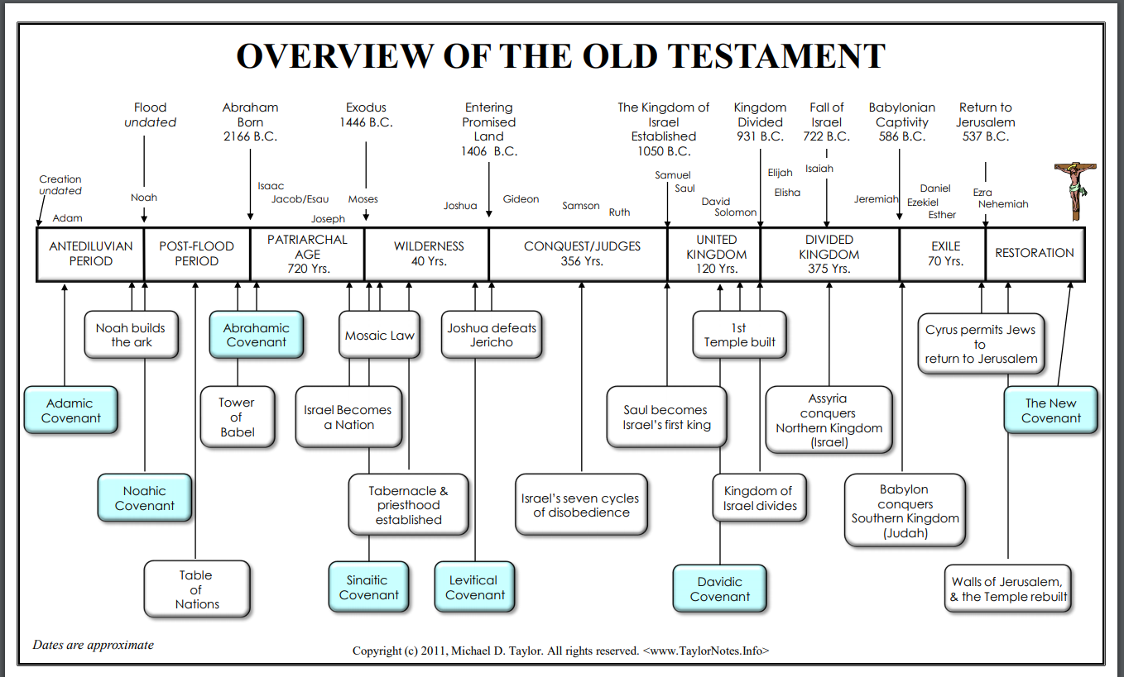
Notes:
Chart

Slide 33

OLD TESTAMENT OVERVIEW CHART
Download from www.TaylorNotes.Info
Notes:
[CLICK] Download from TaylorNotes.info

Slide 34
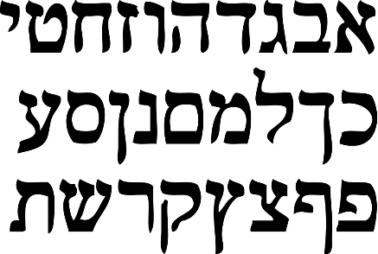
Original Languages of the OT
Hebrew
Aramaic
Notes:
Original Languages
Hebrew
Cognate: Aramaic (Ezra 4:8—6:18; 7:12-26; Daniel 2:4—7:28)

Slide 35
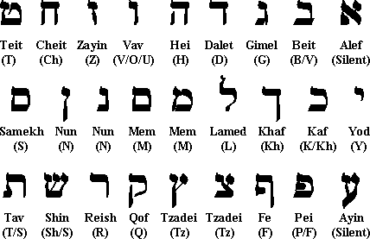
Notes:
Hebrew alphabet
Right to left
23 consonants or letters
some have final forms that look different, others have a second pronunciation)
Original sounds have been lost
Masoretes (Jewish scribes and scholars) created the vowel pointing signs (A.D. 500—950)
TURN TO PSALM 119…do you notice anything unusual about it?

Slide 36
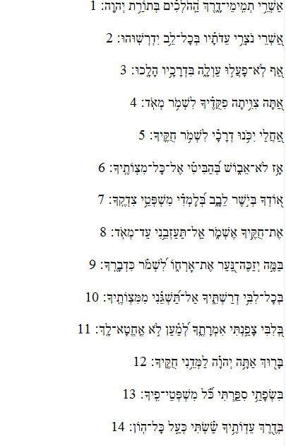
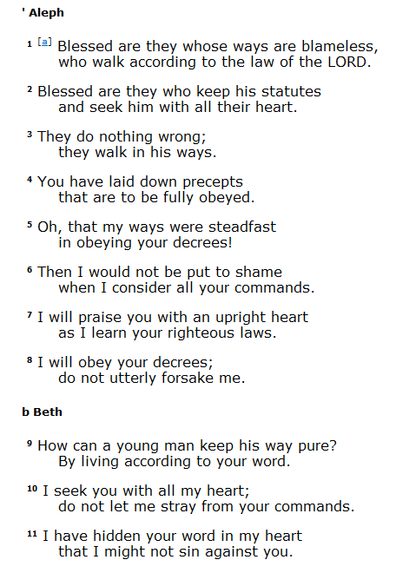
PSALM 119
Notes:
PSALM 119
Longest chapter in the Bible
Its an alphabetical acrostic→8 lines per letter
176 verses
Has more verses than 13 Old Testament Books and 16 New Testament Books
Author: unknown, possibly Ezra the Scribe.

Slide 37
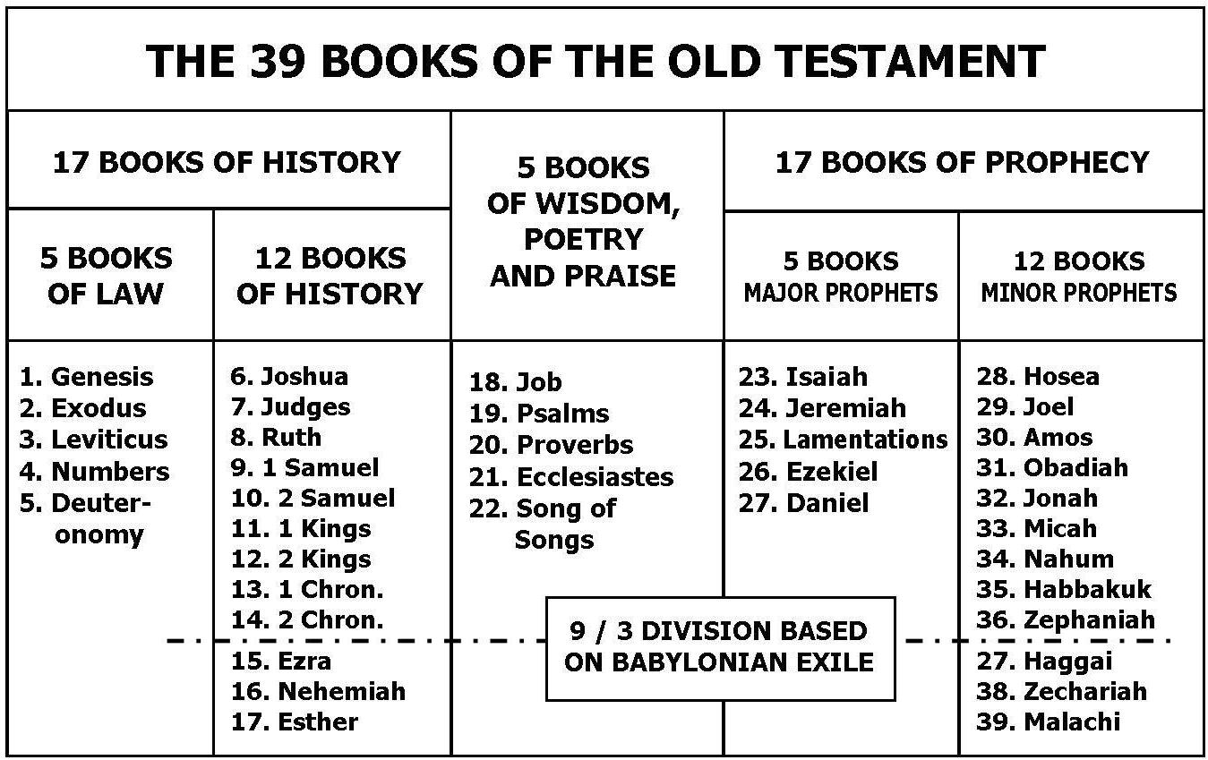
Notes:
OT 5 BOOK GROUPS (GENRES)
Pentateuch (5): From creation to the origin of the nation of Israel to entering the land promised to Abraham’s descendants.
Historical books (12): Children of Israel conquering the promised land, narratives about the kings of Israel, and the nation of Israel return to its land after 70 years of living in Babylon (Iraq).
Poetic Books (5): Beautifully written books of praise and wisdom and genuine human love written in Hebrew poetic form. Over 40% of OT is poetry.
Prophets (17):
5 Major Prophets
12 Minor Prophets
Major & Minor Prophets → God’s dealing with Israel when they break the Mosaic Covenant and his love for them by promising a future golden age.
37

Slide 38
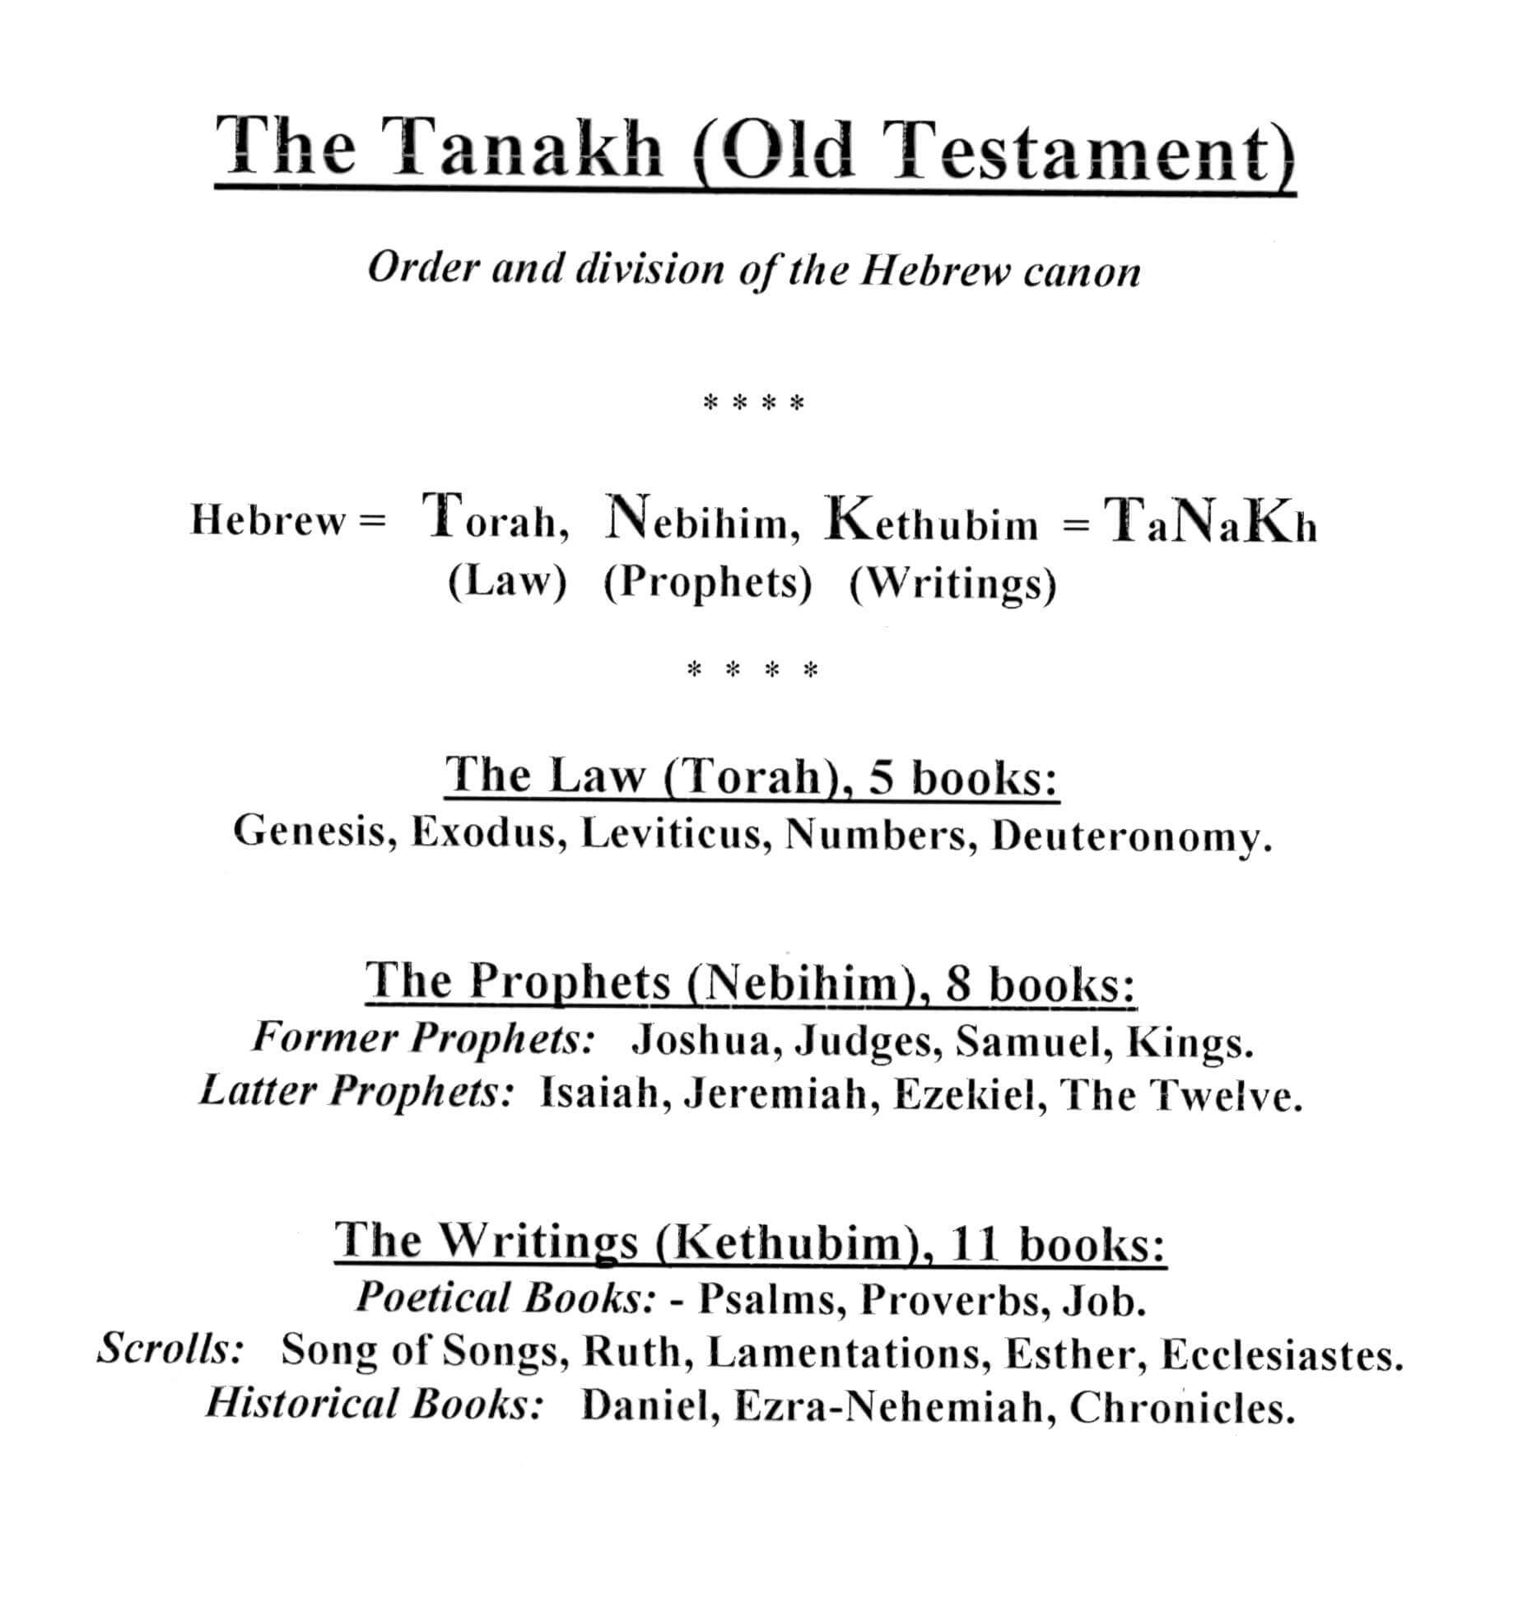
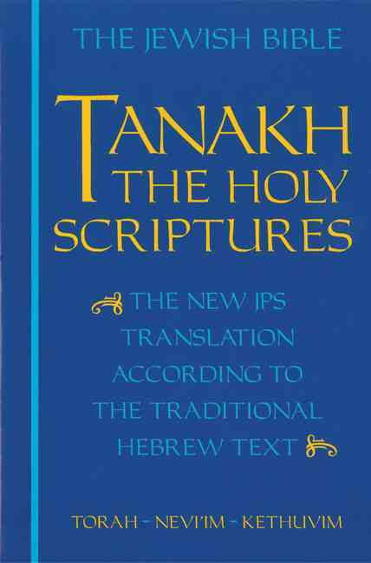
The Jewish Bible (Tanakh) has the same OT books just arranged differently (“old” is somewhat offensive)
1
2
3
Notes:
The Jewish Bible (Tanakh) has the same OT books just arranged differently (“old” is somewhat offensive)
“Old” is somewhat offensive to a Jew
TANAK = Torah + Nevihim + Kethuvim = 24 books
Note groupings of Samuel, Kings, The Twelve, Ezra-Nehemiah, and Chronicles
Turn to Matt. 5:17
"Do not think that I have come to abolish the Law or the Prophets; I have not come to abolish them but to fulfill them. (Matt. 5:17 NIV) → OT
“Law and the Prophets” is referring to OT
NOTE ABOUT SEPTUAGINT
The Hebrew Bible, also called the Tanakh, has three parts: the Torah (law), the Nevi'im (prophets), and the Ketuvim (writings).
The Septuagint has four parts:
law,
history,
Poetry
and prophets.
The books of the Apocrypha were inserted at appropriate locations

Slide 39

At the end of this class you will…
Have a solid grasp of the OT
See the OT in ten major periods
Understand many OT terms
Know how the OT applies today
Have a greater appetite for the OT
Look more spiritual than other people
Notes:
At the end of this class you will…
Have a solid grasp of the OT
See the OT in ten major periods
Understand many OT terms
Know how the OT applies today
Have a greater appetite for the OT
Look more spiritual than other people

Slide 40
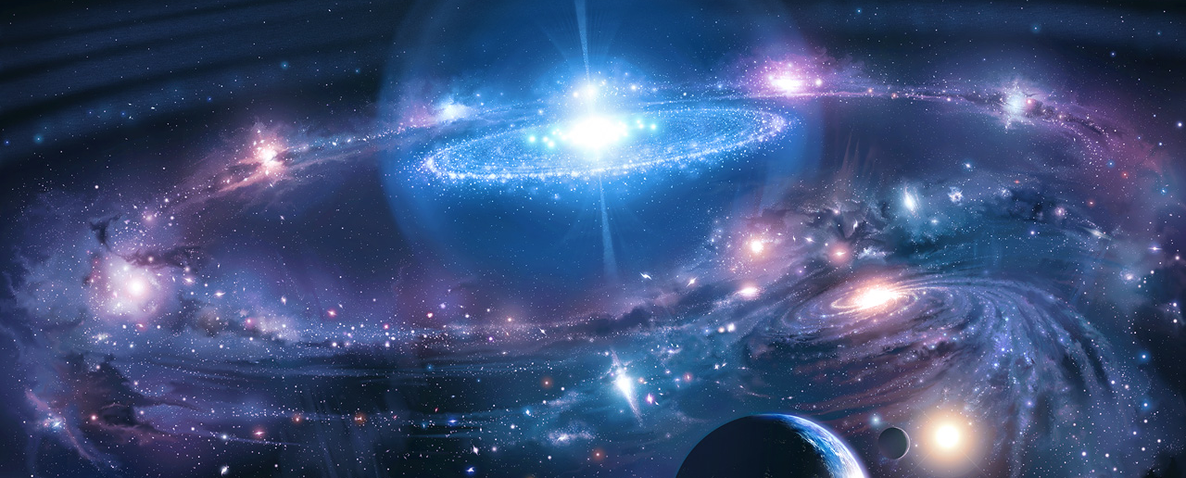
Part 1: CREATION, WHY DID GOD DO IT?
Notes:
TONIGHT Part 1: CREATION, WHY DID GOD DO IT?
I. GOD THE CREATOR
WHAT GOD CREATED
WHY GOD CREATED
HOW GOD CREATED
WHEN GOD CREATED
II. Man’s designated response to the Creator
Man Designated to be God’s representative
Man is Designated to Obey God
III. MAN”S ACTUAL RESPONSE TO THE CREATOR
Man’s Vulnerability: Pride
Man Chose to Disobey the Creator
Exposing Satan’s Four strategies
Exposing Satan’s Three Tactics
The Impacts of Sin Exposed
God’s Response to Sin
IV. SUMMARY

Slide 41
QUICK LOOK AT THE Period
CREATION
THE FALL
CONDITIONS BEFORE THE FLOOD
Notes:
QUICK LOOK AT THE PERIOD
Antediluvian means “before the flood”
The period covers the time from the creation to just before the flood
1) CREATION
Theories
When? (Old vs. new)
Created in God’s image
2) THE FALL (THE FIRST SIN)
Satan’s strategies
Stages of sin
3) CONDITIONS BEFORE FLOOD
The depravity of man
Covered in Period 2 in more detail

Slide 42
I. God the Creator

Slide 43

“Creation just happened…there is no God!”
Notes:
The skeptic says, “creation just happened…there is no God.”
Q: Why do many people argue against the creation by God?
Let’s look at what God says about this..

Slide 44
What God Created
The entire universe
Notes:
God created the entire universe, and it was very good (Gen. 1:1, 31)
At this point. There was no corruption or death.
Evolution can be ruled out by this assertion since evolution requires decay and death.

Slide 45

What God Created
Time
Notes:
God created time (Gen. 1:5)
Another aspect of God’s creation is the creation of time (the succession of moments one after another).
God is timeless in his own being—he has no beginning or end (Psa. 90:2; Rev. 1:8; cf. 4:8).
God’s timelessness is also revealed in Jesus’ bold use of a present tense verb that implies continuing present existence when he replied to Jewish adversaries, “Before Abraham was, I am” (John 8:58).
Before God created the universe, there was no “time” at least not in the sense of a succession of moments one after another.
When God began to create the universe, time began, and there began to be a succession of moments and events one after another (Grudem).
God operates apart from time and is not controlled by it (Job 36:26; Psa. 90:2, 4; John 8:58; 2 Pet. 3:8; Rev. 1:8)

Slide 46
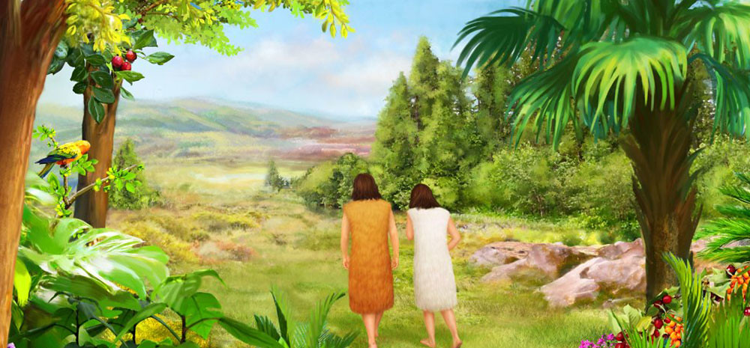
What God Created
Humans
Notes:
God created man (humans) in his image (Gen. 1:26-27; 2:7, 21-23).
Man was created in God’s image. Both the Hebrew word “image” (H. tselem) and “likeness” (H. demuth) means “similar to, but not identical to.”
We are like God morally (Matt. 27:3-5; Rom. 1:18-20)
We are like God spiritually (Rom. 8:16; Gal. 5:18)
We are like God mentally (Mark 12:30; Isa. 1:18)
We are like God relationally (John 14:23; Rev. 3:21)
The Bible reveals that God created Adam and Eve in a very special, personal way—he formed man from the dust of the ground and breathed into his nostril the breath of life so that man became a living being (Gen. 2:7).
After that, God created Eve from Adam’s body (Gen. 2:21-23)
It would, therefore, be very difficult for someone to hold to the complete truthfulness of Scripture and still hold that human beings are the result of a long evolutionary process (Grudem).
When Scripture says that the Lord formed man of dust from the ground it does not seem possible to understand that to mean that he did it over a process that took millions of years and used the random development of thousands of increasingly complex organisms.

Slide 47
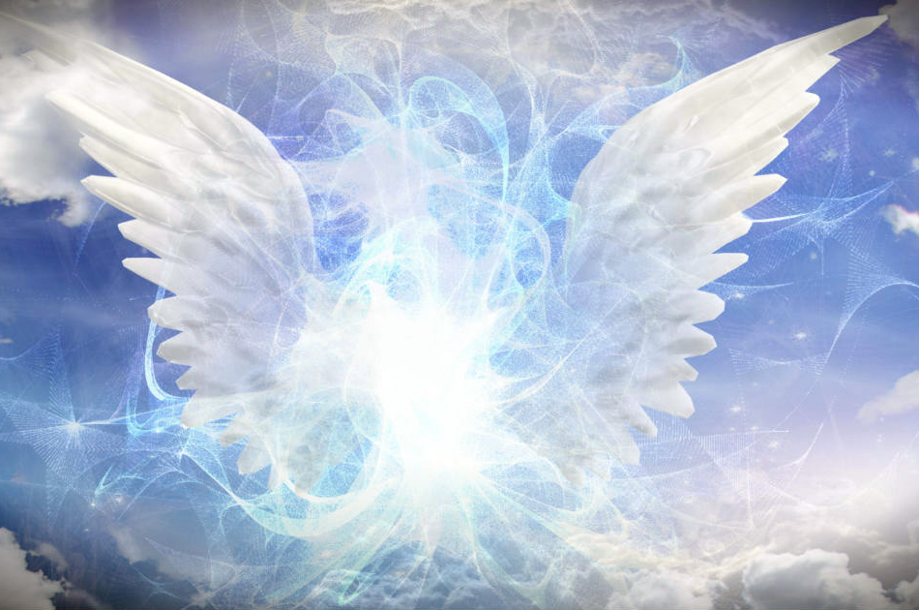
What God Created
Invisible spiritual world
Notes:
God created the invisible spiritual universe.
When God created the entire universe, it included the creation of an unseen, spiritual realm of angels, and other heavenly creatures, as well as animals and man (Rev. 4:6-9; 10:6; cf. Acts 4:24; Neh. 9:6).
Paul points out that in Christ all things were created—both visible and invisible (Col. 1:16).
All religions recognize such a spiritual realm even though their understanding is based on incorrect views—gods, demigods, human-like deities, spirits, souls, etc. (Bavinck)

Slide 48

The really big question is not how God created but WHY he created
Notes:
The really big question is not HOW God created but WHY he created.
Why did God create man?
Read Eph. 1:4-5 → “For he chose us in him before the creation of the world to be holy and blameless in his sight. In love he predestined us for adoption to sonship through Jesus Christ, in accordance with his pleasure and will-- (Eph. 1:4-5 NIV)
Being created for God’s pleasure does not mean humanity was made to entertain God or provide Him with amusement.
God is a creative Being, and it gives Him pleasure to create.
God is a personal Being, and it gives Him pleasure to have other beings He can have a genuine relationship with.
We will understand this more fully when we are in heaven someday, experiencing his goodness (Rev. 21:1-4)
Read more: http://www.gotquestions.org/why-did-God-create-us.html#ixzz3FUyGNSMH

Slide 49

WHY GOD CREATED
To display his glory and goodness
Notes:
Why God created
God did not create because he needed the world but because he delighted in his own will to create and in his act of creating.
God did not need to create, and the universe does not exist for our sake—creation reveals God’s attributes and proclaims his praise (Psa. 8; 19:1; Rom. 1:19; Rev. 4:11).
God brings things into existence in order that his goodness may be communicated and manifested.
The words ‘by thy will they existed and were created’ (Rev. 4:11), cf. ‘created through him, and for him’ (Col. 1:16), indicate the purpose and goal of creation.
God created the entire universe ‘for the manifestation of the glory of his eternal power, wisdom and goodness’ (Westminster Confession).
Creation, in other words, is theocentric, and intended to display the glory of God; to be, as John Calvin says, ‘the theatre of his glory.”

Slide 50

HOW GOD CREATED
He created out of nothing
Notes:
How God created
God created ex nihilo (the Latin phrase meaning “out of nothing”).
The only source of creation is God, he alone can create something from nothing (Augustine).
This has important theological implications, for among other things it precludes the idea that matter is eternal (materialism, atheism).
To say created “out of nothing,” does not mean that “nothing” was some kind of invisible, immaterial something that God used to make the material universe.
Before God began to create the universe, nothing existed except God himself.
The universe was created by the triune God (1 Cor. 8:6; John 1:3; 1 Cor. 8:6; Col. 1:15-17; Heb. 1:10; Gen. 1:2; Job 26:13; 33:4; Ps. 104:30; Isa. 40:12-13).
The phrase “heavens and earth” includes the entire universe, all things (Rev. 4:11)
Man was not created ex nihilo, but out of the dust of the ground (H. adamah Gen. 2:7)
The beasts of the field and the fowls of the air were also formed out of the ground (Gen. 2:19) --this has been called secondary creation (Bavinck)

Slide 51
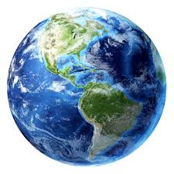
WHEN GOD CREATED
Young earth or old earth?
Young Earth
Old Earth
???
Notes:
When God created
Young earth view: If the book of Genesis is interpreted strictly literally, it seems to indicate that the earth and the universe are around 6,000 years old.
Old earth view: In contrast, various scientific dating methods place the age of the earth around 4.5 billion years and the age of the universe around 14.6 billion years.
The apparent conflict: The Bible indicates that the earth is relatively young, but according to secular scientists and those who accept an old-earth reading of Scripture, the earth is very old.
Conclusion: Since neither viewpoint can be explicitly proved, Bible researchers often side with a plain/literal interpretation of the Bible.

Slide 52
II. Man’s Designated Response to the Creator
Notes:
II. MAN’S DESIGNATED RESPONSE TO THE CREATOR

Slide 53

  Man is designated to be God’s representative on earth
Notes:
Man is designated To be God’s representative on earth.
To be fruitful and multiply (Gen. 1:28a).
Fill the earth and govern and rule over it (Gen. 1:28b).

Slide 54

  Man is designated to obey God
Notes:
Man is designated To obey God
Obedience is a choice
Man was given a free will (Gen. 2:16).
Man’s free will was tested by God (Gen. 2:17).

Slide 55
III. Man’s Actual Response to the Creator
Notes:
III. MAN’S ACTUAL RESPONSE to THE CREATOR

Slide 56

Man’s vulnerability: Pride
Notes:
Man’s vulnerability: Pride
Somehow, sin was hatched in the heart of Satan who now proceeds to tempt man to follow him in his prideful rebellion against God (cf. Isa. 14:13-14)
Man’s original sin hangs like a dark shadow over the beauty of God’s creation so far.

Slide 57

Man Chose to disobey
Notes:
Man Chose to disobey the creator
Eve is tempted by the serpent (Gen. 3:3-5).
Eve and Adam disobey God (Gen. 3:6).

Slide 58

Exposing Satan’s Four Strategies
Notes:
Exposing Satan’s Four Strategies
1) Satan wants to twist the truth (Gen. 3:4).
2) Satan wants to distort our understanding of who God is (Gen. 3:5).
Through a series of questions and implications Satan convinces the woman that the only reason God prohibited the eating of the tree of knowledge was that God was jealous for his own sovereignty and that his sovereignty would be jeopardized by man’s acquisition of knowledge (Genesis 3).
3) Satan wants to exploit our vulnerabilities, “pleasing to the eye” (Gen. 3:6).
4) Satan wants us to invite others into sin (Gen. 3:6).
"Although they know God's righteous decree that those who do such things deserve death, they not only continue to do these very things but also approve of those who practice them." (Rom. 1:32 NIV)

Slide 59

Exposing Satan’s Three Tactics
Doubt
Deception
Desires
Notes:
Exposing Satan’s Three Tactics
He creates doubt (Gen. 3:1). ""Did God really say, 'You must not eat from any tree in the garden'?"" (Gen. 3:1 NIV)
He deceives (Gen. 3:4). "You will not certainly die," the serpent said to the woman." (Gen. 3:4 NIV)
He exploits normal human desires (Gen. 3:6). "When the woman saw that the fruit of the tree was good for food and pleasing to the eye, and also desirable for gaining wisdom, she took some and ate it. She also gave some to her husband, who was with her, and he ate it." (Gen. 3:6 NIV)

Slide 60
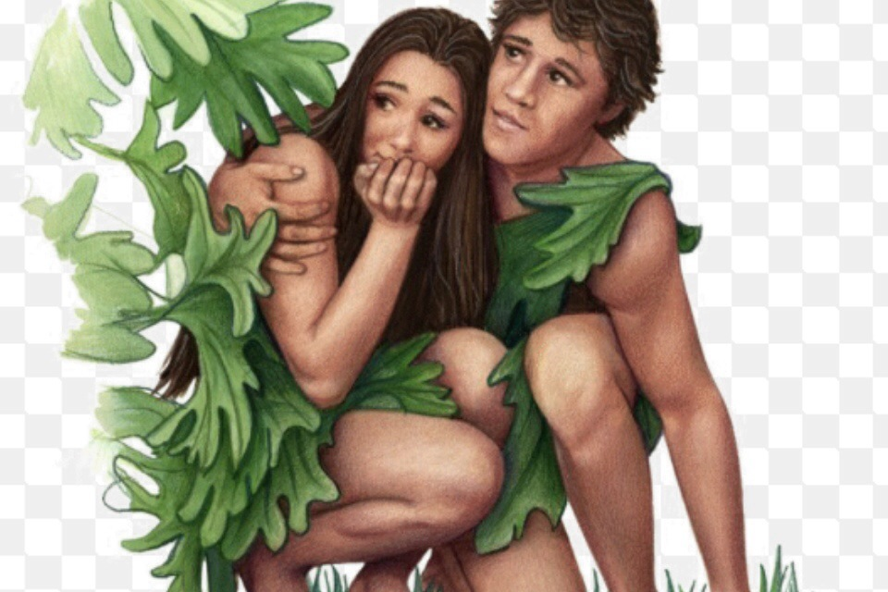
The Impacts of Sin Exposed
Notes:
The impacts of sin Exposed
Sin is rebellion against God expressed through acts of disobedience.
Sin causes man to “hide” from God.
Sin always has harmful natural consequences.

Slide 61
God’s response to sin
Man
Woman
Serpent (Satan)
Notes:
God’s response to Satan: enmity with the human race, and ultimate defeat by the seed of the woman (Gen. 3:14-15).
To Satan he promised immediate retaliation, as represented in the perpetual crawling of the serpent and its ultimate destruction by the seed of the woman.
This reference to the seed (singular) of the woman is the first messianic promise in the Old Testament (3:15; cf. Isa. 7:14).
This Seed, which can only be Christ, the virgin-born Son of God, would eventually destroy Satan and sin forever.
God’s response to the woman: increased pain in childbirth and subservience to husband (Gen. 3:16).
The state of the woman was changed.
There would be increased pain in childbirth and subservience to her husband, both of which were to remind her henceforth of her part in tempting her husband (1 Tim. 2:12-15).
God’s response to the man: must work to survive in a cursed earth, death to all human (Gen. 3:17-19).
The man was told that the ground would be cursed and that, as he expended his energy and very life in an effort to produce from it the food of life, he would weary himself in agonizing toil even to the point of death, eventually returning as dust to that very soil.
.

Slide 62
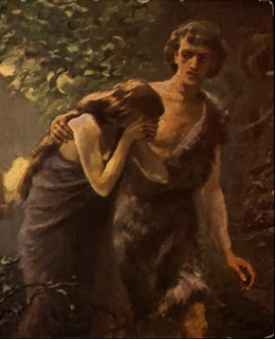
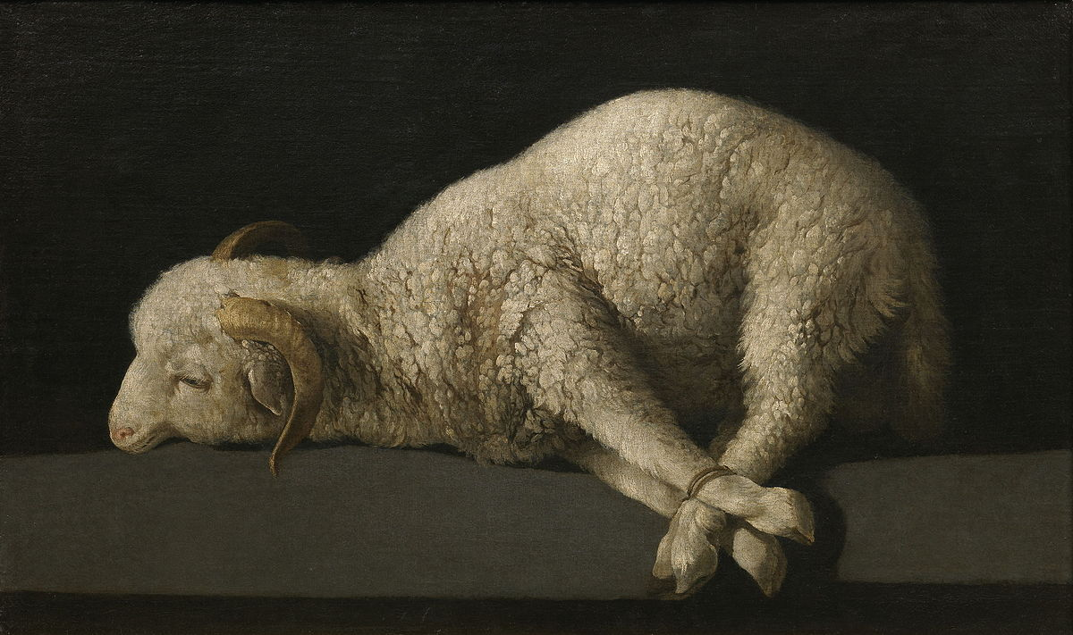
God’s response of mercy
Notes:
God’s response of mercy: provided a temporary covering to Adam and Eve, and provision for a Savior to save man from the penalty of sin (Gen. 3:15, 21).
God slew an innocent animal and made from the victim’s garment of skins to cover Adam and Eve who became aware of their nakedness.
The fig leaves of their invention were insufficient, for what was actually needed was a spiritual covering (atonement), something that would be accomplished only by faith in shed blood (Heb. 9:22).
Genesis 3:15 says, “I will put enmity between you and the woman, and between your offspring and hers; he will crush your head, and you will strike his heel.”
This is known as the protoevangelium—the first gospel.
The verse introduces two elements previously unknown in the Garden of Eden, elements that are the basis of Christianity
the curse on mankind because of Adam’s sin
and God’s provision for a Savior from sin who would take the curse upon Himself

Slide 63
IV. Summary

Slide 64
SUMMARY
  God created the universe to display his glory and goodness.
  Man was created to be God’s representative on earth and obey him.
  Man willfully disobeyed God resulting in sin, separation, and death.
  God will provide a Savior for man.
Notes:
SUMMARY
God created the universe to display his glory and goodness.
Man was created to be God’s representative on earth and obey him.
Man willfully disobeyed God resulting in sin, separation, and death.
God will provide a savior for man.

Slide 65
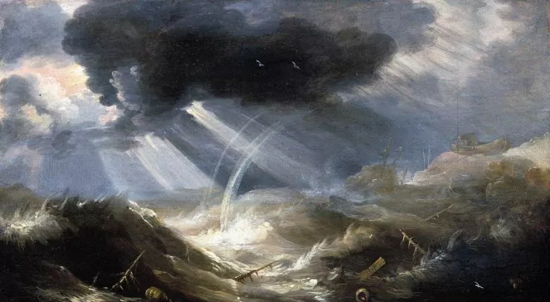
THE FLOOD —WAS GOD TOO CRUEL?
Notes:
THE FLOOD—WAS GOD TOO CRUEL?
Many unbelievers and atheists have made the accusation that they could never believe in the God of the Ot because he was too cruel?
Are they correct? Let’s see

Slide 66
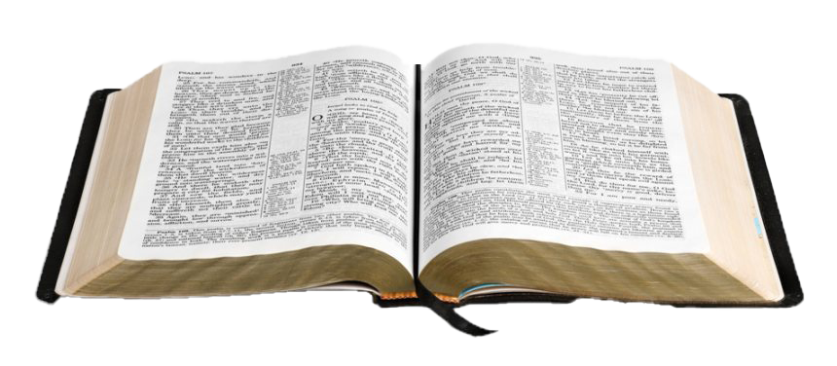
GENESIS 6
Increasing Corruption on Earth (6:1-5)
God Response to Corruption on the Earth (6:6-7)
God Spares Noah and His Family (6:8-13)
God’s Instructions for Building an Ark (6:14-22)
Notes:
Read your notes

Slide 67
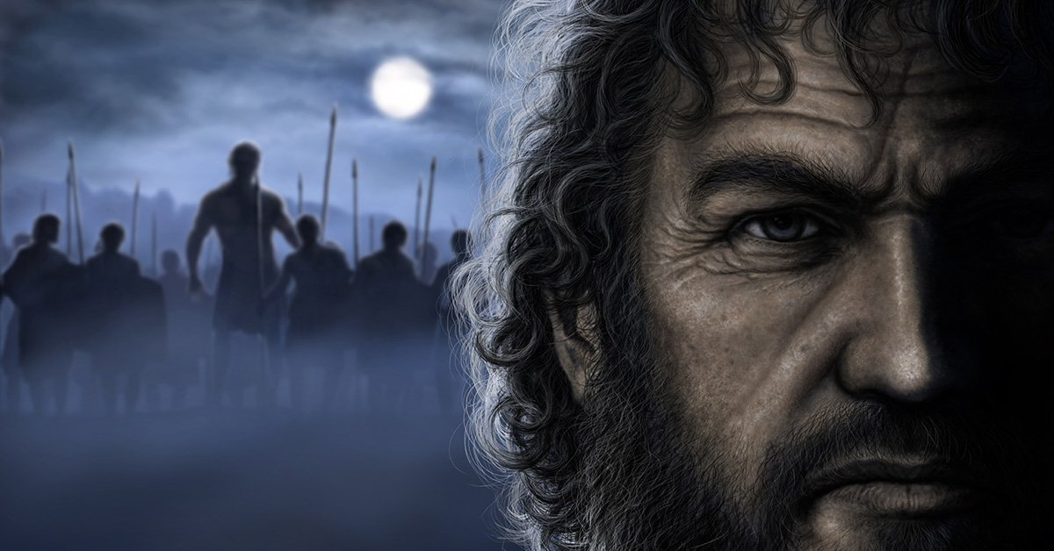
Who are the “sons of God” and the “Nephilim”?
Notes:
Who are the “sons of God” and the “Nephilim”?
Genesis 6:1-4 is one of the most difficult passages in the Bible to interpret. Who are the “sons of God” and the “Nephilim”?
There are three views held on this passage.
First, is the “Sinful Sethite” view where the godly line of Seth deviated from God’s plan and married the ungodly female offspring of Cain.
Second, is the “demon-possessed men” view which holds that demons took up residence in men, who were then prompted to live ungodly, licentious lives with women of the world.
Third, is view that the phrase “sons of God” was an ancient phrase used to describe rulers and their male offspring who were represented as having a direct connection with deity and who ravaged and abused women of the day, which severely distorted God’s holy design for marriage, even resulting in rampant polygamy.
It is best not to make too much of any possible doctrinal or practical implications from this passage as each of these three views have strengths and weaknesses.
The offspring of heavenly beings (“sons of God”; cf. Job 1:6; 2:1; Ps. 29:1; 82:6) who had sexual relations with human women (“daughters of men”; Gen. 6:1-4). Since the boundary between the divine realm and the earthly was not supposed to be crossed in this way, this was the final abomination that led to God’s decision to destroy the Nephilim and all people in the Flood (Gen. 6:3, 5-7).
Prior to the conquest of Canaan Israelite spies reported that there was a gigantic race of people, Nephilim, living in the land of Canaan (Num. 13:33). These people seem to be survivors of the Flood (cf. Gen. 6:4), but there is no explanation of how they survived the disaster. Perhaps there were two conflicting traditions, one in which the Nephilim perished in the Flood and another in which they survived and settled in Canaan. Alternatively, it may be that the giants in the Promised Land came to be called Nephilim by analogy with the earlier race of mighty heroes.

Slide 68
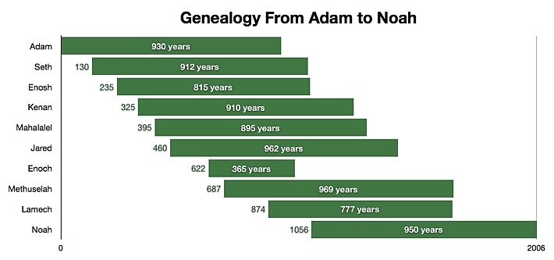
(Genesis 5:1-32)
Notes:
Noah was the 10th of the pre-flood (antediluvian) Patriarchs.
Noah’s father, Lamech, was about 56 years old when Adam died
Adam probably knew everyone in this lineage but Noah in his lifetime
Note: The number to the left of the bars is the number of years this person was born after Adam.
People in Noah’s day knew about God and sin. They were not that far removed from Adam
Source: http://www.hopefromthebible.com/genealogy-from-adam-to-noah

Slide 69
A timeline of the flood
(Genesis 7:1--8:19)
Dove & raven released—dove returns
Dove released—does not return
Animals enter the ark
Ark grounded on Mount Ararat
Rain
Waters recede
7
40
150
75
40
7
7
46
Dove released & returns with olive leaf
Noah & family leave ark
Noah and family enter the ark
Tops of mountains visible
1 year, 11 days (Jewish Calendar)
Notes:
0-Animals enter ark
After 7 days-Noah and family enter ark, rains begin
“God shut him in “(Genesis 7:16 )
Hebrew “covered him round about” → protection from the guilt of what was about to happen to mankind.
Noah had become a special object of God’s divine care and protection
40 days of rain
Waters recede for 150 days-ark lands on Mt. Ararat
After 75 days tops of mountains visible
After 40 days dove and raven released
7 days later only the dove returns with olive leaf
7 days later dove released, does not return
46 days later, Noah, family (and animals) leave ark
TOTAL TIME in Ark, over 1 year (365 solar days)
Note: The Jewish calendar has 354 days (moon month)/year vs. 365 solar days
(Jamieson, Fausset, and Brown, p. 22)

Slide 70
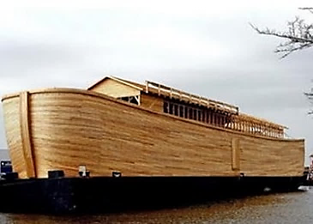
The Ark: God saving Noah’s family during a time of judgment
Notes:
THE ARK → READ GENESIS 6:14—7:3
450 ft. long x 75 feet wide x 45 ft. high
Gopher (KJV) or cypress (NIV) wood-strong & flexible
Divided into rooms – three decks
18-inch opening at top
No rudder or viewing windows
Equivalent to: 50 homes or 20 basketball courts or 569 railroad boxcars
For pictures of a working replica go to: http://www.pbase.com/paulthedane/noahs_ark
How long did it take Noah to build the ark?
See https://answersingenesis.org/bible-timeline/how-long-did-it-take-for-noah-to-build-the-ark/

Slide 71
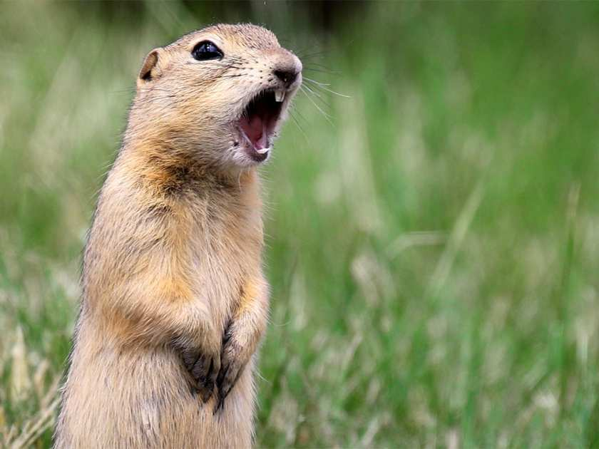
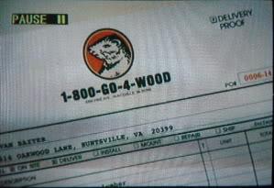
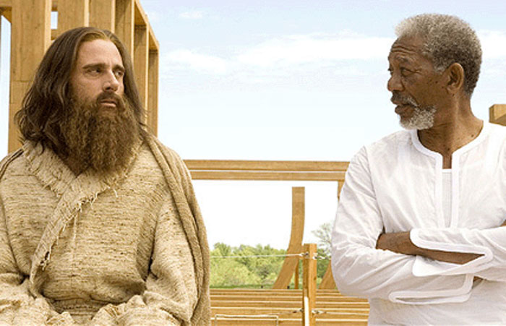
Notes:
Probably not this kind of gopher wood (Evan Almighty)
Evan Baxter (Steve Carell)

Slide 72
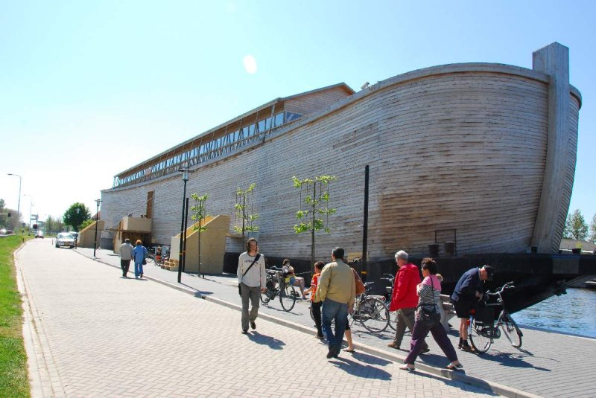
Notes:
Replica of Noah's Ark built by a Dutch contractor, Johan Huibers.
Built approximately to scale….1/2 the length and 1/3 the width of the Biblical dimensions.
To show the world how massive the Ark was and how so many animals could have been housed for a long time.
On a smaller scale so it would be able to travel around Europe, navigating the canals, bridges, and rivers en route.

Slide 73
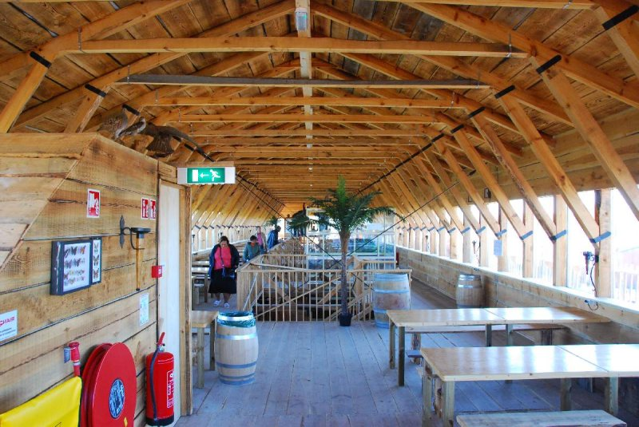
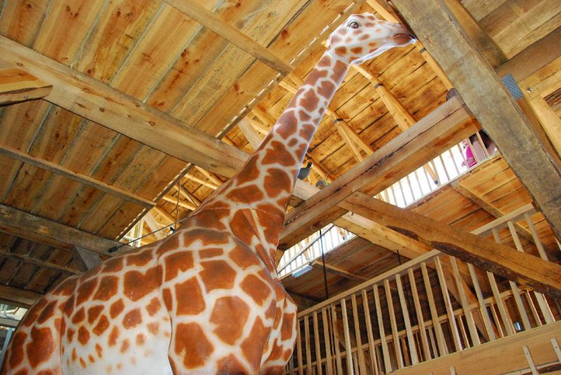
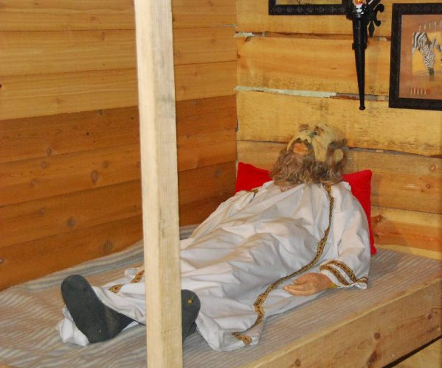
The Ark (Scale Model)

Slide 74
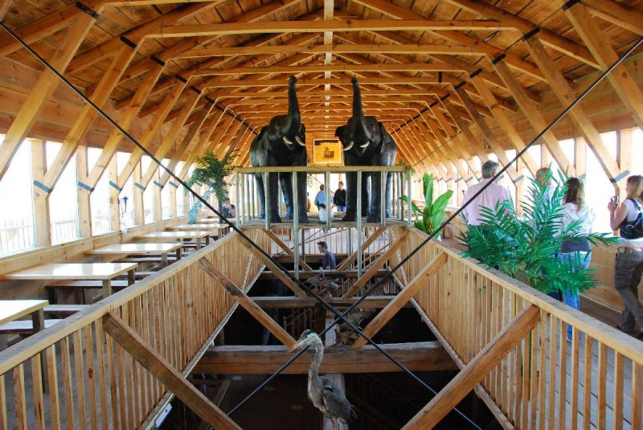
The Ark (Scale Model)

Slide 75
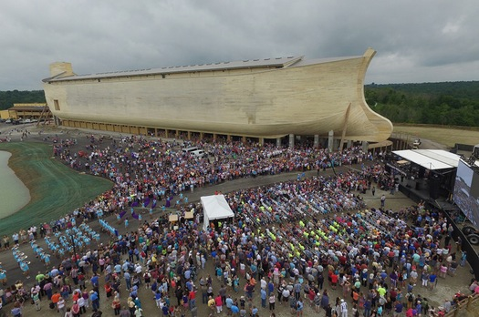
Notes:
Full-size ark in Northern Kentuck. <https://arkencounter.com/>.
Ark Encounter is a Christian theme park that opened in Grant County, Kentucky in 2016.
The centerpiece of the park is a large representation of Noah's Ark based on the Genesis flood narrative contained in the Bible.
It is 510 feet (155 m) long, 85 feet (26 m) wide, and 51 feet (16 m) high.

Slide 76
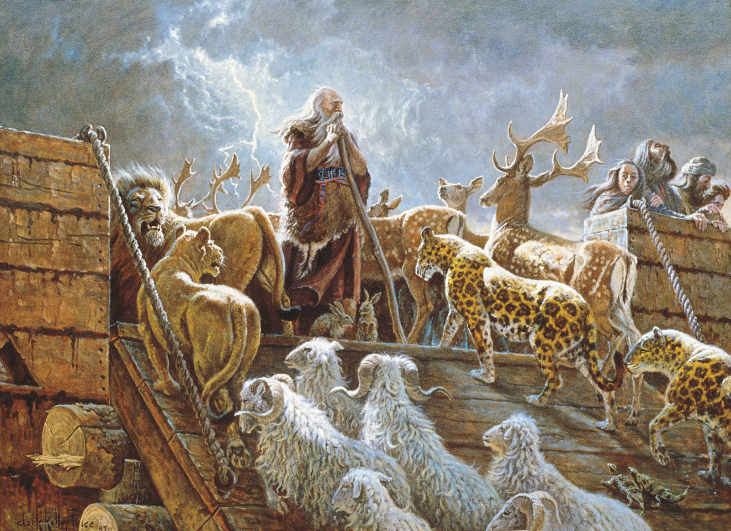
Notes:
THE CARGO
Passengers: Eight people (2 Pet. 2:5)
Estimated cargo (L. Thomas Holdcroft, p. 15)
1,700 species of animals
100,000 species of insects
987 species of reptiles
10,087 species of birds
Animals possibly hibernated – less food needed, easier to care for

Slide 77
THREE REASONS WHY GOD CAUSED THE FLOOD
Notes:
Read Your Notes

Slide 78

THREE REASONS WHY GOD CAUSED THE FLOOD
The wickedness of man was great in the earth (6:5).
Notes:
THREE REASONS WHY GOD CAUSED THE FLOOD
The wickedness of man was great in the earth (6:5).

Slide 79
THREE REASONS WHY GOD CAUSED THE FLOOD
The wickedness of man was great in the earth (6:5).
Every imagination of the thoughts of his heart was only evil continually (6:5).
Notes:
THREE REASONS WHY GOD CAUSED THE FLOOD
.
Every imagination of the thoughts of his heart was only evil continually (6:5).

Slide 80
THREE REASONS WHY GOD CAUSED THE FLOOD
The wickedness of man was great in the earth (6:5).
Every imagination of the thoughts of his heart was only evil continually (6:5).
The earth was filled with violence (6:11).
Notes:
THREE REASONS WHY GOD CAUSED THE FLOOD
.
.
The earth was filled with violence (6:11).

Slide 81
WAS GOD TOO CRUEL?
Notes:
Read Your Notes

Slide 82
WAS GOD TOO CRUEL?
No, because he always gives sinners plenty of time to repent.
Notes:
WAS GOD TOO CRUEL?
No, because he always gives sinners plenty of time to repent (2 Pet. 3:9; Psa. 86:15).
"The Lord is not slow in keeping his promise, as some understand slowness. Instead he is patient with you, not wanting anyone to perish, but everyone to come to repentance." (2 Pet. 3:9 NIV)
"But you, Lord, are a compassionate and gracious God, slow to anger, abounding in love and faithfulness." (Ps. 86:15 NIV)
God always gives man plenty of time to repent before he brings judgment.

Slide 83
WAS GOD TOO CRUEL?
No, because he always gives sinners plenty of time to repent.
No, because he is infinitely wiser than us.
Notes:
WAS GOD TOO CRUEL?
.
No, because he is infinitely wiser than us (Isa 55:8-9).
"For my thoughts are not your thoughts, neither are your ways my ways," declares the LORD. 9 "As the heavens are higher than the earth, so are my ways higher than your ways and my thoughts than your thoughts." (Isa. 55:8-9 NIV)
God is infinitely wiser than man and he always does what is fair and right.
His actions always bring about a greater good.
Humans cannot possibly see things as perfectly as God.

Slide 84
WAS GOD TOO CRUEL?
No, because he always gives sinners plenty of time to repent.
No, because he is infinitely wiser than us.
No, because he is perfectly righteous.
Notes:
WAS GOD TOO CRUEL?
.
.
No, because he is perfectly righteous (Isa. 5:16)
"But the LORD Almighty will be exalted by his justice, and the holy God will be proved holy by his righteous acts." (Isa. 5:16 NIV)
God is righteous and he always acts in accordance with what is right and he is the final standard of what is right, not us!

Slide 85
WAS GOD TOO CRUEL?
No, because he always gives sinners plenty of time to repent.
No, because he is infinitely wiser than us.
No, because he is perfectly righteous.
No, because he is always just.
Notes:
WAS GOD TOO CRUEL?
.
.
.
No, because he is always just (Deut. 32:4; 2 Thess. 1:5-6).
"He is the Rock, his works are perfect, and all his ways are just. A faithful God who does no wrong, upright and just is he." (Deut. 32:4 NIV).
Because God is just, it is necessary that he treat people according to what they deserve
It is necessary that God punish sin because it is wrong and deserves punishment.
What kind of a society would it have existed if God did not bring about the Flood?

Slide 86
WAS GOD TOO CRUEL?
No, because he always gives sinners plenty of time to repent.
No, because he is infinitely wiser than us.
No, because he is perfectly righteous.
No, because he is always just.
No, because he is holy and morally perfect.
Notes:
WAS GOD TOO CRUEL?
.
.
.
.
No, because he is holy and morally perfect (Lev. 11:44; Psa. 99:9; Rev. 4:8).
" I am the LORD your God; consecrate yourselves and be holy, because I am holy. " (Lev. 11:44a NIV)
"Each of the four living creatures had six wings and was covered with eyes all around, even under its wings. Day and night they never stop saying: "'Holy, holy, holy is the Lord God Almighty,' who was, and is, and is to come."" (Rev. 4:8 NIV)
God’s holiness means that he is separated from sin and devotes to seeking his own honor.

Slide 87
Was the Flood Local or World-Wide?

Slide 88

Was the Flood Local or
World-Wide?
Notes:
Was the flood local or world-wide?
One of the most critical and debated problems involved with the flood narrative has to do with its extent. Did the flood cover the entire earth or was it merely a local flood? Several arguments support a world-wide flood:
A local flood probably could not be deep enough to cover the highest mountains.
A local flood would probably not last for one year.
If the flood was local, Noah could have easily moved the animals to a large enough area which was not flooded.

Slide 89
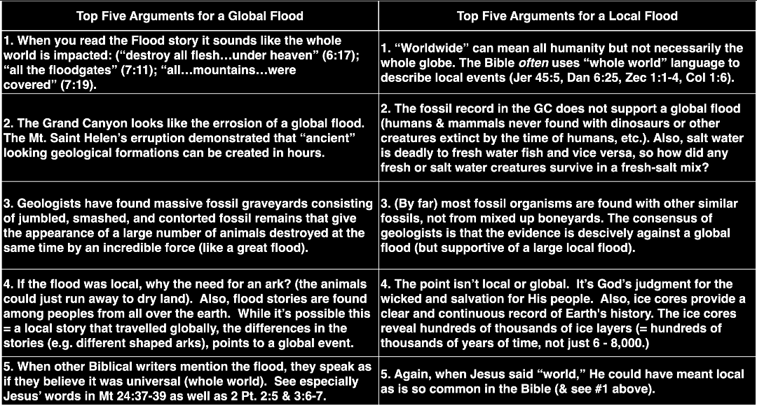

Slide 90
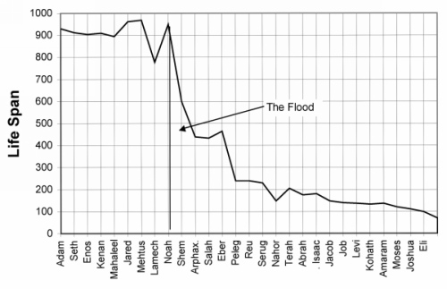
Notes:
Why shorter life spans after flood?
Loss of a large canopy of water before the flood → firmament (Gen. 1) resulting in increase in harmful radiation reaching ground level
from solely plant-based to one where meat was eaten (Gen. 9:3)
http://www.biblestudy.org/basicart/why-did-man-live-longer-before-flood-of-noah-than-after-it.html

Slide 91
DISCUSSION QUESTIONS
Notes:
Read Your Notes

Slide 92
DISCUSSION QUESTIONS
Why did God wait over 100 years to bring judgment? (Gen. 6:6; 2 Pet. 3:9)
What is the significance of God shutting to door and what does this tell you about God (Gen. 7:16)?
Why did God not include a rudder or steering device on the ark? How might you apply this to your life?
Notes:
DISCUSSION QUESTIONS
Why did God wait over 100 years to bring judgment? (Gen. 6:6; 2 Pet. 3:9)
Gen. 6:6. He was grieved…his heart was filled with pain…man had missed the blessings of God.
Did God make a mistake? No, God does not change his mind (1 Sam. 15:29).
2 Pet. 3:9. The Lord is not slow in keeping his promise, as some understand slowness. He is patient with you, not wanting anyone to perish, but everyone to come to repentance.
God always gives man plenty of time to repent before bringing his judgment.
This same condition will prevail at the time of Jesus’ return.
Just as people knew nothing about the coming flood, so people will be surprised when Jesus returns.
What is the significance of God shutting to door and what does this tell you about God (Gen. 7:16)?
It signaled the end of the time for repentance.
The beginning of the flood-judgment.
It showed that God was taking responsibility for what was to happen, not Noah.
Why did God not include a rudder or steering device on the ark? How might you apply this to your life?
To ensure that he had full control.
If we always had full control of our lives (rudder) we would never learn to put our full trust in God.

Slide 93
SUMMARY
Notes:
Read Your Notes

Slide 94
SUMMARY
God always gives sinners time to repent.
Our sin is God’s sorrow.
God’s judgment of sin is inevitable.
God always follows through with his warnings .
God’s judgments always contain justice and grace.
Notes:
Summary
[CLICK]
God always gives sinners time to repent (Gen. 6:3).
Our sin is God’s sorrow (Gen. 6:5-6).
God’s judgment of sin is inevitable (Gen. 6:7).
God always follows through with his warnings (Gen. 7:6).
God’s judgments always contain justice and grace (Gen. 8:15-17).

Slide 95

GOT IT?
Notes:
GOT IT?

Slide 96
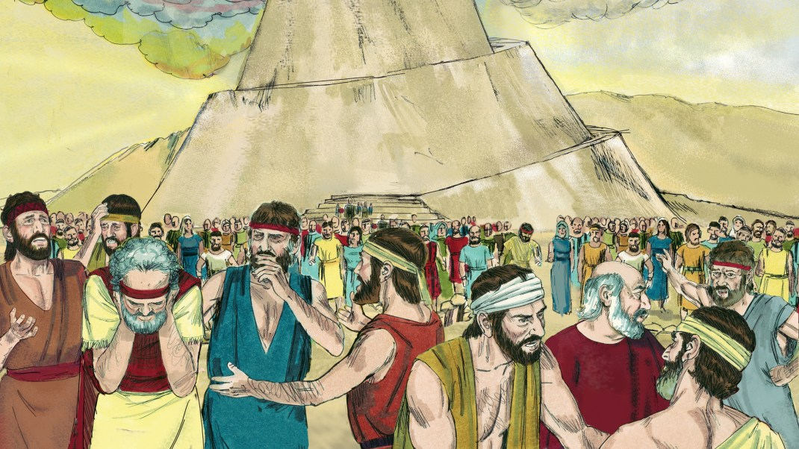
NEXT WEDNESDAY
The First Mass Protest
Notes:
NEXT WEDNESDAY: THE FIRST MASS PROTEST
What happens when man rebels against God en masse.

Slide 97

PRAYER & PRAISE TIME
Notes:
PRAYER & PRAISE TIME
Our nation…seriously divided…much hate at top level.
Upcoming elections.
Our TLC pastors and staff.
Those who developing a vaccine.
Others?

Slide 99

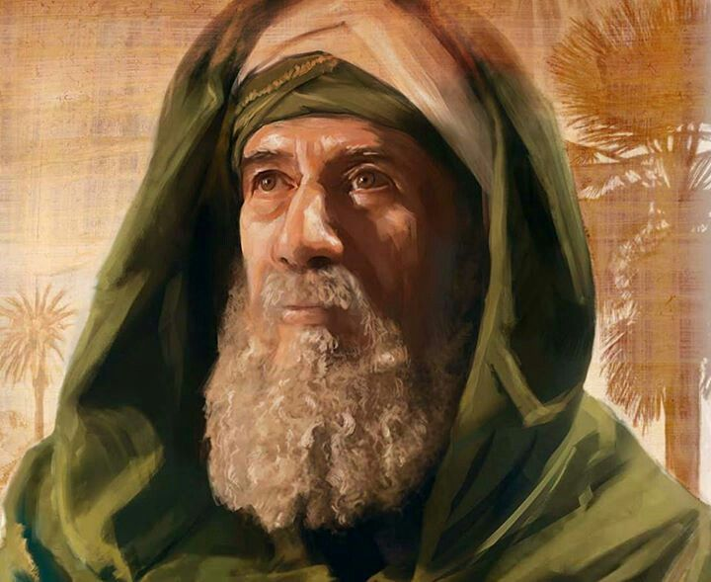
PERIOD of the PATRIARCHS

Slide 100
Quick Look at the Period
Abraham
2166-1991 BC
Isaac
2066-1886 BC
Jacob
2006-1859 BC
Joseph
1915-1805 BC
Notes:
Scripture now focuses on the line of Shem, one of the Noah’s sons, through whom the Redeemer will come.
This period is from the time of Abraham to Joseph
Key people include
Abraham/Sarah
Isaac
Jacob/Esau
and Joseph
Key Scriptures are Genesis 11:25—50:26
Major Events
God's promise to bless the world through Abraham, Isaac and Jacob
The testing of Abraham's faith
The origin of the nation of Israel

Slide 101

A patriarch in the Ancient Near East was either the father of a family, or the ruler of a clan or tribe whose role was like that of a priest, a spiritual head of his family. The primary patriarchs of Israel were: Abraham, Isaac, Jacob and his 12 sons.
(Acts 7:8-9)
Notes:
A patriarch in the Ancient Near East was either the father of a family, or the ruler of a clan or tribe whose role was like that of a priest, a spiritual head of his family.
The primary patriarchs of Israel were: Abraham, Isaac, Jacob and his 12 sons (Acts 7:8-9).

Slide 102
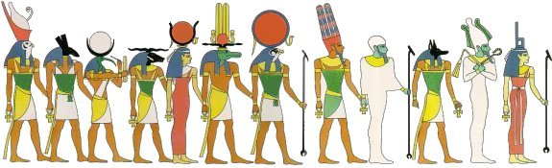
BACKGROUND
Notes:
Ancient Near-East Setting
After the dispersion of mankind at the Tower of Babel, the knowledge of the true God seems to have become even more limited.
Two great empires existed at this time, the Egyptian Empire, and the Chaldean (Babylonian) Empire.
Even though there was phenomenal progress in culture, literature, art, and material wealth, moral standards and religious life had declined rapidly.
Idolatry had spread like wildfire.
People worshipped various gods and images such as the sun, the moon, animals, and even called upon the dead to make intercession for them.
It was during this time that Abraham was born.

Slide 103
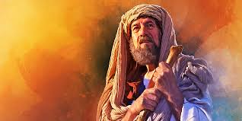
ABRAHAM
Notes:
ABRAHAM
While the Bible gives a genealogical continuity from Noah to Abraham, it does not imply a continuity of faith.
Q: What does Joshua 24:2 imply about Abraham's spiritual life when God called him?
A: …your forefathers, including Terah the father of Abraham and Nahor” and worshiped other gods.
Abraham probably worshipped other gods too (like his father)
Henotheist?
Unlike Noah, Abraham was not a godly person when God called him.
Abraham is not found initially to be a righteous man, nor was he someone like Noah who lived in contrast to the world around him.
It is clear in the Scripture that Abraham’s family did not worship Yahweh (Josh. 24:2), so in a sense God came to Abraham “out of the blue.”

Slide 104
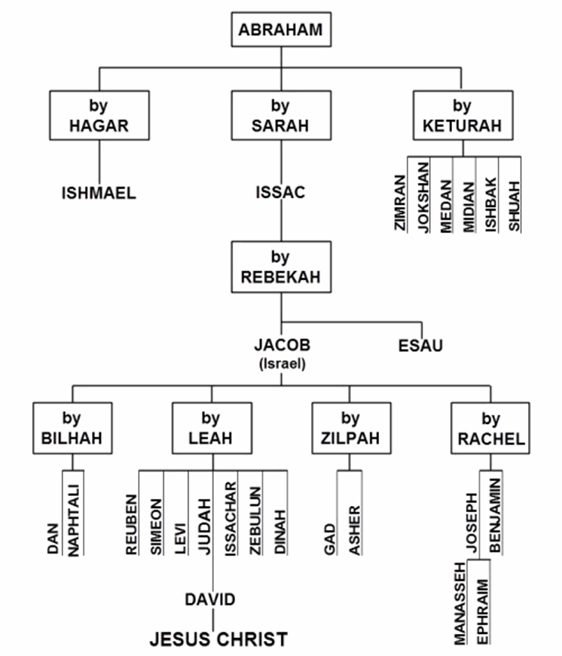

Slide 105
Notes:
About 26% of Genesis is dedicated to Abraham, the first Patriarch of Israel, and 25% dedicated to Joseph
WHY DID AUTHOR EMPHASIZE THESE TWO INDIVIDUALS?
Abraham→ demonstrated total trust in God
Joseph → was a “type” of Jesus Christ

Slide 106
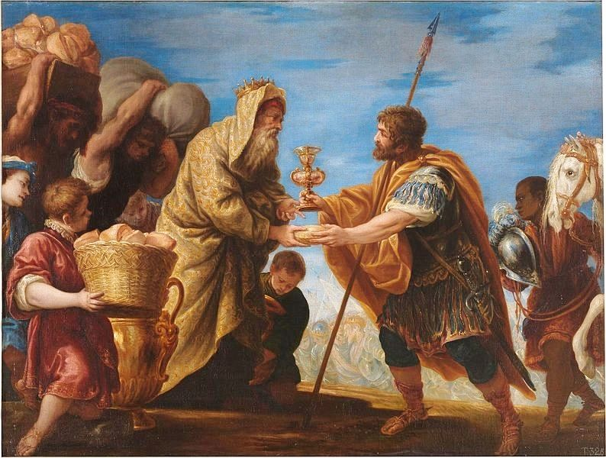
Abraham meets Melchizedek
Notes:
Abraham Meets Melchizedek
Melchizedek:
Was the king of Salem (Jerusalem)
He blessed Abram
Was a faithful priest who recognized God as the Creator of heaven and earth
Was honored by Abram with a tithe (10th) of all the items he gathered
Was viewed by Abram as ranking higher than himself
Was without father, mother, or genealogy
Resembles the Son of God
Remains a priest forever

Slide 107
Who was Melchizedek?
A Canaanite priest?
A human king?
Pre-incarnate Christ?
Notes:
Three possibilities exist for the identification of Melchizedek
A Canaanite priest: He was a Canaanite priest of a tribal deity named El Elyon and that Abram confused him with the Hebrew God, or even identified Ell Elyon with Yahweh. This view is unlikely since Hebrews 7 describes him as having no beginning or end, neither a father or a mother.
A human king: Some believe he was more likely a fully human king, probably the ruler of Jerusalem, who gives evidence of a genuine monotheistic faith in pre-Mosaic times. The phrase “without father and mother “could mean that there is no record of such in the Old Testament.
The preincarnate Christ in bodily form (a Christophany): This is a possibility because God did appear many times in the Old Testament in bodily form. One possible exception is that Melchizedek is called the “king of Salem” which is difficult to imagine God as the king of only this earthly place (Jerusalem).

Slide 108
What is the significance of Melchizedek?
His major importance lay not only in his name but also in his non-Levitical priesthood. As such he could be a type of both David and Jesus who were both called priests yet not in the Levitical line
(2 Sam. 6:12-15; Psa. 110:4; Heb. 7:1-8:6).
Notes:
MELCHIZADEK
His major importance lay not only in his name (“king of righteousness) but also in his non-Levitical priesthood.
As such he could be a type of both David and Jesus who were both called priests yet not in the Levitical line (2 Sam. 6:12-15; Psa. 110:4; Heb. 7:1-8:6).

Slide 109
ABRAHAMIC COVENANT
To Abraham God promised…
A GREAT LAND
A GREAT NATION
A GREAT BLESSING
Notes:
God made three significant promises to Abraham (Genesis 12:1-3; 13:14-17; 15:1-21; 17:1-27; and 22:15-18)
Abram was 75 years old
Note to self: See chart on page 35 of Paul Enns’ “Moody Handbook of Theology.”

Slide 110
ABRAHAMIC COVENANT
To Abraham God promised…
A GREAT LAND
Notes:
The Promise of a Great Land
God called Abraham from Ur of the Chaldees to a specific land that He would give him (12:1, 7).
This promise is reiterated in Genesis 13:14–18 after Lot chooses his land; its dimensions are given in Genesis 15:18–21.
Abram’s fourth generation (twelve tribes of Israel) would return to the Promised Land after a period of enslavement (15:13-14).

Slide 111

???
Notes:
Q: What would you do if God told you to sell your house and start driving…he’d tell you where to go later…?
That’s what it was like when God called Abraham
Genesis 12:1 The LORD had said to Abram, "Leave your country, your people and your father's household and go to the land I will show you.

Slide 112
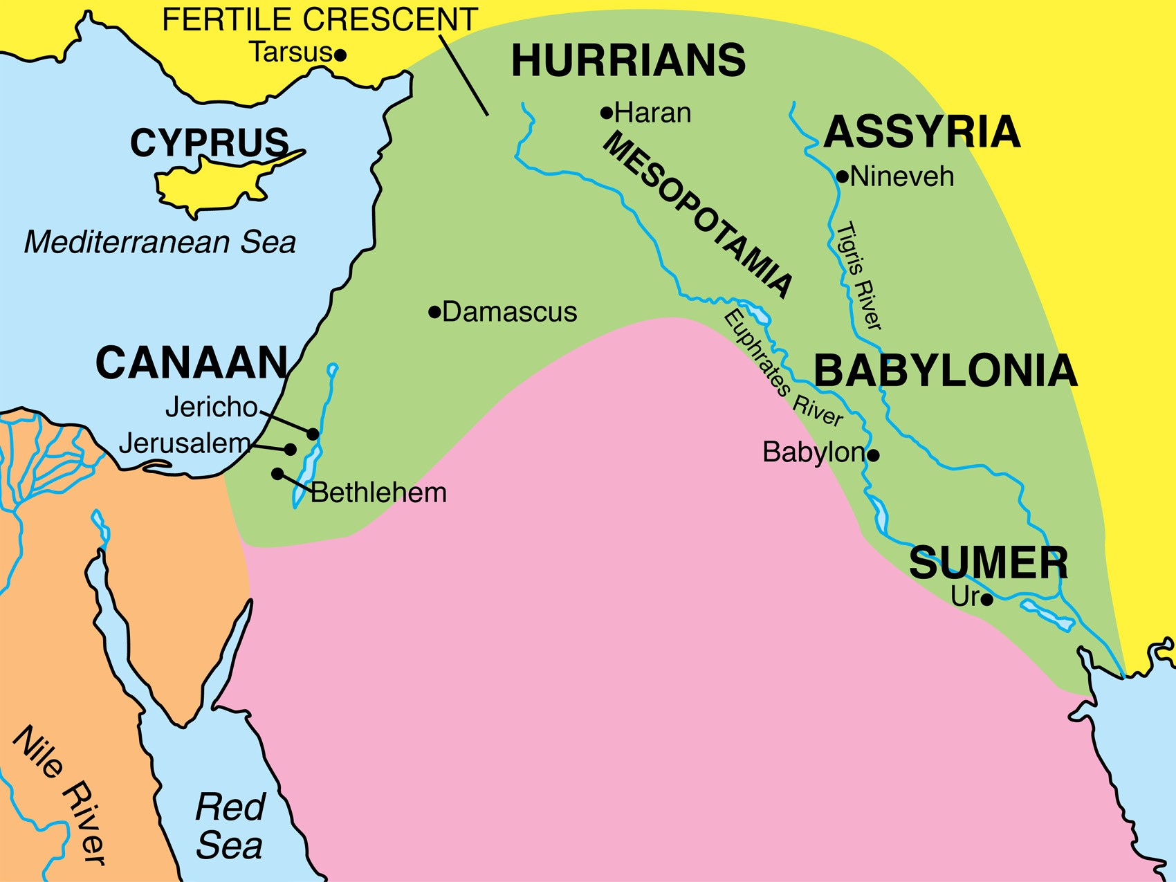
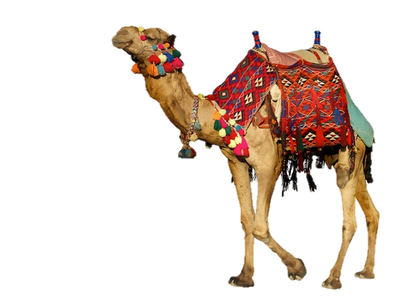

Notes:
He was 75 years old and living in the Ur of Chaldeans when he was called by God to leave his home, his family, and his people, and go to a place that would be revealed to him later (Gen. 12:1).
Q: Why do you suppose God didn't tell him where he was to go. Wouldn't that have made more sense?
God wanted Abram to trust him completely! …and Abraham obeyed God!
Ur→ Haran → Canaan (Land of Israel)
Via fertile crescent
Not directly (Lawrence of Arabia)

Slide 113
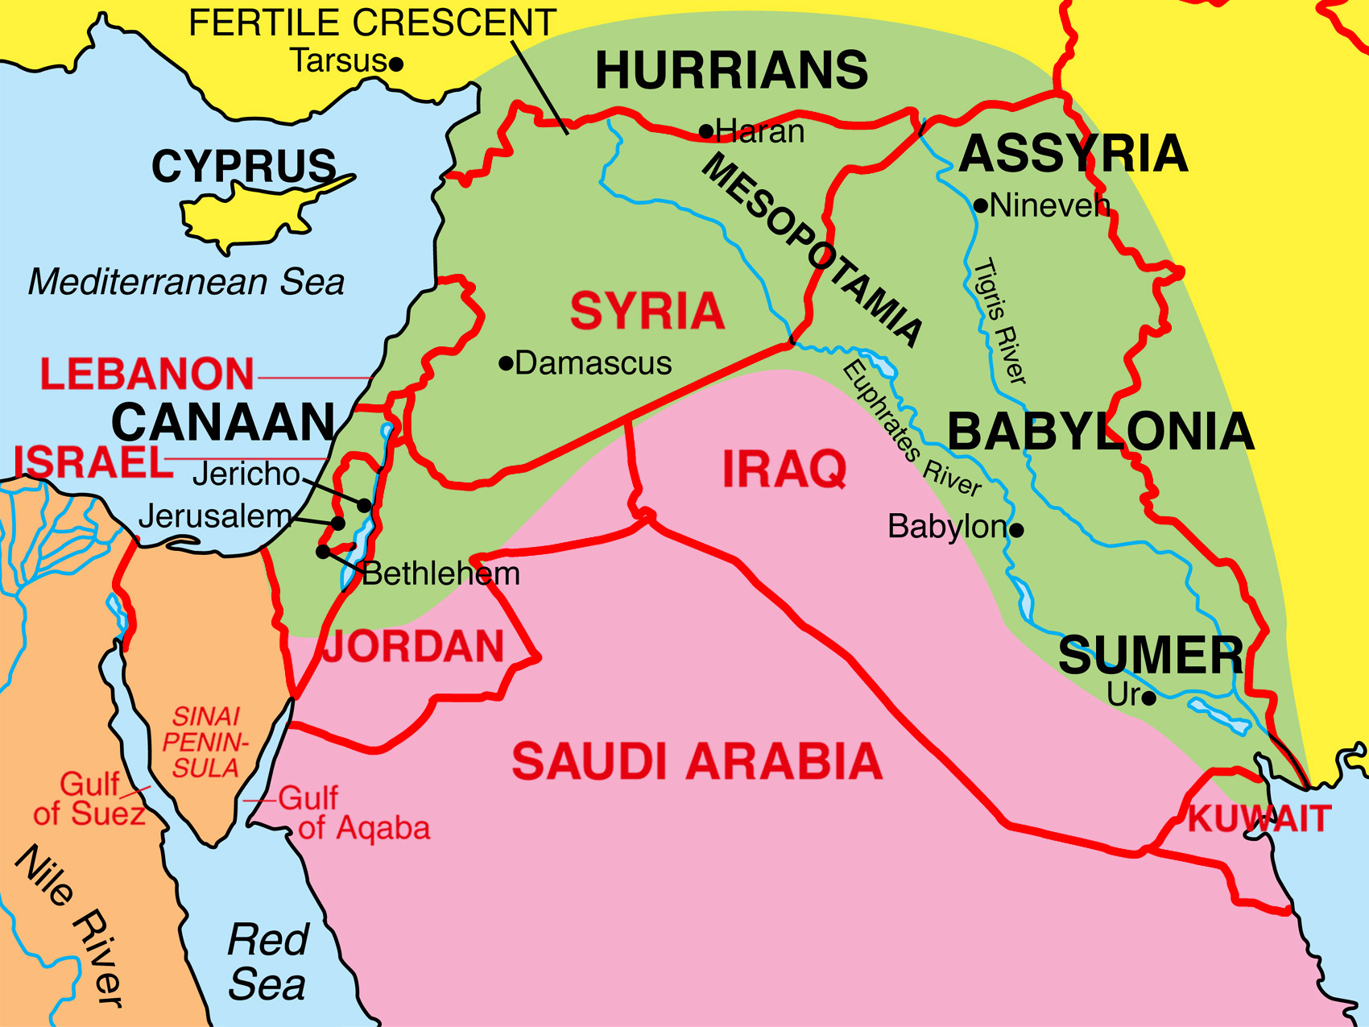
Notes:
TODAY’S NATIONS
Iraq → Syria → Lebanon→ Canaan (Israel)

Slide 114
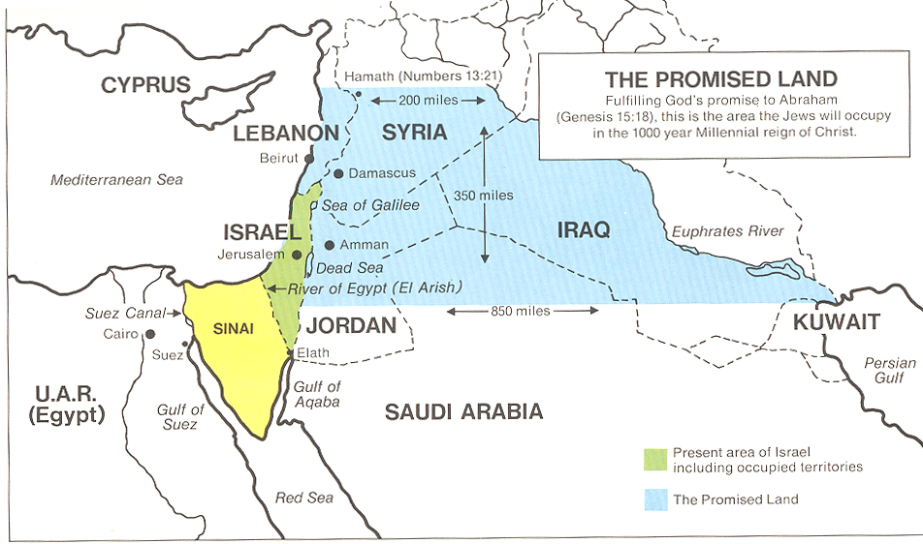
A Great Land
Notes:
“A GREAT LAND”
Genesis 15:18-21
⁸ On that day the LORD made a covenant with Abram and said, "To your descendants I give this land, from the Wadi of Egypt to the great river, the Euphrates --¹⁹ the land of the Kenites, Kenizzites, Kadmonites, ²⁰ Hittites, Perizzites, Rephaites, ²¹ Amorites, Canaanites, Girgashites and Jebusites." (Gen. 15:18-21 NIV)
Source: Gary Cohen and Salem Kirban, “Revelation Visualized.” P. 35

Slide 115
Biblical Names of Promised Land
Israel declared a sovereign state
Jewish Revolt
Abram
Joshua
Canaan
Israel
Palestine
Israel
2100 B.C.
1400 B.C.
A.D. 135
A.D. 1948
Today
Israel was recognized as a sovereign nation on May 14, 1948
Notes:
Canaan: Its original name (Genesis 11:31-32; 12:5-6; 16:3).
Israel
The name used from time of Joshua until the time of Christ (Matthew 2:20-21), and up to the Jewish Revolt in A.D. 135.
Palestine
Roman Emperor Hadrian renamed the land Palestine (a Latinized name)
He Banned Jewish practices and built a temple to Jupiter Capitolinus on the site of Herod's temple.
Jews revolted
Occupants of Palestine from A.D. 135—1917
Romans
Byzantines
Muslims
Crusaders
Ottomans (Turks)
British
1917: (British/Balfour Declaration)
Letter from Lord Arthur James Balfour, British Foreign Minister to Baron de Rothchild of Paris on November 2, 1917, declared, “His Majesty's government view with favour the establishment in Palestine of a national home for the Jewish people, and will use their best endeavours to facilitate the achievement of this object, it being clearly understood that nothing shall be done which may prejudice the civil and religious rights of existing non-Jewish communities in Palestine, or the rights and political status enjoyed by Jews in any other country.”
Israel : On May 14, 1948, the independent state of Israel was proclaimed as British rule in Palestine came to an end.

Slide 116
Abraham
(Semite)
God’s blessing on Ishmael (Gen. 17:20)
Abrahamic Covenant (Gen. 17:19, 21)
Hagar
(Egyptian)
Sarah
(Semite)
Ishmael
1st Born
Isaac
2nd Born
QUR’AN
Arabs
Jews
PROMISED LAND
Source: Stanley A. Ellisen, Who Owns the Land? (Portland: Multnoma Press, 1977) 191-192
Notes:
The Qur’an reconstructs the Abrahamic Covenant to indicate that its promises flow through Abraham’s first-born son, Ishmael (Surah 2:124-129→Isma’il).
Palestinian Arabs today claim to be descendants of Ishmael
There is nothing in the Bible to indicate that Ishmael was the forefather of the Arabs
Nor was this belief held by ancient Arabs
The Bible makes it clear three times that the promises of the Abrahamic Covenant go through Isaac (Gen. 17:19-21; Exod. 2:24; Lev. 26:42).
Setting Hagar free, according to the law of the day, meant her son, Ishmael, forfeited any inheritance (Gen. 21:14).
(Stanley Ellisen, “Who Owns the Land,” pp. 148, 170).

Slide 117
ABRAHAMIC COVENANT
To Abraham God promised…
A GREAT LAND
Land of Israel
A GREAT NATION
Nation of Israel
Notes:
The Promise of a Great Nation:
Abram’s descendants would be enslaved and mistreated in a strange land for 400 years--they would however, come out of the enslavement with great possessions (15:13-14).
Male descendants were to be circumcised on the 8th day as a sign of this covenant (17:10).
Ishmael would become a great nation and the father of twelve rulers (25:12-16), but the covenant with Abraham would continue through Isaac.
-----------------------------------
And these are the names of the sons of Ishmael, by their names, according to their generations: The firstborn of Ishmael, Nebajoth, and Kedar, and Adbeel, and Mibsam, and Mishma, and Dumah, and Massa, Hadad and Tema, Jetur, Naphish and Kedmah. These are the sons of Ishmael, and these are their names, by their towns and by their encampments; twelve princes according to their nations." Genesis 25:12-16

Slide 118
ABRAHAMIC COVENANT
To Abraham God promised…
A GREAT LAND
A GREAT NATION
A GREAT BLESSING
Notes:
The Promise of a Great Blessing:
God will bless those who bless this nation and curse those who curse it (12:3a).
God will bless other nations of the earth through Abram’s descendants (12:3b).
Abram, meaning “exalted father” would be blessed and he would be given a great name, “Abraham” meaning “father of many.” (17:5).
Sarai’s name will be changed to Sarah, and God would bless her and give her a son--she would become the mother of nations (17:15-16).

Slide 119
The Nature of the Abrahamic Covenant
It is an unconditional covenant
It is a literal covenant
It is an everlasting covenant
Notes:
The Nature of the Abrahamic Covenant
It is an unconditional covenant…there are no “if” conditions attached to it (15:17).
It is a literal covenant in which the promises should be understood literally.
It is an everlasting covenant (17:7, 13, 19).

Slide 120
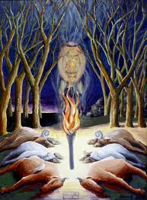
The Unconditional Covenant
As the sun was setting, Abram fell into a deep sleep, and a thick and dreadful darkness came over him. (Gen. 15:12 NIV)
When the sun had set and darkness had fallen, a smoking firepot with a blazing torch appeared and passed between the pieces. (Gen. 15:17 NIV)
Notes:
It is an unconditional covenant…there are no “if” conditions attached to it (15:17).
Gen. 15:1-21…only God (smoking firepot & blazing torch) passed between the sacrificed animals.
Abram in deep sleep—no conditions for him to agree to (Gen. 15:12, 17).
The halves of the animals (as referenced in Jeremiah 34:18, for example) implied that the party who would be responsible for any future violation of the terms of the covenant would suffer the same fate as the animals had.
It is also a literal covenant in which the promises should be understood literally.
The land that is promised should be understood in a normal definition of the word—it is not a figure of heaven (Houdmann).
It is also an everlasting covenant (17:7, 13, 19).

Slide 121
Abram believed (placed his faith in) the LORD, and he credited it to him as righteousness,
Gen. 15:6 NIV
Notes:
Abram believed (placed his faith in) the LORD, and he credited it to him as righteousness, Gen. 15:6 NIV
Righteousness comes by faith in OT and NT
Hab. 2:4… but the righteous shall live by his faith. (Hab. 2:4 ESV)
Rom. 4:13…It was not through the law that Abraham and his offspring received the promise that he would be heir of the world, but through the righteousness that comes by faith. (Rom. 4:13 NIV)

Slide 122
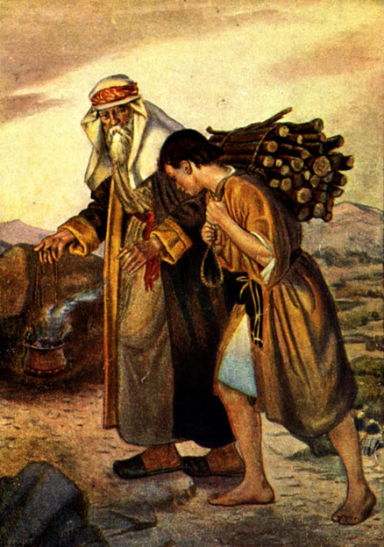
Abraham’s faith is tested
Notes:
ABRAHAM TESTED
Genesis 22:1-19 describes how God tested Abraham by requiring him to offer his beloved son, Isaac, as a sacrifice.
Scripture states that Abraham did not debate the command but knew that Yahweh could bring his son back to life (notice the pronoun “we” in Gen. 21:5).
Also, human sacrifice was a pagan practice during this period.
The Hebrew word “tested” (H. nasah) does not mean enticed to do wrong but to test a person’s trust in God (1 Kings 10:1; 2 Chron. 9:1; Dan. 1:12, 14).
Notice the parallel between the substitutionary ram and Jesus Christ.
The site of the event (Mount Moriah) was most likely the site of Israel’s Temple

Slide 123
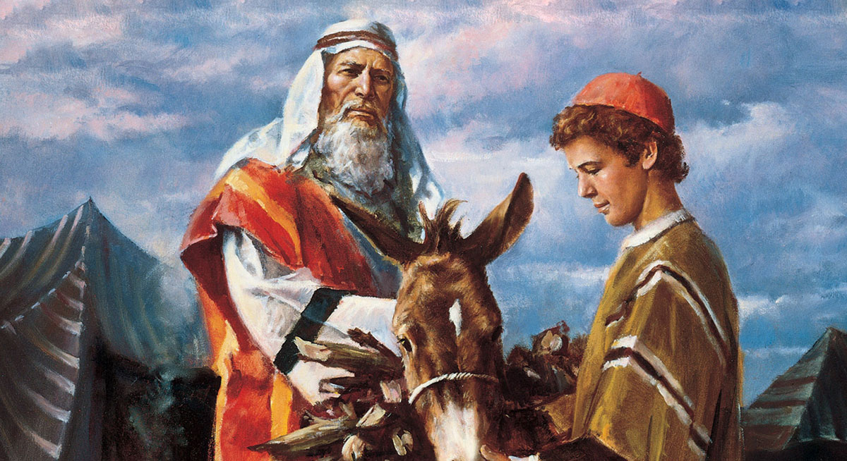
ISAAC
Notes:
Isaac, Abraham’s 2nd Son…2nd Patriarch
Name: “He laughs”
Personality
He a quiet but very obedient individual
Often compromised or lied when facing a confrontation
He did not resist when Abraham was about to sacrifice him
Only child of Abraham and Sarah
Became a wealthy livestock owner
Married Rebekah, daughter of his uncle (Laban)
Recipient of the covenant God made with his father (Genesis 17:19)
Fathered twin boys, Esau and Jacob, whose mother was Rebekah
He favored Esau over Jacob
Esau was born first
Jacob tricked Esau out of receiving Jacob’s covenantal blessing

Slide 124
ABRAHAM
Hagar
Sarah
Ishmael
ISAAC
Covenant line
Esau
JACOB
(Israel)
12 Sons
(Children of Israel)
Notes:
GENESIS 17:21 Covenant line → Abraham → Isaac (not Ishmael) → Jacob (not Esau) → 12 Sons (land) → Judah (Redeemer) → Jesus Christ (the blessing)

Slide 125
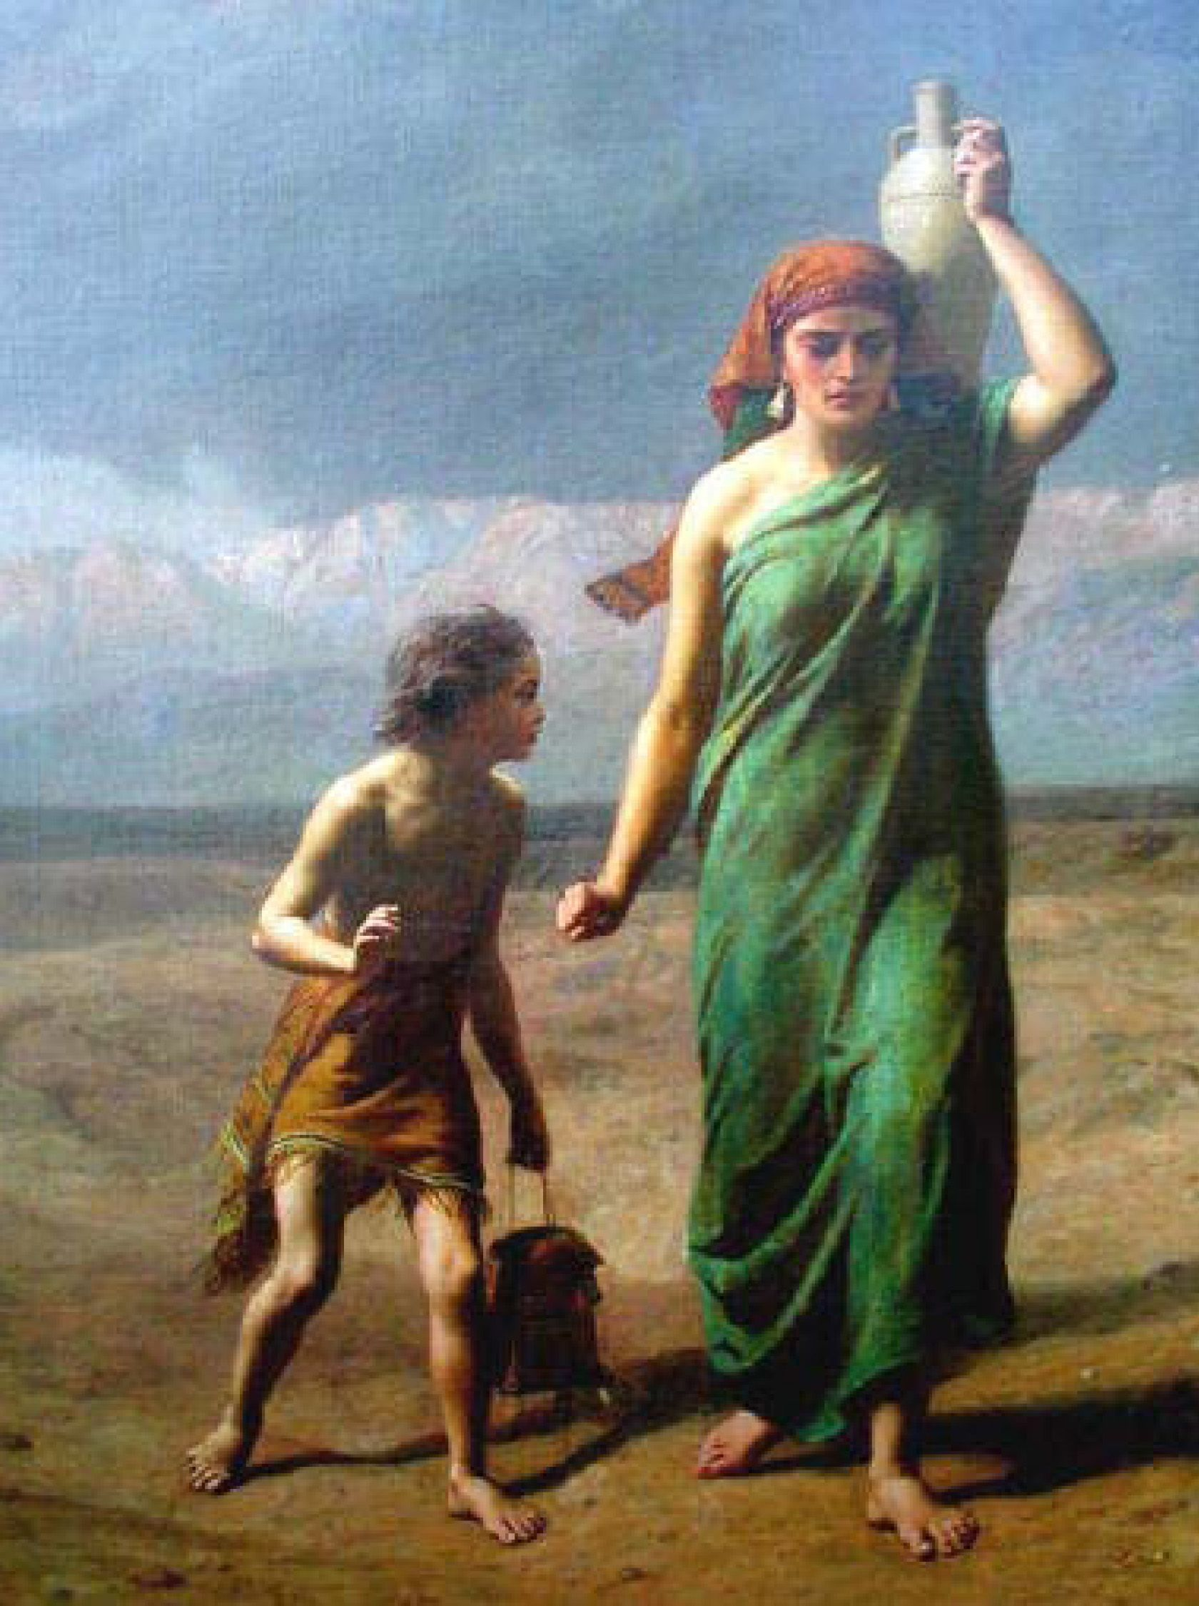
Ishmael
Notes:
Ishmael is considered a patriarch of Islam based upon legends that have developed around him and information found in the Qur’an.
But what does the Bible tell us about Ishmael?
Ishmael was the firstborn son of Abraham.
God had appeared to Abraham and promised that he would have a son and that he would be the father of many nations (Genesis 15).
However, as time went on, Abraham had no children.
His wife, Sarah, had been unable to conceive, and they began to question just how the promise would be fulfilled.
In Genesis 16 Sarah suggests that Abraham should have a child with her slave Hagar, an Egyptian.
Apparently, this was a somewhat common practice at the time
The wife would give a female slave to her husband, but any children born would be counted as the children of the wife (perhaps an ancient version of surrogacy).
While this may have seemed like a workable solution for Abraham and Sarah, in actuality it caused more problems than it solved.
Hagar did conceive a child with Abraham.
When Hagar knew she was pregnant, she began to “despise” Sarah, and Sarah appealed to Abraham for help.

Slide 126
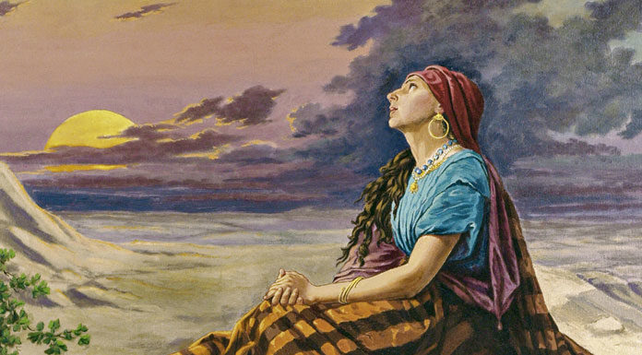
Ishmael
Notes:
Abraham told Sarah to do as she saw fit, so she began to mistreat Hagar, and Hagar ran away (Genesis 16:4–6).
The angel of the Lord found Hagar in the desert and told her to return to Sarah.
He then told her about her yet unborn son: “You are now pregnant and you will give birth to a son.
You shall name him Ishmael, for the Lord has heard of your misery. [Ishmael means “God hears.”]
He will be a wild donkey of a man; his hand will be against everyone and everyone’s hand against him, and he will live in hostility toward all his brothers” (Genesis 16:11–12).
So Hagar went back and bore a son; Abraham was 86 years old.

Slide 127
ABRAHAM
Hagar
Sarah
Ishmael
ISAAC
Covenant line
Esau
JACOB
(Israel)
12 Sons
(Children of Israel)
Notes:
Isaac’s sons -> Esau and Jacob
Esau oldest

Slide 128
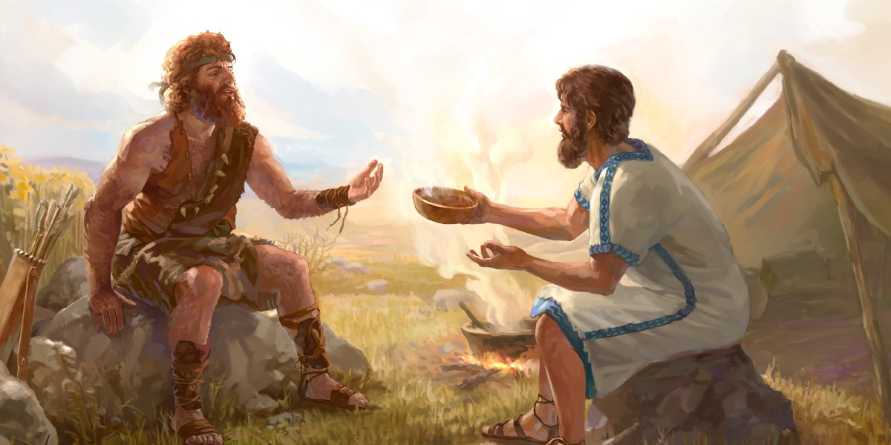
ESAU
Notes:
Esau was Abraham’s grandson, the older twin born to Isaac and Rebekah (the younger was Jacob).
Rebekah had a difficult pregnancy, and God told her it was because “two nations are in your womb; one people will be stronger than the other, and the older will serve the younger” (Genesis 25:23).
Esau’s name means “hairy,” which described him at birth (Genesis 25:25).
Esau’s twin was born holding Esau’s heel and was named Jacob, which means “supplanter”—someone who tricks another out of something for personal gain.
The twins’ birth story served as a prophecy about their future.
Esau became a skillful hunter (Genesis 25:27), and his father favored him.
His mother favored Jacob.
Esau took his hunting seriously; one day he came in from hunting so tired and hungry that he thought he was going to die (our first indication that Esau was a whiner).
His hunger, along with the tantalizing scent of the red lentil stew his brother was cooking, convinced him to give up his birthright when Jacob asked for it (verses 29–34).
Because of his desire for red stew, Esau became known as “Edom,” which means “red.”
The son with the birthright would receive a double portion of the family inheritance, so Esau’s giving up his birthright was a big deal.
In order to fill his belly, Esau had “despised his birthright” (verse 34).

Slide 129

JACOB
Notes:
Jacob was a determined man; some would consider him to be ruthless.
He was a con-artist, a liar, and a manipulator--in fact, the name Jacob not only means “deceiver,” but more literally it means “grabber”
He tricked his older brother, Esau, into giving him the covenant blessing from Jacob, and fled to Haran to avoid a confrontation with Esau after tricking him
He in turn was tricked by his Uncle Laban into marrying his first-born daughter Leah instead of Rachel.
Jacob fathered 12 sons and one daughter through Rachel, Leah, and two of his concubines, Bilhah, and Zilpah
Later, on his way to reconcile with Esau, he wrestled with the Angel of the Lord who is also identified as God, a preincarnate appearance of the Lord Jesus Christ.
This heavenly being then changes his name from Jacob (“deceiver,” “grabber”) to Israel (“one who struggles with God”)

Slide 130
ABRAHAM
Hagar
Sarah
Ishmael
ISAAC
Covenant line
Esau
JACOB
(Israel)
12 Sons
(Children of Israel)
Notes:
Next: The 12 sons of Jacob (Israel)

Slide 131
MOTHER | CHILDREN OF JACOB (ISRAEL)
Leah (Wife) | Reuben, Simeon, Levi, Judah, Issachar, Zebulun, Dinah
Rachel (Wife) | Joseph, Benjamin
Bilhah (Concubine) | Dan, Naphtali
Zilpah (Concubine) | Gad, Asher
Notes:
The 12 sons of Jacob → “children of Israel”

Slide 132

JOSEPH
Notes:
About 25% of the book of Genesis is dedicated to Joseph (Genesis 39:1-50:26).
Of all the people in the Bible, Joseph was the most nearly perfect type of Christ:
Both were loved dearly by their fathers.
Both were hated by their brothers.
Both were put in charge of a kingdom.
If you want to understand the life of Jesus Christ, become familiar with the life of Joseph.
The two have very much in common
In the story of Joseph and his brothers, we see the themes of forgiveness, the father-son bond, sibling rivalry, brotherly love, God’s sovereignty, and God’s greater good in times of suffering.
Just like Joseph, we are called to forgive those who have offended us and see life’s experiences as part of God’s plan to help us serve others.

Slide 133

SUMMARY
Abraham’s life teaches us to trust God fully even when we don’t know where he is taking us.
Joseph teaches us that God often works in ways we don’t always understand but he ultimately means them for good.
God’s covenant with Abraham reminds us of the great blessing that came through Abraham’s line, the Redeemer Jesus Christ.
Notes:
SUMMARY
[CLICK]
Abraham’s life teaches us to trust God fully even when we don’t know where he is taking us.
Joseph teaches us that God often works in ways we don’t always understand but he ultimately means them for good.
God’s covenant with Abraham reminds us of the great blessing that came through Abraham’s line, the Redeemer Jesus Christ.

Slide 134
GOT IT?
Notes:
GOT IT?

Slide 135

NEXT WEEK
Moses the Navy Seal of the Desert
Notes:
NEXT WEEK: Moses the Navy Seal of the Desert

Slide 136
PRAYER & PRAISE TIME
Notes:
PRAYER & PRAISE TIME
Our nation…seriously divided…much hate at top level.
Upcoming elections.
Our TLC pastors and staff.
Those who developing a vaccine.
Others?

Slide 137

Part 4:
THE WILDERNESS PERIOD

Slide 138
Wilderness Period
Abrahamic Covenant (review)
God makes Jacob into a great nation
Moses Leads Israelites to a Great Land
The Exodus
Summary

Slide 139
Quick Look at the Period
Mosaic Law given
Jacob & family
Moses born
Exodus begins
Israelites enter the
enter Egypt
1525 BC
1446 BC
Promised Land
1876 BC
1406 BC
Notes:
WILDERNESS PERIOD
Jacob & family enter Egypt
Moses born
The Exodus…the Law is given at Mt. Sinai
Israelites enter the Promised Land

Slide 140
Review:
Abrahamic Covenant

Slide 141
ABRAHAMIC COVENANT
To Abraham God promised…
A GREAT NATION
A GREAT LAND
A GREAT BLESSING
Notes:
LAST WEEK: ABRAHAMIC COVENANT
A great nation (expanded in the Davidic Covenant).
A great land (Palestinian Covenant).
A great blessing (New Covenant, Jesus).
WE WILL SEE HOW GOD was beginning to bring THIS ABOUT

Slide 142
God Makes Jacob Into a Great Nation

Slide 143
And God spoke to Israel in a vision at night and said, "Jacob! Jacob!" "Here I am," he replied. "I am God, the God of your father," he said. "Do not be afraid to go down to Egypt, for I will make you into a great nation there.
Gen. 46:2-3 NIV
Notes:
And God spoke to Israel in a vision at night and said, "Jacob! Jacob!" "Here I am," he replied. "I am God, the God of your father," he said. "Do not be afraid to go down to Egypt, for I will make you into a great nation there. (Gen. 46:2-3 NIV)

Slide 144

GOSHEN
Best land in Egypt
Great for crops & livestock
Isolated from Egyptians
Notes:
Goshen
Goshen was a fruitful land (Gen. 47:27)
Isolated from Egyptians who hated shepherds (Gen. 46:34)
No intermarriage with Egyptians
No religious involvement with Egyptians
No Egyptians enculturization
Egyptians enslaved Hebrews (Gen. 15:13)

Slide 145

Notes:
MAP: Goshen

Slide 146

ISRAELITES ISOLATED FROM EGYPTIANS
God made Israel into a unique nation by isolating it from Egyptian culture and religion
Notes:
God made Israel into a unique nation by isolating it from Egyptian culture and religion
Isolated from Egyptians who hated shepherds (Gen. 46:34)
No intermarriage with Egyptians
No religious involvement with Egyptians
No Egyptians enculturization
Egyptians enslaved Hebrews (Gen. 15:13)

Slide 147

Family
Nation
70
In Egypt 430 Years
~2 Million
Gen. 46:26-27
Exod. 12:40-41
Exod. 12:37
Notes:
Hebrews lived in Land of Goshen…like a greenhouse

Slide 148
Creation of a Nation
Nation
70
(Jacob’s family)
430 years in Egypt
~2 Million
(Exodus)
Exod. 1:5
Exod. 12:40
Exod. 12:37
Notes:
CREATION OF A NATION
When the children of Israel (Jacob) entered Egypt, they were a family, and 400 years later when they left Egypt, they had become a nation.
While in Egypt, Israel’s descendants grew from 70 people (Genesis 46:27) to a nation of 600,000 men, besides women and children (Exodus 12:37).
Based on this, it is estimated that the total number of Israelites at the beginning of the Exodus was close to 2 Million.
CR

Slide 149

ABRAHAMIC COVENANT
To Abraham God promised…
A GREAT NATION
Notes:
GOD HAD MADE JACOB INTO A GREAT NATION JUST AS HE PROMISED.

Slide 150
Moses Leads Israelites to a Great land

Slide 151

BACKGROUND
Jacob (Israel) had 12 sons – living in Canaan
430 years later, Moses → Exodus
CANAAN
EGYPT
Notes:
Jacob (Israel) had 12 sons – living in Canaan
Joseph (favorite) taken to Egypt (Midianite merchants).
He rose to a position 2nd only to Pharaoh
Jacob and his sons (Canaan)—famine
2nd year of famine, Joseph, invited the sons of Israel to live in Egyptian territory (Goshen)…the story of Joseph being united with his father Jacob goes on
430 years later, Moses → Exodus
40 years in wilderness
Only Joshua and Caleb enter Canaan

Slide 152

Moses
40 Years in Egypt
40 Years in Land of Midian
40 Years in Wilderness
Notes:
THREE PERIODS OF MOSES’ LIFE
1st Period: 40 years in Egypt
Pharaoh, worried that there are too many Hebrews, has the Hebrew newborns killed.
Moses is put in a basket by his mother and drifted down the Nile to avoid being killed.
An Egyptian princess finds him and raises Moses as one of her own children.
Moses was considered an Egyptian prince; however, he eventually realized his true identity.
He kills an Egyptian taskmaster for harming a Hebrew slave.
He runs for his life and ends up in Midian…to the far East of Egypt
2nd Period: 40 years in land of Midian (next slide)
Marries Zipporah, one of the seven daughters of Jethro, a Kenite shepherd who was a priest of Midian
Kenites were possibly descendants of Cain… a nomadic tribe.
Not much known about Kenites…probably Semites.
Moses tends Jethro’s sheep for 40 years in the Midian desert.
3rd Period: 40 years in the wilderness after the Exodus

Slide 153
ABRAHAM
ISAAC
JACOB
LEVI
MOSES
Notes:
WHO WAS MOSES?
“Moses” (Moshe maw-shay) → “I drew him out of the water”
Main character in books of Exodus-Deut.
He was a descendant of Levi (Exod. 16:18, 20).
Eventually became the priestly tribe of Israel

Slide 154
Moses
Was born in Egypt
A descendant of Abraham
He had an Egyptian name (Moshe, which is derived from the word mishisihu, “he was drawn,” since he drawn the baby from the water (Exod. 2:10)
He was a fugitive (Exod. 2:15)
He was a shepherd (Exod. 3:1)
He heard God speak from a burning bush (Exod. 3:2-4:17)
He had a speech disability (Exod. 4:10)
Notes:
MOSES
Was born in Egypt
A descendant of Abraham
He had an Egyptian name (Moshe, which is derived from the word mishisihu, “he was drawn,” since he drawn the baby from the water (Exod. 2:10)
He was a fugitive (Exod. 2:15)
He was a shepherd (Exod. 3:1)
He heard God speak from a burning bush (Exod. 3:2-4:17)
He had a speech disability (Exod. 4:10)

Slide 155
Moses
He brought ten plagues on Egypt (Exod. 8ff)
God split the red sea through Moses (Exod. 14:16)
He followed Jethro’s advice (Exod. 18:13-23)
He gave God’s 10 laws to Israel (Exod. 20:3-17)
He survived the Korah rebellion (Num. 16:1-40)
He defiantly struck the rock (Num. 20:11-12)
He lived 120 years (Deut. 34:7)
Notes:
MOSES
He brought ten plagues on Egypt (Exod. 8ff)
God split the red sea through Moses (Exod. 14:16)
He followed Jethro’s advice (Exod. 18:13-23)
He gave God’s 10 laws to Israel (Exod. 20:3-17)
He survived the Korah rebellion (Num. 16:1-40)
He defiantly struck the rock (Num. 20:11-12)
He lived 120 years (Deut. 34:7)

Slide 156


Notes:
Land of Midian
After Killing an Egyptian Taskmaster He then flees to Midian
Marries Zipporah and lives as a shepherd for 40 years
Zipporah, daughter of Jethro a Kenite
Not much known about Kenites
Possibly descendants from Cain
Nomadic, metalsmiths
Most likely not Hebrews
It was here in Midian that Moses learned survival skills for living in a desert (Navy Seal→ Exodus).
Q: Why would he need desert survival skills?
To teach the Israelites how to survive in the desert during the Exodus and their wilderness wanderings.
God appeared to him on Mount Horeb (burning bush)
Ordered him to return to Egypt to secure the freedom of the Israelites

Slide 157
The Exodus

Slide 158


10
9
1
2
7
8
3
4
6
5
Notes:
EXODUS
Rameses: Israel begins the Exodus
Succoth: God leads with a cloud by day and a pillar of fire at night. God is with them!
Israel passes through the Red(Reed) Sea. Specific crossing unknown—there may have been a series of lakes connecting to the Red Sea in those days.
God sends manna and quail to feed Israel. God meets their needs.
Ten Commandments given at Mount Sinai (Horeb). Spent a year here.
The Tabernacle constructed.
Kadesh-barnea: Moses sends spies into the promised land; Israel rebelled; Israel remained here many years.
Israel spends years in the eastern wilderness careful to avoid a conflict with those living in Edom and Moab.
Moses views the Promised Land and delivers his last three sermons (Deut. 1—32).
Joshua leads Israel into the Promised Land 40 years (Numbers 14:33-34) after Kadesh Barnea. Joshua and Caleb were the only ones in the original Exodus to make it to the Promised Land. (Deut. 1:36-38)

Slide 159
Notes:
WILDERNESS
It is important to understand that a wilderness is different from a desert.
A desert is a barren expanse of sand dunes and rocky areas that support no life.
A wilderness may also have barren areas but it has grassy upland plains, oases, springs, and vegetation, such as flowers, shrubs, and trees that can support a variety of animal life.

Slide 160

Movie Exodus = ~ 200 people
Notes:
Movie Exodus = ~ 200 people

Slide 161
The Amazing Exodus
Real Exodus = ~ 2 Million people
Notes:
Real Exodus = ~ 2 Million people
FOOD: Feeding 2 or 3 million people requires a lot of food. 1500 tons of food each day. Equivalent two freight trains, each at least a mile long, would be required!
FIREWOOD: take 4000 tons of wood and a few more freight trains, each a mile long, just for one day
WATER: If they only had enough to drink and wash a few dishes, it would take 11,000,000 gallons each day and a freight train with tank cars, 1800 miles long, just to bring water!

Slide 162

Crossing the Red Sea
Notes:
Actual Crossing the Red Sea
Two million people would be up to 800 miles long and would require 35 days and nights to get through the Red Sea.
The Red Sea opening would have to be 3 miles wide so that they could walk 5000 abreast to get over in one night.

Slide 163

Compelling Evidence of Red Sea Crossing
Source: Bible Lessons; Evidence of Red Sea Crossing by Donald P. Moss, <http://www.biblebigpicture.com/biblelessons/evidenceofredseacrossing.htm>
Notes:
ARCHAEOLOGICAL EVIDENCE OF THE RED SEA CROSSING
The scientists led by Professor Abdel Muhammad Gader and associated with Cairo University’s Faculty of Archaeology, have already recovered a total of more than 400 different skeletons, as well as hundreds of weapons and pieces of armor.
The archaeology team was searching for the remains of ancient ships and artifacts related to Stone Age and Bronze Age trade in the Red Sea area when they stumbled upon a gigantic mass of human bones darkened by age.
The remains of two war chariots were also discovered scattered over an area of approximately 200 square meters.
They estimate that more than 5,000 other bodies could be dispersed over a wider area, suggesting that an army of large size may have perished on the site.
Source: Bible Lessons; Evidence of Red Sea Crossing by Donald P. Moss http://www.biblebigpicture.com/biblelessons/evidenceofredseacrossing.htm
Source: World News, https://worldnewsdailyreport.com/red-sea-archaeologists-discover-remains-of-egyptian-army-from-the-biblical-exodus/

Slide 164

Israel wandering in the Wilderness
Notes:
CAMP GROUNDS NEEDED
Two-thirds the size of the state of Rhode Island was required, or a total of 750 square miles long.
Do you think Moses figured all this out before he left Egypt ?
I think not! You see, Moses believed in God. God took care of these things for him.
Now do you think God has any problem taking care of all your needs? Our God is an Awesome God!!!

Slide 165


THE MOSAIC (SINAITIC) LAW
Notes:
Shortly after leaving Egypt
God gave the Mosaic (Sinaitic) Law

Slide 166
MOSAIC (SINAITIC) COVENANT
CEREMONIAL LAWS
Worship
Offerings
Feast practices.
CIVIL LAWS
Regulations for daily living
Punishments for crimes.
MORAL LAWS
Ten Commandments
Love God
Love others
Notes:
MOSAIC (SINAITIC) COVENANT
Ceremonial Laws: Involved worship, offering, and feast practices
Civil Laws: Involved regulations for daily living, and punishments for crimes
Moral Laws: The Ten Commandments based on loving God (Exod. 20:3-11; Mark 12:30), and loving others (Exod. 20:12-17, Mark 12:31)
Scripture doesn’t make these distinctions
Mostly to help us see the overall purposes of the types of Law

Slide 167
The SIX Purposes of the Mosaic law
To reveal what sin is.
To reveal God’s holy character to the nation of Israel .
To provide forgiveness of sin through sacrifices and offerings .
To set apart the nation of Israel as distinct from all the other nations.
To provide a way of worship for Israel through the yearly feasts.
To provide God’s direction for Israel’s physical and spiritual health.
Notes:
The SIX Purposes of the Mosaic law
[CLICK]
To reveal what sin is (Romans. 7:7).
To reveal God’s holy character to the nation of Israel (Leviticus 19:2; 20:7–8).
To provide forgiveness of sin through sacrifices and offerings (Leviticus 1—7).
To set apart the nation of Israel as distinct from all the other nations (Exodus 19:5).
To provide a way of worship for Israel through the yearly feasts (Leviticus 23).
To provide God’s direction for Israel’s physical and spiritual health (Exodus 21—23; Deuteronomy 6:4–19; Psalm 119:97–104).

Slide 168

Tabernacle
A place where the people could properly worship God
Notes:
TABERNACLE
A place to meet God (“tent of meeting”)
Overall, 75 ft wide x 150 ft long
Actual tabernacle…sat in back of courtyard
15’ x 45’ (small brown object in back)
The overall sides and back were made of gold-covered acacia boards, about 28” wide and 15’ high.
Two rooms in the Tabernacle→ Holy Place + Holy of Holies (20 cubits x 20 cubits x 20 cubits…perfect cube!
Rev 21:16 (NIV) “The city (New Jerusalem) was laid out like a square, as long as it was wide. He measured the city with the rod and found it to be 12,000 stadia (1400 miles) in length, and as wide and high as it is long.
Priests carried the Ark and the altars on their shoulders, but the rest fit in ox-drawn carts

Slide 169


Slide 170
Download excellent video from YouTube “King Solomon’s Temple”

Slide 171

Placement of Israel’s Tribes
N
W
E
S
TABERNACLE
Notes:
When Camping:
12 mile circumference
Notice the centrality of the Tabernacle with Judah at the front entrance.
God is to be central in our lives too.
When moving:
First was Judah’s standard.
Main standards (Reuben, Ephraim, Dan)
Apparently the order put the strongest divisions at the head and rear for protection.
Protected in the middle were Moses, Aaron and sons, tabernacle.
GOD was to be the CENTER of Israel’s life
Source: L. Thomas Holdcoft, The Pentateuch, p. 102)

Slide 172

The Priesthood
Levites
Priests
Non-priests
High Priest
Notes:
THE PRIESTHOOD
Aaron, Moses’ brother commissioned by God to be a priest (mediator/sacrifices)
Aaron and Moses-tribe of Levi.
All priests were Levites, but not every Levite was a priest
Levites who were non-priests
Assisted the priests
Caretaking of the tabernacle
High priest
Could deliver edicts to guide the nation
Only one permitted to enter Most Holy Place
Once a year
Offered sacrifices for all the people
Levitical priest never intended to be permanent (Heb. 7:11)
Christ’s death on cross ended the Mosaic Law
Temple veil split in two
Access to God now through Christ by all who believe (Heb. 6:19-20)
Heb. 6:19-20 (NIV): We have this hope as an anchor for the soul, firm and secure. It enters the inner sanctuary behind the curtain, where our forerunner, Jesus, has entered on our behalf. He has become a high priest forever, in the order of Melchizedek.

Slide 173


How were people saved in the OT?
FAITH that God would provide a perfect sacrifice
"When he saw Jesus passing by, he said, "Look, the Lamb of God!"" (Jn. 1:36 NIV)
Notes:
FAITH
People in the OT were saved by forward-looking faith, believing that God would someday would provide a Savior who would be the perfect sacrifice. See Habakkuk 2:4.
As early as Genesis 3:15, we see the promise of a coming Savior, and throughout the Old Testament there are hundreds of promises that the Messiah would “save His people from their sins” (Matthew 1:21; cf. Isaiah 53:5-6).
Job’s faith was in the fact that he knew that his “Redeemer lives, and that in the end he will stand upon the earth” (Job 19:25).
A common misconception about the Old Testament way of salvation is that Jews were saved by keeping the Law.
Paul taught that the purpose of the Law was to serve as a “tutor to bring us to Christ, that we might be justified by faith” (Galatians 3:24).
Also, in Romans 3:20 Paul makes the point that keeping the Law did not save either Old or New Testament Jews because “no one will be declared righteous in his sight by observing the law.”
The Law was never intended to save anyone; the purpose of the Law was to make OT Israelites:
Aware of God’s character
Conscious of sin
Sin brings death unless it is atoned for (sacrifice)

Slide 174
Judaism (works based faith)
Laws made up to keep from breaking the Torah Laws
FENCE LAWS
TORAH
613 Commandments (mitzvah)
60% positive
40% negative
Notes:
JUDAISM TODAY: LAW = Written law (Torah) + Oral law
Written law : Torah → 613 commandments
60% Negative (don’t do this)
40% Positive (do this)
Oral Law (fence; gezeirah)
Jews felt that God gave Moses many laws orally to be passed down orally, since the Torah alone was deemed to be an insufficient guide to Jewish life
Jews felt that God gave Moses many laws orally to be passed down orally, since the Torah alone was deemed to be an insufficient guide to Jewish life.
Described in the Bible as “tradition.” (Matt. 15:3-5; Mark 7:3-5, 13, etc.).
Pharisees elevated the oral law above the written law (Sadducees didn’t)

Slide 175


JEWISH TALMUD
Notes:
AD 70 → A.D. 500 Oral law put into writing (Mishna) by Rabbi Judah
Right side was a commentary by Rabbi Rashi
Left side a commentary on Rabbi Rashi’s commentary
Mishna + Gemarah = Talmud (36 Volumes)
Source: The Words and Works of Jesus (J. Dwight Pentecost), 545ff.

Slide 176
Does the OT Law Apply Today?
The Ceremonial Laws no longer apply because they were completely fulfilled by the perfect sacrifice of Jesus Christ (Matthew 5:17).
The Civil Laws are no longer in effect but mankind has always established laws for coexisting.
The Moral Laws are still in effect today and can be found in the New Testament.
Notes:
DOES THE OT LAW APPLY TODAY?
The Ceremonial Laws no longer apply because they were completely fulfilled by the perfect sacrifice of Jesus Christ (Matthew 5:17).
The Civil Laws are no longer in effect but mankind has always established laws for coexisting.
The Moral Laws are still in effect today and can be found in the New Testament (Except for strict Sabbath Laws)

Slide 177
SUMMARY
    God promised to make Jacob’s descendants into a great nation which he did in Egypt where Jacob’s descendants grew from 70 people to about 2 million while keeping them isolated from the pagan Egyptian culture.
    God promised to give Jacob’s descendants a great land. He began doing this by leading the nation of Israel out of Egypt (Exodus) to the promised land of Canaan under the leadership of Moses.
    God always keeps his promises and overcame all obstacles and threats to the Abrahamic Covenant promises of a great nation and a great land.
Notes:
SUMMARY
God promised to make Jacob’s descendants into a great nation which he did in Egypt where Jacob’s descendants grew from 70 people to about 2 million while keeping them isolated from the pagan Egyptian culture.
God promised to give Jacob’s descendants a great land. He began doing this by leading the nation of Israel out of Egypt (Exodus) to the promised land of Canaan under the leadership of Moses.
God always keeps his promises (Gen. 12, “I will”) and overcame all obstacles and threats to the Abrahamic Covenant promises of a great nation and a great land.

Slide 178
GOT IT?
Notes:
GOT IT?

Slide 179

…What do you do when you face a huge crisis?
Notes:
What do you do when you face a huge crisis?
Have you ever been in a situation where you saw no solution?
TONIGHT…how Israel faced a huge crisis!!

Slide 180

Next week
Israel and the giants!
Notes:
COMING NEXT WEEK → Israel and the Giants

Slide 181
PRAYER & PRAISE TIME
Notes:
PRAYER & PRAISE TIME
Our nation…seriously divided…much hate at top level.
Upcoming elections.
Our TLC pastors and staff.
Those who developing a vaccine.
Others?

Slide 182
Next week
…What do you do when you face a huge crisis?
Notes:
NEXT WEEK
What do you do when you face a huge crisis?
Have you ever been in a situation where you saw no solution?
How Israel faced such a huge crisis!!

Slide 183
TONIGHT
Israel enters the promised land for the first time
They face great opposition
It takes years to conquer the land
The land is allocated to Israel’s tribes

Slide 184

Part 5:
CONQUEST and JUDGES PERIODS

Slide 185
1
ABRAHAMIC COVENANT
Great Nation
Nation of Israel
2
Great Blessing
Blessings/ Redeemer
3
Great Land
Promised Land (Canaan)
Notes:
JOSHUA is about taking the Land promised in the Abrahamic Covenant

Slide 186
THE CONQUEST PERIOD
The Book of Joshua
Israelites enter the Promised Land
1406 BC
Joshua’s Central Campaign
Joshua’s Southern Campaign
Joshua’s Northern Campaign
Dividing the Promised Land 1375 BC
Notes:
THE CONQUEST PERIOD…book of Joshua
This period is from the time Israel enters the Promised Land to the tribal allocations within the land
Key people include Joshua and the Canaanites
Key Scripture is the book of Joshua

Slide 187
1
2
3
4
5
Antediluvian Period
Post-Flood Period
Period of the Patriarchs
Wilderness Period
Conquest of the Promised Land
6
7
8
9
10
Period of Judges
United Monarchy Period
Divided Kingdom Period
Exile Period
The Restoration

Slide 188

JOSHUA
Joshua became the leader of Israel after Moses died
Developed brilliant strategy to divide and conquer the land
God commands Joshua to drive out Canaanites
Notes:
JOSHUA
Joshua became the leader of Israel after Moses died
Born in Egypt
Gifted military leader
Developed brilliant strategy to divide and conquer the land
Enters Promised Land (Gen. 15:18-21)
God commands Joshua to drive out Canaanites
Have no fear (Joshua 1:9)

Slide 189
After the death of Moses, the servant of the LORD, the LORD said to Joshua son of Nun, Moses' aide: “Moses my servant is dead. Now then, you and all these people, get ready to cross the Jordan River into the land I am about to give to them -- to the Israelites. I will give you every place where you set your foot, as I promised Moses. Your territory will extend from the desert to Lebanon, and from the great river, the Euphrates -- all the Hittite country-- to the Mediterranean Sea in the west. No one will be able to stand against you all the days of your life. As I was with Moses, so I will be with you; I will never leave you nor forsake you. (Jos. 1:1-5 NIV)
Notes:
God commands Joshua and the Israelites to conquer the Land
After the death of Moses, the servant of the LORD, the LORD said to Joshua son of Nun, Moses' aide: “Moses my servant is dead. Now then, you and all these people, get ready to cross the Jordan River into the land I am about to give to them -- to the Israelites. I will give you every place where you set your foot, as I promised Moses. Your territory will extend from the desert to Lebanon, and from the great river, the Euphrates -- all the Hittite country-- to the Mediterranean Sea in the west. No one will be able to stand against you all the days of your life. As I was with Moses, so I will be with you; I will never leave you nor forsake you. (Jos. 1:1-5 NIV)
Never will I leave you; never will I forsake you. (Heb. 13:5 NIV)

Slide 190

“…we seemed like grasshoppers” Numbers 13:33
Notes:
The problem: Promised Land was occupied by giants
Numbers 13:33
We saw the Nephilim there (the descendants of Anak come from the Nephilim).
We seemed like grasshoppers in our own eyes, and we looked the same to them."

Slide 191

The Canaanites
Notes:
CANAANITES
Deut. 7:2 “Destroy them totally, show them no mercy.”
Josh. 6:17, 21 “Destroy every living thing living in it—men, women, young and old, cattle, sheep, and donkeys.”
Discussion: Was God too cruel? How can this be right? Doesn’t God tell us to love our enemies?
Although God is loving and merciful, he is also just
God does not allow evil to continue unchecked
The command to destroy these nations was both a judgment and a safety measure
God’s command was designed to protect the nation of Israel from being ruined by the idolatry and immorality of its enemies
To think God is too nice to judge sin would be to underestimate him
Canaanites
The people of the land (Canaanites) had incurred the wrath of God because they defiled the land—
Worshipped pagan gods.
Sacrificing children—thinking they would gain immortality.
Buried children alive
Rampant sexual immorality, etc.
Worshipped demons
Note: The Bible says that there were seven nations in the land of Canaan that would be conquered. They were worshipers of false gods who demanded live human sacrifices to appease them. One famous archaeologist made a chilling remark in one of his books. He stated that the foundation of nearly every building that was erected in the ancient world was erected over the offering of a firstborn sacrificial victim who was "buried alive." The Old Testament reveals that the Canaanites were actually sacrificing to demons, and all of the rituals, and temple prostitution, and incest, and orgies, and divination, and many other gross immoralities were inspired by the worship of demons. <https://www.bible-history.com/interestingfacts/oldtestament/6-wickednessofthecanaanites.html>

Slide 192
The term” conquest” refers to a series of wars fought by the Israelites over the land that had been inhabited by their ancestors, Abraham, Isaac, and Jacob. In this sense they were not seizing the land as much as they were reclaiming the land
Notes:
The term” conquest” refers to a series of wars fought by the Israelites over the land that had been inhabited by their ancestors, Abraham, Isaac, and Jacob.
In this sense they were not seizing the land as much as they were reclaiming the land

Slide 193

Notes:
Before Invading the Land…Obstacle…had to cross the Jordan River with Tabernacle
Read Joshua 3:15-17
“Now the Jordan is at flood stage all during harvest. Yet as soon as the priests who carried the ark reached the Jordan and their feet touched the water's edge, the water from upstream stopped flowing. It piled up in a heap a great distance away, at a town called Adam in the vicinity of Zarethan, while the water flowing down to the Sea of the Arabah (the Salt Sea) was completely cut off. So the people crossed over opposite Jericho. The priests who carried the ark of the covenant of the LORD stood firm on dry ground in the middle of the Jordan, while all Israel passed by until the whole nation had completed the crossing on dry ground.”
Q: Why do you suppose God didn’t stop the Jordan well before the priests walked into it?

Slide 194
QUESTION
Joshua and Israel did some miraculous things but do you think such things just don’t happen today?
Why, or why not?
Notes:
QUESTION
Joshua and Israel did some miraculous things but do you think such things just don’t happen today?

Slide 195
Joshua’s Divide & Conquer Strategy

Slide 196

3
Northern Canaan
1
Central Canaan
2
Southern Canaan
Notes:
Israel on east side of Jordan River (blue hexagon)
Joshua
Conceived a three-part strategy
Central → Southern → Northern regions
Divide and conquer…couldn’t join forces against Israel
Israelites were fierce fighters…raised in desert

Slide 197
Joshua’s divide & conquer strategy
1
Central Campaign
Notes:
Central Campaign (Josh. 5:13-8:35)
Jericho: great walled city.
Rahab: prostitute who placed her faith in the God of Israel.
Marched around Jericho for six days-blowing trumpets & carrying the ark (psych-out?)
Seventh day: 7 times—then shout!
Contrary to Gods’ command, Achan took a Babylonian garment, 200 shekels of silver, a wedge of gold and hid them in his tent
City of Ai
Israel was chased away, some were killed, the nation was shamed.
Achan’s sin was revealed by God and he was stoned.
Ai was subsequently destroyed.

Slide 198

Joshua’s divide & conquer strategy
2
Southern Campaign
Notes:
SOUTHERN CAMPAIGN (Josh. 9:1—10:43))
City of Gibeon.
Gibeonites, in disguise, trick Joshua into making a peace treaty—meal eaten together.
Gibeonites heard of the Israelite’s victories and pretended to be ambassadors from a far country in order to make a peace treaty with the Israelites (9:4-15).
Joshua did not consult God beforehand.
Joshua made a treaty (oath) with them.
Even after they realized they had been tricked they could not go back on their oath because of the Law (Lev. 5:4; 27:1, 28).
Gibeonites were allowed to live but were enslaved as woodcutters and water carriers.
Joshua defeats seven more southern cities (Gilgal, Gibeon, Jarmuth, Azekah, Makkedah, Debir, Hebron)
Adoni-Zedek, king of Jerusalem hears of Israel’s victories at Ai and Jericho and attempts to form a coalition with four other nearby Amorite kings to resist Israel.
The five kings attack the Gibeonites because they had a treaty with Israel.
Joshua and his army march all night from Gilgal to Gibeon and defeat the Amorite armies with God’s help (large hailstones).
Joshua prayed that the sun would stand still so they could continue pursuing the escaping Amorites.
The sun remained in the middle of the sky about a full day.
Joshua finds and kills the five kings.

Slide 199
Joshua’s divide & conquer strategy
3
Northern Canaan
Notes:
The Northern Campaign (Josh. 11:1-15)
Cities as far north as Sidon above Mount Hermon.
Jabin, king of Hazor gathered the kings of Madon, Shimron, Acshaph, and other northern kings
They confronted the Israelites at the Waters of Merom
Joshua, probably at night, hamstrung their horses and burned their chariots
Nothing was spared
Israel defeated almost most of the Canaanites—but not the Jebusites-- later plagued Israel for years (Josh. 15:63)
Joshua fulfilled “98%” of God’s commands to destroy/drive out ALL Canaanites

Slide 200
DIVIDING THE PROMISED LAND

Slide 201

Notes:
DIVIDING THE PROMISED LAND
Israel now controlled the land
After seven years of battle, Joshua left the mopping up to the tribes.
They did not finish the job of completely driving out all Canaanites.
Jerusalem still had Jebusites
East of Jordan
Reuben, Gad and Manasseh fulfilled their part of the bargain and now claimed the land east of the Jordan (Transjordan plateau)
Manasseh-great portion →split
North-western region
Issachar, Asher, Naphtali, Zebulun
Central
Ephraim, Dan
Southern
Benjamin (Jerusalem), Judah (Bethlehem), Simeon (within the territory Judah)
All regions
Tribe of Levi (priests who lived in cities)

Slide 202

Geography and the Conquest
4
2
3
Transjordan Plateau
Central Mountains
1
Notes:
Geography is similar to California
Coastal plains→Beach coast
Central mountains like Santa Cruz mountains/Highway 17.
Jordon rift→San Joaquin Valley
Transjordan plateau→Sierra Mountains
1: Coastal plain: Philistines, chariots.→ Deborah defeated them, chariots get stuck in mud.
Central mountains:
West Bank (today).
7,000 feet.
Dry, arid →rock mulching.
2: Central Mountains
Today’s West Bank
Southern region low rainfall—difficult to produce vegetation—used rock mulching, spreading rocks over ground to retain moisture.
3: Jordan rift:
-1,290 feet below sea level.
Sudden changes in weather.
Earthquakes.
4: Transjordan plateau:
5,000 ft above sea level
Abundant rivers and streams
Abundant vegetation.
For the Israelites, it was a source of wheat and one of the best regions for raising cattle.

Slide 203
THE PERIOD OF THE JUDGES
The Book of Judges
Period of the judges begins
1375 BC
Ehud
1309-1229 BC
Gideon
1162-1122 BC
Sampson
1075-1055 BC
Othniel
1367-1327 BC
Deborah
1209-1169
Samuel born 1105 BC
Saul anointed king1050 BC
Notes:
Quick Look at the Period
This period is from the tribal allocations of the Promised Land to the time of Samuel the prophet (1375-1050 B.C.)
Key people include the Judges of Israel and Ruth
Key Scripture are the books of Judges and Ruth
Major events include Israel’s six cycles of apostasy
(~) tilde

Slide 204
1
2
3
4
5
Antediluvian Period
Post-Flood Period
Period of the Patriarchs
Wilderness Period
Conquest of the Promised Land
6
7
8
9
10
Period of Judges
United Monarchy Period
Divided Kingdom Period
Exile Period
The Restoration

Slide 205

ISRAEL FORGETS GOD
“After that whole generation had been gathered to their ancestors, another generation grew up who knew neither the LORD nor what he had done for Israel.”
Notes:
“After that whole generation had been gathered to their ancestors, another generation grew up who knew neither the LORD nor what he had done for Israel.”
Q: Where do children today learn about God?

Slide 206
QUESTION
Where do children today learn about the living God?
Notes:
Question
Where do children today learn about the living God?

Slide 207
ISRAEL’s SIX CYCLES OF APOSTACY

Slide 208
Israel obeys God
Israel disobeys God
Israel is enslaved
Israel cries out to God
God raises up a judge
Israel delivered
Israel’s cycle of apostasy
Notes:
Stage 1: Israel serves the Lord
Stage 2: Israel disobeys God and falls into idolatry
Read Judges 3:7 “The Israelites did evil in the eyes of the LORD; they forgot the LORD their God and served the Baals and the Asherahs.
Read Deut. 28:25: God punished them according to the Mosaic Law—gave them over to other nations
Stage 3: Israel is enslaved
Judges 3:8 “The anger of the LORD burned against Israel so that he sold them into the hands of Cushan-Rishathaim king of Aram Naharaim, to whom the Israelites were subject for eight years.
Stage 4: Israel repents and cries out to the Lord
Judges 3:9a “But when they cried out to the LORD...
Read Deut. 28:1 If you fully obey the LORD your God and carefully follow all his commands I give you today, the LORD your God will set you high above all the nations on earth.
Stage 5: God raises up a Judge
Judges 3:9b-10a "...he raised up for them a deliverer, Othniel son of Kenaz, Caleb's younger brother, who saved them. The Spirit of the LORD came upon him, so that he became Israel's judge and went to war.
Stage 6: Israel is delivered
Joshua 3:10b "The LORD gave Cushan-Rishathaim king of Aram into the hands of Othniel, who overpowered him.
Back to Stage 1: Israel serves the Lord
Judges 3:11 “So the land had peace for forty years, until Othniel son of Kenaz died.”

Slide 209

ISRAEL’s JUDGES

Slide 210


JUDGE?
Notes:
Which of these two represent what a biblical judge was like?
Not like Judge Judy, except for Deborah
More like Rambo → Military leaders

Slide 211
Israel’s Judges
Cycle 1: Othniel
Cycle 2: Ehud and Shamgar
Cycle 3: Deborah and Barak
Cycle 4: Mostly Gideon but including Tola, & Jair
Cycle 5: Jephthah, Ibzan, Elon, and Abdon
Cycle 6: Samson
Notes:
Cycle 1: Othniel (Judges 3:7-11).
“The Spirit of the Lord came upon them.” Gideon, Jepthah, and Samson where the others.
Cycle 2: Ehud and Shamgar (Judges 3:12-30)
Ehud was left-handed and hid short sword on his right side to enable him to assassinate the evil Eglon, king of Moab, Israel’s oppressor.
Normally, one looked on the left side of a person to see if he was carrying a sword.
Shamgar (3:31) used an ox goad (long stick with pointed end) as a weapon to kill 600 Philistines.
Cycle 3: Deborah and Barak (Judges 4:1—5:31)
Deborah was the only female judge and an actual Judge.
She and Barak (military General) devised a plan to defeat the superior army of the Canaanites.
Cycle 4: Primarily Gideon but including Tola, and Jair (Judges 6:1—8:32).
Gideon is known for testing God with a fleece (Judges 6:36-40) and devising a plan to make Israel’s army of 300 men, appear to be greater than the Midianite army (Judges 7:15-22).
Cycle 5: Jephthah, Ibzan, Elon, and Abdon (Judges 11:29-40; 12:8-15).
Jephthah’s mistake was making a foolish vow to God (only daughter).
Ibzan, Elon, and Abdon were also raised up as judges during this cycle.
Cycle 6: Samson (Judges 13:1—21:25).
More than 1/3 of the book of Judges is devoted to Samson who was endowed with the Spirit of Yahweh
Samson was a wild, self-willed man. Passion ruled him. He could not resist the flatteries of women. In short, he was an overgrown schoolboy, without self-control.

Slide 212
QUESTION
God restored Israel every time they repented… so is it OK for us sin knowing that God always forgives?
Notes:
Question
God restored Israel every time they repented… so is it OK for us sin knowing that God always forgives?

Slide 213
THE STORY OF RUTH

Slide 214

THE STORY OF RUTH
Ruth teaches us about God’s LOYAL LOVE!
H. hesed
Notes:
Ruth teaches us about God’s LOYAL LOVE! (hesed)
Our story opens on a nice Jewish family with a problem.
Famine has hit Bethlehem, which forces Elimelech and his wife, Naomi, to move east to Moab with their two sons to get some grub.
There, they set up shop, eat some food, and live for about ten years.
The sons marry two local girls, Ruth and Orpah, during this time.
One by one, Elimelech and his two sons die. Bummer. This leaves Naomi, Ruth, and Orpah man-less and in need of help.
Naomi decides to head back to Bethlehem (ten years is enough time to get over a famine, right?) and her daughters-in-law pack their luggage and join her.
Naomi begs the girls to stay behind and, while Orpah is convinced and high tails it back to Moab, Ruth pledges her devotion to Naomi, forsaking her god and her people to become part of Naomi's life. Ruth's stubbornness pays off and Naomi lets her tag along.
In Bethlehem, things are not good for the ladies.
Naomi is feeling down and out and Ruth is reduced to gleaning in the barley fields.
There, Ruth happens to run into a well-known rich guy named Boaz, who instantly takes a liking to her and offers her all kinds of sweet gleaning privileges.
Boaz also happens to be a relative of Naomi's late husband, which is very, very important, since Boaz would have an obligation to marry Ruth and provide for her as family.
When Naomi hears about Boaz and what a stand-up guy he is, she hatches a plan for Ruth to snag him as a husband.
She tells her daughter-in-law to visit Boaz at night in secret and lie at his feet.
Ruth does what her mother-in-law asks and Boaz is pleasantly surprised to see the cute girl from the fields is interested in him.
He tells Ruth that he would love to marry her, but that there's another relative with even closer ties to her in-laws.
Boaz sets out to meet the guy and everyone is left to hold his or her breath while we wait to find out whom Ruth will end up with.
As it turns out, this random relative is interested in buying some land that Naomi has, but he's much less interested in taking her daughter-in-law as his wife.
So a deal is struck—the other guy renounces his claim on Ruth and Boaz is free to marry her. Wedding bells start ringing and everyone is happy.
Soon, Ruth and Boaz have a son, which makes Naomi über happy.
The women in town name the baby Obed and, surprise, surprise, he goes on to be the grandfather of King David. Talk about a happy ending.

Slide 215
RUTH (MOABITE) Great Grandmother of David
OBED
JESSE
KING DAVID
JESUS
Notes:
RUTH
RUTH: Lived during period of Judges
Ruth (Moabitess) lived during the period of the judges.
Ruth remained faithful to God, even though Moabites were considered aliens to God.
Ruth gives us an example of God's loyal love (ḥesed).
Ruth was the great grandmother to King David.
Ruth was a type of God’s loyal and unconditional love for you!

Slide 216
GOT IT?
Notes:
GOT IT?

Slide 217

Next Week
We want to be like the other guys!!!

Slide 218
PRAYER & PRAISE TIME
Notes:
PRAYER & PRAISE TIME
Our nation…seriously divided…much hate at top level.
Upcoming elections.
Our TLC pastors and staff.
Those who developing a vaccine.
Others?

Slide 219
TONIGHT
We want to be like the other guys!!!
Notes:
ISRAEL: 12 independent tribes—tribal conflicts
Lost faith in God
Forgotten consequences of Mosaic Law (Deut. 28)
Wanted to be like pagan neighbors—“grandeur and power”
Pagan Canaanites had kings (not all were destroyed during Joshua’s day)
Coexisting city-states
Their grandeur appealed to the Israelites
1 Sam. 8:5 NIV: They said to him (Samuel), "You are old, and your sons do not follow your ways; now appoint a king to lead¹ us, such as all the other nations have.”
What’s wrong with this?
Read 1 Sam. 8:20 → Then we will be like all the other nations, with a king to lead us and to go out before us and fight our battles." (1 Sam. 8:20 NIV)
Up until now God fought their battles and gave them victories (Judges)
The problem was not in having a king, but rather, the reason they wanted a king.
Israel was rejecting God
They foolishly assumed there would be some greater power in a king leading them in battle.

Slide 220
Question
What is it about us that wants to be like other people even when it may not be good for us?

Slide 221



United Monarchy Period & Divided Kingdom Periods
Part 6

Slide 222
monarchy:
a form of government with a monarch at the head

Slide 223
Quick Look at the Period
Samuel born 1105 BC
Saul anointed king
1050 BC
David becomes king over all Israel
1003 BC
Solomon becomes king
970 BC
The kingdom divides
930 BC
Notes:
The United Monarchy period is the name given to the Israelite kingdom of Israel and Judah, during the reigns of Saul, David and Solomon.
This is traditionally dated between 1050 when Saul is anointed as king until 930 BC when the kingdom divides shortly after Solomon’s death.

Slide 224
UNITED MONARCHY PERIOD
Notes:
United monarchy period
The United Monarchy period is the name given to the Israelite kingdom of Israel and Judah, during the reigns of Saul, David and Solomon.
This is traditionally dated between 1050 bc when Saul is anointed as king until 930 BC when the kingdom divides shortly after Solomon’s death.

Slide 225
United Monarchy
Theocracy
Transition
Judges
Samuel
Saul
David
Solomon
1 & 2 Samuel
(Samuel?)
1 & 2 Chronicles
(Ezra)
1 & 2 Kings
(Jeremiah?)
Notes:
Israel transitions from a Theocracy to a Monarchy
Samuel is a transition between Judges & United Monarchy
In wanting a human king, Israel transitioned from a theocracy to a monarchy of kings
Books: 1-2 Samuel, 1-2 Chronicles; 1-2 Kings

Slide 226

SAMUEL
Notes:
Samuel was a man chosen for God, from his miraculous birth until his death.
He served in several important positions during his life, earning God's favor because he listened to God and obeyed unswervingly.
Heb. “Hineni” means: “Here I am ready and waiting to do Your will.
Samuel was born to an initially barren woman named Hannah, who prayed longingly to God for a child.
The Bible says "the Lord remembered her," and she became pregnant.
She providentially named the child Samuel, which means "the Lord hears."
When Samuel was weaned, Hannah presented him to God at Shiloh because God heard her cry for a child, and placed him in the care of Eli the high priest.
The Bible describes how Samuel grew in wisdom and eventually became a prophet.
Following a great Philistine victory over the Israelites, Samuel became a judge and rallied the nation against the Philistines at Mizpah.
Unfortunately, Samuel's sons, Joel and Abijah, who had been delegated to follow him as judges, were corrupt, so the people demanded a king.
Samuel listened to God and reluctantly anointed the first king of Israel, a tall, handsome Benjaminite named Saul.

Slide 227
Question
Do you think Hannah may have been too impulsive is giving her child, Samuel, to Eli the priest?

Slide 228

God forewarned Israel
Notes:
ISRAEL FOREWARNED if they insisted on having a king (READ 1 Samuel 8:1-22)
God forewarned Israel of the consequences
The king would take their sons from them to act as his personal attendants
He would make their daughters to be perfumers, cooks and bakers
He would make them serve in a permanent army
He would force them to work at farming and making weapons of war
He would compel them to give 10% of all their crops, herds, and flocks which would be given to his officials and attendants
He would take the best of their servants and cattle for his own use
They would become the king’s slaves until they cry out to God but he will not answer them
NEVERTHELESS…Israel still wanted a human king over their nation
God wanted Israel to have a king but not now
God’s king was to be of his choosing and in his perfect timing
Abrahamic Covenant (Gen. 17:6)—included kings in lineage of Abraham.
Gen. 17:6 “I will make you very fruitful; I will make nations of you, and kings will come from you.”

Slide 229

King Saul
(Israel’s first king)
Notes:
King Saul, Israel’s first king → next slide

Slide 230
King Saul’s strengths
Notes:
King Saul’s STRENGTHS
Saul began by putting the Lord first in his life.
He had physical superiority-striking appearance (1 Samuel 9:2).
He was given the Holy Spirit (1 Samuel 10:9-13).
He was discreet (1 Samuel 10:27), generous (1 Samuel 11:12, 13), and had godly companions (1 Samuel 10:25, 26).
Organized an army of 300,000
Gave Israel some initial military victories

Slide 231
King Saul’s weaknesses
Notes:
King Saul’s Weaknesses
He relied less on Samuel’s advice
He took the priestly function which should have been Samuel's into his own hand against the will of God (1 Samuel 13:8-13).
As a result his kingdom did not flourish (1 Samuel 13:14).
He didn’t execute Agag the Amalekite as God commanded (1 Samuel 15:9).
He lost the Spirit of God (1 Samuel 16:14).
Tried to kill David on several occasions
His frustration caused him to kill the priests of Nob (1 Samuel 22:11-19).
He turned to witchcraft at Endor (1 Samuel 28:7-20).
He committed suicide to end his life (1 Samuel 31:4).

Slide 232

A
B
Chiasms in the Bible
(Example Genesis 6—9)
C
D
E
F
G
H
MAIN POINT
H’
G’
F’
E’
D’
C’
B’
A’
Notes:
Genesis 6-9

Slide 233
DISOBEDIENCE
(1 Samuel 15:1-35)
Chiastic Structure
RISE
(1 Samuel 8:1-14:52)
DECLINE
(1 Samuel 16:1--31:13)
Notes:
SAUL’s LIFE
When Saul obeyed God he rose in king power and success.
But later he disobeyed God when he spared Agag the Amalekite and some cattle (“BUT” 1 Samuel 15:9)
But Saul and the army spared Agag and the best of the sheep and cattle, the fat calves and lambs-- everything that was good. These they were unwilling to destroy completely, but everything that was despised and weak they totally destroyed. (1 Sam. 15:9 NIV)
Chiasm → disobedience was the main point→ CLICK on “CHIASTIC STRUCTURE”
Ref: Phillip G. Kayser [https://kaysercommentary.com/Sermons/BibleSurvey/09%20Samuel.md]

Slide 234

KING DAVID (Israel’s greatest king)
Notes:
King David…Israel’s greatest king → next slide

Slide 235
King David’s Strengths
Notes:
DAVID’s STRENGTHS
A valiant (courageous) spirit
Military strategist
Diplomatic skills
He united the 12 tribes of Israel
Musical and poetic gifts
Ability to admit his faults
An unshakeable trust in God

Slide 236

David’s rise
Notes:
DAVID vs. GOLIATH
Goliath was about 6’9” tall (Dead Sea Scrolls, Josephus, Greek Septuagint)
(Masoretic text → 9’ 9”)
Battles were seen as fights between gods
Trash talk
David defeats Goliath
Philistines run for it—Israel’s God must be stronger than their gods.
Source:
<(https://www.google.com/search?source=hp&ei=P8qsWb2oIqfi0gLY-b3oBQ&q=how+tall+was+goliath&oq=how+tall+was+gol&gs_l=mobile-gws-hp.1.0.0l5.1880.55142.0.56702.31.24.7.11.11.0.400.2998.11j12j4-1.24.0....0...1.1j4.64.mobile-gws-hp..0.31.2159.3..5j41j0i131k1j0i131i155k1j0i10k1.-01p41Agytc)>

Slide 237

Andre the Giant
Notes:
Andre the Giant 7’4” (“The Princess Bride”)
520 lbs.
1946-1993 (50 years old)
Standing next to Andre is Mike Graham 5’ 8” tall
Imagine David facing Goliath at 6’ 9”???
Next slide

Slide 238

Suleiman Ali Nashnush – 8 ft tall
Notes:
Suleiman Ali Nashnush – 8ft
Officially the tallest athlete in any sport, Libyan Suleiman Ali Nashnush came in at a colossal 8ft!
The former basketball player is one of only 17 registered individuals to have ever reached eight feet or higher.
Although he had an abnormal growth, which was not caused by any extra professional training, Nashnush was eventually treated for it and underwent successful surgery.
He was also an actor, starring in Federico Fellini’s Fellini Satyricon.
Despite his peak height being 8ft, Nashnush only reached 7’10” when he played professional basketball.

Slide 239
King David’s weaknesses
Notes:
DAVID’s decline (weaknesses)
1) Committed adultery with Bathsheba
2) Arranged the murder of Uriah, Bathsheba’s husband.
3) He directly disobeyed God in taking a census of the people (See note below).
As to why God was angry at David, in those times, a man had the right to count or number what belonged to him.
He was a poor father--his reluctance to take needed disciplinary action brought bloodshed within his own family
One son (Amnon) raped his half-sister
Absalom rebelled against David and tried to take his kingdom by force
NOTE: THE CENSUS
Question: "Who incited David to take the census in 2 Samuel 24, God or Satan? Why was God so angry at David for taking the census? Why did God punish the Israelite people when it was David who ordered the census?“
Answer: Second Samuel 24:1 says, “Again the anger of the Lord burned against Israel, and he incited David against them, saying, ‘Go and take a census of Israel and Judah.’”
The parallel account of the incident surrounding the census, however, reveals it was Satan who incited David to take the census: “Satan rose up against Israel and incited David to take a census of Israel” (1 Chronicles 21:1).
This discrepancy is often explained by the understanding that, in order to achieve His purposes, sometimes God sovereignly permits Satan to act. God can use Satan in various ways, with the result being the refining, disciplining, and purification of disobedient believers (Luke 22:31–32; 1 Corinthians 5:1–5; 2 Corinthians 12:7–10).

Slide 240

BATHSHEBA
(2 Samuel 11:1-4)
Chiastic Structure
RISE
(2 Samuel 5--10)
DECLINE
(2 Samuel 11:5—21:22)
Notes:
Notice the author’s main point (chiasm) → Bathsheba → 2 Samuel 11:1-14
It only takes a second to make a bad decision.
The consequences are initially repressed.
The consequences often cause damage over a long period of time.

Slide 241

The Davidic Covenant
The Messiah will come through David’s lineage and establish an everlasting kingdom
Notes:
THE DAVIDIC COVENANT (2 Sam. 7:11-16)
David is to have a child, yet to be born, who shall succeed him and establish his kingdom (2 Sam. 7:11-12).
This son (Solomon) shall build the temple instead of David (2 Sam. 7:13a).
The throne (authority) of his kingdom shall be established forever (2 Sam. 7:13b).
The throne will not be taken away from him (Solomon) even though his sins justify chastisement (2 Sam. 7:14-15).
David’s house, throne, and kingdom shall be established forever (2 Sam. 7:16).
. 7:16).

Slide 242
ABRAHAMIC COVENANT
To Abraham God promised…
A Great Land
A Great Nation
A Great Blessing
Davidic Covenant
Notes:
Abrahamic Covenant …a great blessing, Redeemer
Davidic Covenant…the Redeemer (Messiah) would come from David’s lineage and would establish an eternal Kingdom

Slide 243
King Solomon
Notes:
King Solomon → next slide

Slide 244
King Solomon’s strengths
Notes:
SOLOMON’S STRENGTHS
Requested wisdom from God so that he could successfully lead Israel.
Directed the construction of Israel’s 1st temple
Led Israel to become a significant kingdom in the ancient near east
Ruled 40 years (970—930 B.C.)
Age: 20-60
Wrote Proverbs, Ecclesiastes, Song of Solomon
Brought Israel to its highest standard of luxury

Slide 245
Solomon’s weaknesses
Notes:
SOLOMON’S WEAKNESSES
Married foreign pagan women as a diplomatic jesture.
Allowed pagan wives to divert his devotion from God.
Established excessive taxation.
Allowed syncretistic practices (1 Kings. 3:1-3)
1 Kings 3:1-3 “Solomon made an alliance with Pharaoh king of Egypt and married his daughter. He brought her to the City of David until he finished building his palace and the temple of the LORD, and the wall around Jerusalem. The people, however, were still sacrificing at the high places, because a temple had not yet been built for the Name of the LORD. Solomon showed his love for the LORD by walking according to the statutes of his father David, except that he offered sacrifices and burned incense on the high places.
[High places, very simply, were places of worship on elevated pieces of ground or raised altars in low land such as a valley.
High places were originally dedicated to idol worship especially among the Moabites].

Slide 246
Question
Should good leaders always appease the will of the people in order to keep peace? Why, or why not?

Slide 247

KINGSHIP OF SOLOMON
FOREIGN WIVES
(1 Kings 11:1-13)
Chiastic Structure
RISE
(1 Kings 2--10)
DECLINE
(1 Kings 11:14-43
Notes:
Chiastic Structure
Q: What is the author’s main point?
A: He married foreign wives

Slide 248

Notes:
KING SOLOMON’S WEALTH
Over 700 wives
Over 300 concubines
In order to maintain his palace he required:
Annual income of 666 Talents (Today: $256 Million)
40,000 horse stalls
12,000 horsemen
Daily provisions of
Deer, fat fowl, gazelles…
20 cows
10 fat oxen
100 sheep
60 measures (about a donkey load) of meal, and 30 measures of fine flour

Slide 249
DIVIDED KINGDOM
PERIOD

Slide 250


Northern Kingdom (10 Tribes)
Southern Kingdom
(2 Tribes)
Notes:
MAP

Slide 251
Four Reasons for Israel’s Decline
Solomon’s oppression of Israel.
Solomon’s heart was turned away from Yahweh.
Rehoboam’s rejection of sound advice.
Rehoboam’s decision to increase Israel’s oppression and taxation.
Notes:
FOUR REASONS FOR ISRAEL’S DECLINE
1. Solomon’s oppression of Israel (1 Kings 5:13-14; 9:15-23).
(1 Ki. 5:13-14 NIV) "King Solomon conscripted laborers from all Israel-- thirty thousand men. He sent them off to Lebanon in shifts of ten thousand a month, so that they spent one month in Lebanon and two months at home."
2. Solomon’s heart was turned away from Yahweh (1 Kings 11:1-6)
4 As Solomon grew old, his wives turned his heart after other gods, and his heart was not fully devoted to the LORD his God, as the heart of David his father had been. 5 He followed Ashtoreth the goddess of the Sidonians, and Molek the detestable god of the Ammonites. 6 So Solomon did evil in the eyes of the LORD; he did not follow the LORD completely, as David his father had done."
Rehoboam’s rejection of sound advice (1 Kings 12:6-8)
(1 Ki. 12:6-8 NIV) "8 But Rehoboam rejected the advice the elders gave him and consulted the young men who had grown up with him and were serving him."
Rehoboam’s decision to increase Israel’s oppression (1 Kings 12:13-14)
"The king answered the people harshly. Rejecting the advice given him by the elders, 14 he followed the advice of the young men and said, "My father made your yoke heavy; I will make it even heavier. My father scourged you with whips; I will scourge you with scorpions.""

Slide 252
Northern Kingdom
(Israel-10 Tribes)
722
BC
Conquered by Neo-Assyrians
Solomon
Rehoboam
David
Saul
Conquered by Neo-Babylonians
931
BC
United Monarchy Period
Southern Kingdom
(Judah-2 Tribes)
586
BC
Exile
538
BC
Notes:
Israel in deep idolatry at Solomon’s death
They begin to experience the curses of Deut. 28
931 BC, under Rehoboam, Nation of Israel splits into two kingdoms
Northern Kingdom (Israel)
For 0ver 200 years…northern kingdom…ruled by corrupt kings, assassinations…became weaker and weaker
In 722 B.C. conquered by the Neo-Assyrians
Taken from their homeland
Assimilated into Assyria’s culture
Israel” (10 tribes) effectively disappears from Scripture
Southern Kingdom (Judah)
For 345 years ruled mostly by corrupt kings
586 B.C. conquered by the Neo-Babylonians
Taken from their homeland
Exiled…taken to Babylon…assimilated into their culture
538 BC…small remnants return to Promised Land

Slide 253
Northern Kingdom (Israel) | Southern Kingdom (Judah)
10 tribes 20 kings All were evil Lasted 240 years Kingdom fell in 722 BC— captured by Neo-Assyrians | 2 tribes 19 kings, 1 queen 8 were good, 11 were evil Lasted 395 years Kingdom fell in 586 BC— captured by Neo-Babylonians
Notes:
Lasted 240 years…s/b 209 years
Lasted 395 years…s/b 345 years

Slide 254

Israel’s first temple (Solomon)
Notes:
ISRAEL’S 1st TEMPLE
Tabernacle to Temple
Built by Solomon…God’s design
Seven years to build
180,000 men
Entire interior was overlaid with gold
90’ long x 30’ wide x 45’ high
A house for God rather than a gathering place
Total cost: $5 Billion (David contributed $100 Million)
Destroyed and looted in 586 BC (Nebuchadnezzar)
Nebuchadnezzar took all temple treasures and gold, never to be found again (except in “Raiders of the Lost Ark”)

Slide 255

NEXT WEEK
We’re going home!
Notes:
Next week (last class)…we’re going home!

Slide 256
PRAYER & PRAISE TIME
Notes:
PRAYER & PRAISE TIME
Our nation…seriously divided…much hate at top level.
Upcoming elections.
Our TLC pastors and staff.
Those who developing a vaccine.
Others?

Slide 257
EXILE & RESTORATION PERIODS
Notes:
United monarchy period
The United Monarchy period is the name given to the Israelite kingdom of Israel and Judah, during the reigns of Saul, David and Solomon.
This is traditionally dated between 1050 bc when Saul is anointed as king until 930 BC when the kingdom divides shortly after Solomon’s death.

Slide 258
1
2
3
4
5
Antediluvian Period
Post-Flood Period
Period of the Patriarchs
Wilderness Period
Conquest of the Promised Land
6
7
8
9
10
Period of Judges
United Monarchy Period
Divided Kingdom Period
Exile Period
The Restoration

Slide 259
The Exile Period

Slide 260
The Exile Period
The Exile Period
Nebuchadnezzar begins a series of Jewish deportations
605 BC
Nebuchadnezzar destroys the temple and deports remaining Jews to Babylon
586 BC
Persian king Cyrus permits Jews to return to Jerusalem
538 BC
Notes:
Quick Look at the Period
Begins when King Nebuchadnezzar begins raiding Judah in 605 BC
Ends when Persian king Cyrus allows return of Jews to their land

Slide 261
Northern Kingdom
(Israel-10 Tribes)
722
BC
Conquered by Neo-Assyrians
Solomon
Rehoboam
David
Saul
931
BC
Conquered by Neo-Babylonians
United Monarchy Period
Southern Kingdom
(Judah-2 Tribes)
586
BC
Exile
538
BC
Notes:
Israel in deep idolatry at Solomon’s death
They begin to experience the curses of Deut. 28
931 BC, under Rehoboam, Nation of Israel splits into two kingdoms
Northern Kingdom (Israel)
For 0ver 200 years…northern kingdom…ruled by corrupt kings, assassinations…became weaker and weaker
In 722 B.C. conquered by the Neo-Assyrians
Taken from their homeland
Assimilated into Assyria’s culture
Israel” (10 tribes) effectively disappears from Scripture
Southern Kingdom (Judah)
For 345 years ruled mostly by corrupt kings
586 B.C. conquered by the Neo-Babylonians
Taken from their homeland
Exiled…taken to Babylon…assimilated into their culture
538 BC…small remnants return to Promised Land

Slide 262

Nebuchadnezzar destroys Jerusalem
Notes:
The Beginning of the Exile Period
Nebuchadnezzar now rules the world (at that time) with his Babylonian Empire
King Jehoiakim of Judah (vasal) refuses pay tribute to Nebuchadnezzar (suzerain)
605, 597 BC Nebuchadnezzar responds by raiding Jerusalem
586 BC Nebuchadnezzar attacks & destroys Jerusalem
destroys the Jewish temple
takes captive many thousands of Jews (leaves only the poorest, oldest and handicapped Jews)
takes the treasures and furnishings of the Temple, including golden vessels dedicated by King Solomon (2 Kings 24:13–14).
God used the Babylonian Empire as his agent of judgment against Judah for their sins of idolatry and rebellion against Him.

Slide 263


Nebuchadnezzar destroys Solomon’s temple
Notes:
Nebuchadnezzar destroys Solomon’s temple (586 BC)
He set fire to the temple of the LORD, the royal palace and all the houses of Jerusalem.
Every important building he burned down.
The whole Babylonian army under the commander of the imperial guard broke down the walls around Jerusalem (2 Ki. 25:9-10 NIV)

Slide 264

Notes:
The Ark was lost forever until discovered by Indiana Jones in Egypt ☺

Slide 265


Nebuchadnezzar took only some of the Judeans
Notes:
Nebuchadnezzar took all the officers and fighting men, and all the skilled workers and artisans-- a total of ten thousand.
Only the poorest people of the land were left. (2 Ki. 24:14 NIV).
By taking the leaders, scholars, and promising youth the conquered people were less likely to rebel later on.

Slide 266

70 Year Captivity?
605 BC
536 BC
Nebuchadnezzar’s 1st attack
586 BC
516 BC
Nebuchadnezzar destroys 1st temple
Building of the 2nd temple
See Old Testament Survey, Irving L. Jensen, pp. 220-221
This Photo by Unknown Author is licensed under CC BY-NC
This Photo by Unknown Author is licensed under CC BY-NC
Notes:
There is some question about the specific 70-year period.
"^{NIV} Daniel 9:1-2 In the first year of Darius son of Xerxes (a Mede by descent), who was made ruler over the Babylonian kingdom-- ² in the first year of his reign, I, Daniel, understood from the Scriptures, according to the word of the LORD given to Jeremiah the prophet, that the desolation of Jerusalem would last seventy years." (Dan. 9:1-2 NIV)

Slide 267
Six Reasons Why Judah was Exiled

Slide 268
Six Reasons Why Judah was Exiled
They abandoned God and worshipped idols.
They adopted the customs and religions of their heathen nations.
They practiced the Baal fertility cult.
They worshipped Molech.
They refused to pay tribute to Nebuchadnezzar.
Without God they became defenseless.
Notes:
Six Reasons Why Judah was Exiled
They abandoned God and worshipped idols
They adopted the customs and religions of their heathen nations.
They practiced the Baal fertility cult.
They worshipped Molech.
They refused to pay tribute to Nebuchadnezzar.
Without God they became defenseless.

Slide 269
The Jews in Babylon

Slide 270


Jews in Babylon
Notes:
Jews in Babylon
Forced to take on Babylonian culture
Names were changed
Could live in their own houses
Had to speak Aramaic
Genealogies became important
Synagogues replaced Temple worship

Slide 271

Babylon
Notes:
CITY OF BABYLON
Area of Babylonia was more fertile than Palestine so agriculture was more profitable…many Jews lost all desire to return
Tribal identities were preserved
Some Jews, like Daniel, rose to positions of prominence.
Many Jews became active in commerce and had become very wealthy.
J. Barton Payne, “An Outline of Hebrew History,” 155ff

Slide 272

The term “Jew” became prominent during this period because the exiles were mainly from the tribe of Judah.
Notes:
The term “Jew” became prominent during this period because the exiles were mainly from the tribe of Judah.

Slide 273
The Rise of Synagogues

Slide 274


The Rise of Synagogues
Notes:
THE RISE OF SYNAGOGUES
The focus shifted from animal sacrifices, which could only be properly performed at the Temple, to the study and teaching of the Torah, which became the focal point of worship in the synagogues.
Synagogues were usually buildings set aside for communal prayer, the reading of scriptures while standing, and singing.
A synagogue could be established with a minimum of 10 adult Jews (an adult Jew is any Jewish male who has passed his 13th birthday).

Slide 275
The Rise of Rabbis

Slide 276

The Rise of Rabbis
Notes:
THE RISE OF RABBIS
The rabbi was and is both a scholar and a teacher, a spiritual leader tasked with explaining God's expectations to the common people.
According to Jewish tradition the oral law may have developed during the exile period, or just before it.
Jewish tradition teaches that in addition to the written Mosaic Law which God gave to Moses, many laws that were to be passed down orally.
Until the fall of Jerusalem in AD 70, it was illegal to put these oral laws into writings.
The books of Ezra and Nehemiah detail the end of the exile.
They describe the overthrow of the Babylonian Empire by the Persian Empire, the subsequent return of many of the Jews to Judea and the rebuilding of the Temple in Jerusalem.

Slide 277
The RESTORATION Period
Notes:
Jews in Babylon…70 years
Now permitted to go home to Israel

Slide 278
We’re going home!
Notes:
Restoration…we’re going home!

Slide 279
1
2
3
4
5
Antediluvian Period
Post-Flood Period
Period of the Patriarchs
Wilderness Period
Conquest of the Promised Land
6
7
8
9
10
Period of Judges
United Monarchy Period
Divided Kingdom Period
Exile Period
The Restoration

Slide 280
Why a 70-Year Exile
Israel’s disobedience for 490 Years
EXILE
Notes:
Israel was to let the land fallow every seven years (Lev. 25:1-7)…they ignored this commandment for 490 years’

Slide 281

Notes:
Nice to come home.
Your own bed
Your own neighborhood
Many returnees were born in Babylon
But they knew their roots…Israel was their true home

Slide 282
Quick Look at the Period
Temple rebuilt 516 BC
Persian king Cyrus permits Jews to return to Jerusalem 538 BC
Zerubbabel takes 50,000 Jews back to Jerusalem 537 BC
Ezra takes about 2,000 Jews back to Jerusalem 458 BC
Nehemiah takes a few Jews back to Jerusalem 445 BC
Malachi-end of OT Period 430 BC
Notes:
The decree of King Cyrus (538 BC)
The three waves of Jewish returnees to the Promised Land
Zerubbabel 537 BC…50,000 (out of about 1 million)
Ezra 458 BC
Nehemiah 445 BC
The rebuilding of the Temple, the walls of Jerusalem (completed 516 BC)
Rekindled obedience to the Law
Malachi…end of OT (~430 BC)

Slide 283
The Decree of Cyrus

Slide 284
Two kings, two strategies
Remove
Nebuchadnezzar
(Babylonian)
Restore
Cyrus (Persian)
Notes:
Nebuchadnezzar→ remove from land/gods…can’t fight
King Cyrus (Persian) ← restore to land/gods…won’t fight

Slide 285

The Cyrus Cylinder
Notes:
After the Jews had been in exile for seventy years, God moved the heart of Cyrus, king of Persia, to let his people return to Jerusalem.
Cyrus cylinder records decree of King Cyrus…in British Museum
Read Ezra 1:1 “In the first year of Cyrus king of Persia, in order to fulfill the word of the LORD spoken by Jeremiah (prophesied in 626 BC), the LORD moved the heart of Cyrus king of Persia to make a proclamation throughout his realm and to put it in writing”
This was done to fulfill the word of the Lord spoken by Jeremiah (Ezra 1:1-4).

Slide 286

Notes:
9 inches long x 4 inches wide
Cuneiform script

Slide 287

Four Post-Exilic Issues
Locals vs. returnees
Samaritans (“Goyim”)
Drought
Security – no wall
Notes:
FOUR POST-EXILIC ISSUES
Locals vs. Returnees
There was tension between the returnees and the local Israelites who resided in the areas of Judea, Samaria and Benjamin.
Whose property is it?
Samaritans (goyim)
Additional religious tension was created between them and the Samaritans who perceived themselves as Jews on every count, whereas the returnees treated them as goyim (non-Jews, gentiles).
Later…intermarriage problem → Ezra
Drought
Consecutive years of a harsh drought in the Land of Israel shortly after the return to Israel.
Security – no wall
Jerusalem had no wall and no defense. (Later…Nehemiah to the rescue)

Slide 288
Ezra and Nehemiah

Slide 289

Ezra
Priest and scribe
Condemned mixed marriages
He read and interpreted the law
Renewed the celebration of festivals
Notes:
EXRA
Priest and scribe
Condemned mixed marriages
He read and interpreted the law
Renewed the celebration of festivals

Slide 290

Nehemiah
A cup-bearer to king Artaxerxes (~445 BC)
Oversaw the rebuilding of the wall around Jerusalem in spite of opposition
Responsible for a series of social and religious reforms (rich vs poor)
Notes:
NEHEMIAH
A cup-bearer to king Artaxerxes (~445 BC)
Oversaw the rebuilding of the wall around Jerusalem in spite of opposition…in 52 days
Responsible for a series of social and religious reforms (rich vs poor)

Slide 291

Notes:
Return routes of Ezra and Nehemiah
Zerubbabel served under Nebuchadnezzar (Babylon)
Ezra & Nehemiah served later under "King Artaxerxes" (Neh. 2:1 NIV) whose capital was Shushan

Slide 292
Three Waves of Returnees

Slide 293


Three Waves of Returnees
1
2
3
Zerubbabel
~50,000
537 BC
Ezra
~2,000
458 BC
Nehemiah
Few people
445 BC
Malachi
(430 B.C. )
End of OT
Decree of Cyrus (538 BC)
Temple rebuilt
(516 BC)
Esther
(479 BC)
Palestine
Restoration Period
Notes:
Wave No. 1
Led by Zerubbabel: governor of Judah, descendant of King David (Haggai 1:1; 1 Chron. 3)
About 50,000 returnees (Ezra 2:1-70; Neh. 7:4-69)
Esther Queen of Persia
Jew who remained in Babylon
No mention of God in book of Esther
But the book of Esther shows how God can accomplish his purposes through what we call “coincidences”
Wave No. 2
Led by Ezra the scribe/priest
About 2,000 Jews returned to Palestine with Ezra (Ezra 8:1-14)
Upon arriving in Jerusalem Ezra was shocked at the intermarriages
A great reform took place under Ezra’s leadership (Ezra 9)
Wave No. 3
Led by Nehemiah, cup bearer to King Artaxerxes
Nehemiah was greatly saddened when he learned about his fellow Jews in Jerusalem which had no protective wall around it
King Artaxerxes permitted Nehemiah to return to Jerusalem
Only a few went with him
He organized the Jews in Jerusalem to rebuild the wall, which was completed in 52 days
About 1 million Jews stayed in Babylon

Slide 294
The 2nd Temple

Slide 295

The 2nd Temple
Two years to build foundation
Delayed by Samaritans
On hold for 17 years
Haggai & Zechariah encouraged rebuilding
Not as ornate as Solomon’s temple
Notes:
The 2nd Temple
Took Zerubbabel 2 years to rebuild the foundation of the temple.
Construction was delayed by Samaritan settlers whose friendly overtures masked a hidden hostility
As a result of the opposition to the temple construction, Persia withdrew support for the project, and for 17 years the temple sat unfinished.
Finally, God sent the prophets Haggai and Zechariah to encourage and support Zerubbabel, and the work on the second temple resumed.
For this reason, Zerubbabel’s temple is often referred to simply as the “second temple.”

Slide 296

Older Jews remembered the first temple
Older Jews
Younger Jews
Notes:
Older Jews who recalled the size and grandeur of the first temple regarded Zerubbabel’s temple as a poor substitute for the original.
To their minds, it did not even begin to compare with the splendor of Solomon’s temple.
Zerubbabel’s temple was built on a smaller scale and with much fewer resources.
Also, Solomon’s temple had housed the Ark of the Covenant, which was no longer in Israel’s possession.
God’s presence (shekinah glory) not there.

Slide 297
Intertestamental Period

Slide 298
INTERTESTAMENTAL PERIOD
Persian Period, cont'd
Greek Period
Roman Period
538-331 BC
331-168 BC
168 BC – Birth of Jesus Christ
Notes:
INTERTESTAMENTAL PERIOD:
Malachi (430 BC – Birth of Jesus) ~ 400 years…no prophets
God is silent
PERSIAN PERIOD (400-334 BC)
Esther
Palestine was under the rule of the Jewish high priests, who were responsible to the governor of Syria, a province of Persia.
Even though Israel had no king or singular leader, the period was mild and uneventful in Israel’s history
Worship in temple was “without heart”
GREEK PERIOD (334-63 BC…includes sub-periods)
Alexander the Great died in 323 BC (32 years old) in Babylon
Four generals: Lysimachus (Asia Minor)—Cassander (Greece)—Seleucas (Israel)—Ptolemy (Egypt)
Greek (koine)
Pharisees may have originated during this period
ROMAN PERIOD (63 BC- AD 5+)
When Jesus was born (ca. 5 BC) the political situation was generally stable,
…but opposition to the Messiah's coming was quickly demonstrated by King Herod's reactions end decree.
It is here that the incarnation of Christ takes place bringing a whole new covenant.
It must be remembered that the Roman Empire continued its dominance until the year A.D. 476.

Slide 299

See Old Testament Survey, Irving L. Jensen, p. 458
Notes:
The Spiritual State of Israel toward end of OT
At the time of Jesus Christ
Israel was in a back-slidden state
More emphasis on oral law than written law
Pharisees
Sadducees
Scribes
Under Roman Law, peace
→ Next slide

Slide 300

The time was right for Israel’s King to arrive –
→ Gospels

Slide 301

You have completed the Old Testament Survey course

Slide 302
PRAYER & PRAISE TIME
Notes:
PRAYER & PRAISE TIME
Our nation…seriously divided…much hate at top level.
Upcoming elections.
Our TLC pastors and staff.
Those who developing a vaccine.
Others?

